Slide 1



Workforce Workshop
Rhianydd Barnes & Leanne Mcfarland

Slide 2



Background

Slide 3
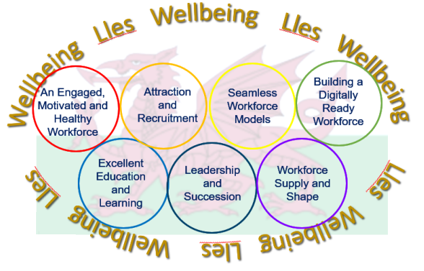

Slide 4
Regional Workforce Board

Slide 5
Workstreams
Leadership
Data & Intelligence
Education & Development
Retention and Recruitment

Slide 6

Leadership Workstream

Slide 7

Data & Intelligence Workstream

Slide 8

Education & Development Workstream

Slide 9
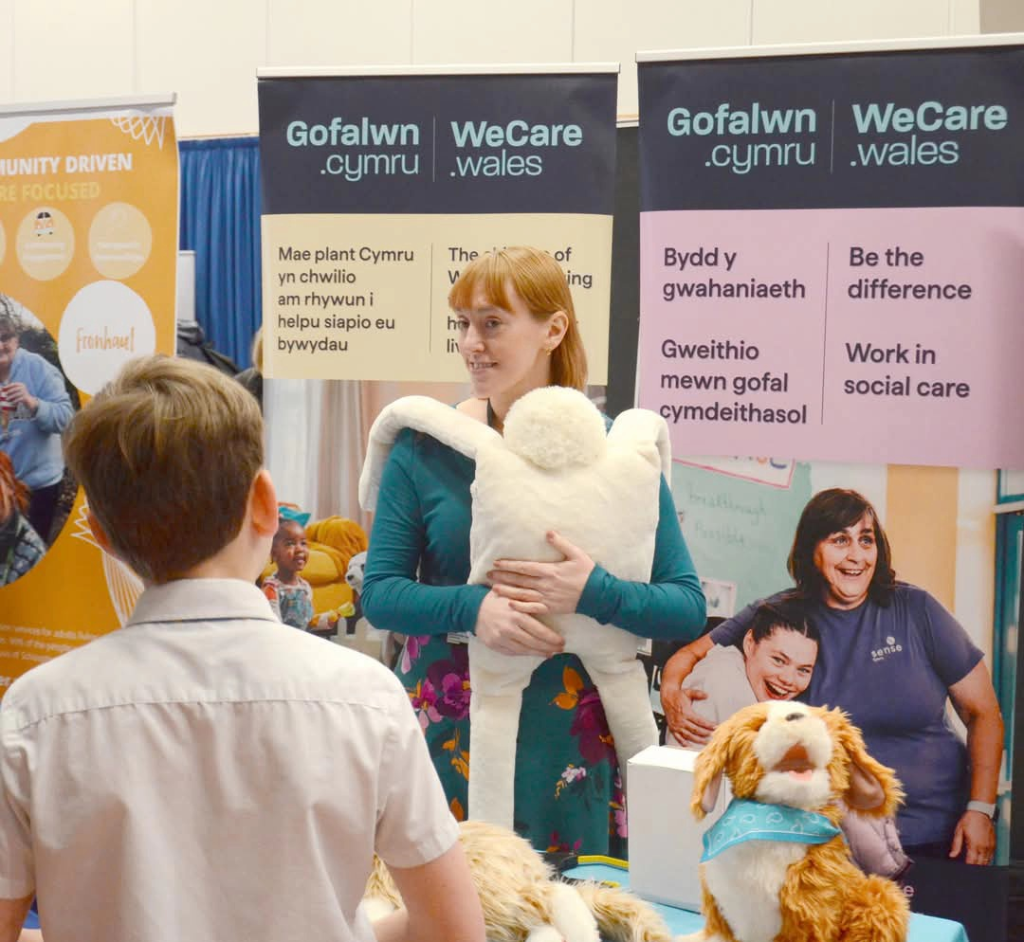
Retention & Recruitment Workstream
Notes:
Workstream set up Oct 2024 – members from all 3 LA’s and Health
To develop a sustainable means of young people being exposed to as many health and social care roles as possible to aid them with their career choices.
To align experiences for students with roles which are difficult to recruit into.
To offer Secondary Schools a health and social care careers pathway programme from year 7 to year 12. From experiencing careers through VR, to work site visits, to work placements to employment.

Slide 10

Do you have any ideas on how we can expose children to roles in Health & Social Care to help them make informed career choices?

Slide 11

Group Discussion / Feedback

Slide 12

Let's take a deep dive

Slide 13
Our Workforce now/ future
Aging population and
low birth rates
Need to attract young people into the workforce
30% of the workforce will be GenZ within 10 years
There is a growing aging population with care and support needs. Predictions suggest that in Wales1 in 4 will be aged over 65 by 2050 (Senedd Research 2021), and needs are becoming more complex (Sion and Trickey, 2020).
Between Jan – March 2020 and Nov 2020 to Jan 2021, employment numbers had decreased by the largest amount for 18–24-year-olds. A decrease of 250,000 in total employed. (Powell et al. 2022).
6.4% of 16–18year-olds were classified as (NEET) in 2021(UK Government, 2022).
Future projections estimate high demand for staff: it is estimated that at least 20,000 additional social care employees will be required by 2030 (Social Care Wales, 2023).
The social care workforce must expand or look for alternatives in the coming years to keep pace with increasing demand.

Slide 14
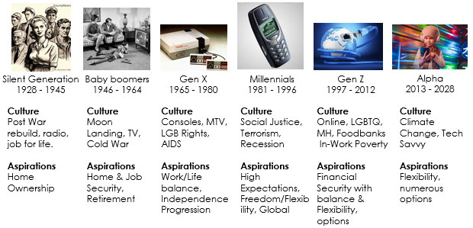
Generations

Slide 15

Did you know Careers Wales no longer offer Work Based Placements for all children across Wales!

Slide 16

Work Based Placements
Currently Welsh Government only fund work placements for children who are likely to become NEET in schools who have the highest population of free school meals allocated.
Therefore, the tailored work-based Programme can only be accessed by children in receipt of free school meals.
Some schools do continue to offer a work placement opportunity, but they manage it all themselves.

Slide 17

Importance of
Work Based Placements
Future Workforce - Key in attracting the new and future workforce
Learning - Is vital and extremely valuable (Skill building)
Equity - Opportunities should be made accessible to all students
Benefits - Meaningful experiences that are mutually beneficial to both the individual and the employer
No standardised model – Create a pathway
Virtual - ‘Immersive’ work experience resources

Slide 18
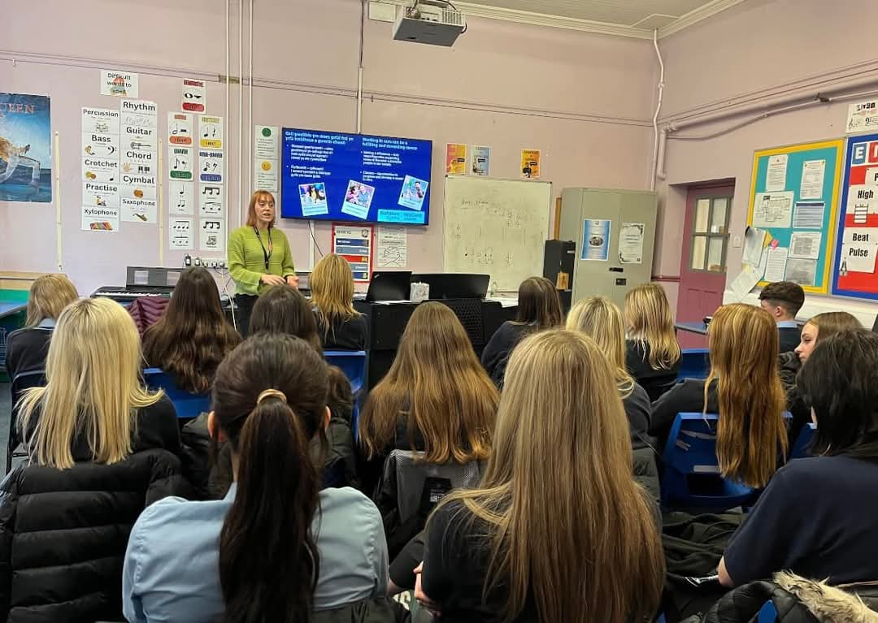
Outcomes
To support young people earlier from year 7 (prior to choosing their GCSE options).
To create a pathway of opportunities for each year group. Developing our work with employers, to offer such opportunities.
To bring greater connectively between young people and employers, giving students an insight into the world of world and care careers whilst developing some of the skills needed.

Slide 19

Outcomes (continued)
To promote a variety of opportunities from apprenticeships, further learning and showcase some of our harder to recruit roles.
To create virtual reality (VR) resources to inspire young people to pursue a carer in care. Previously students have been expected to be physically present in the workplace to gain experience, however technology advances now enable this to be more accessible than before.

Slide 20
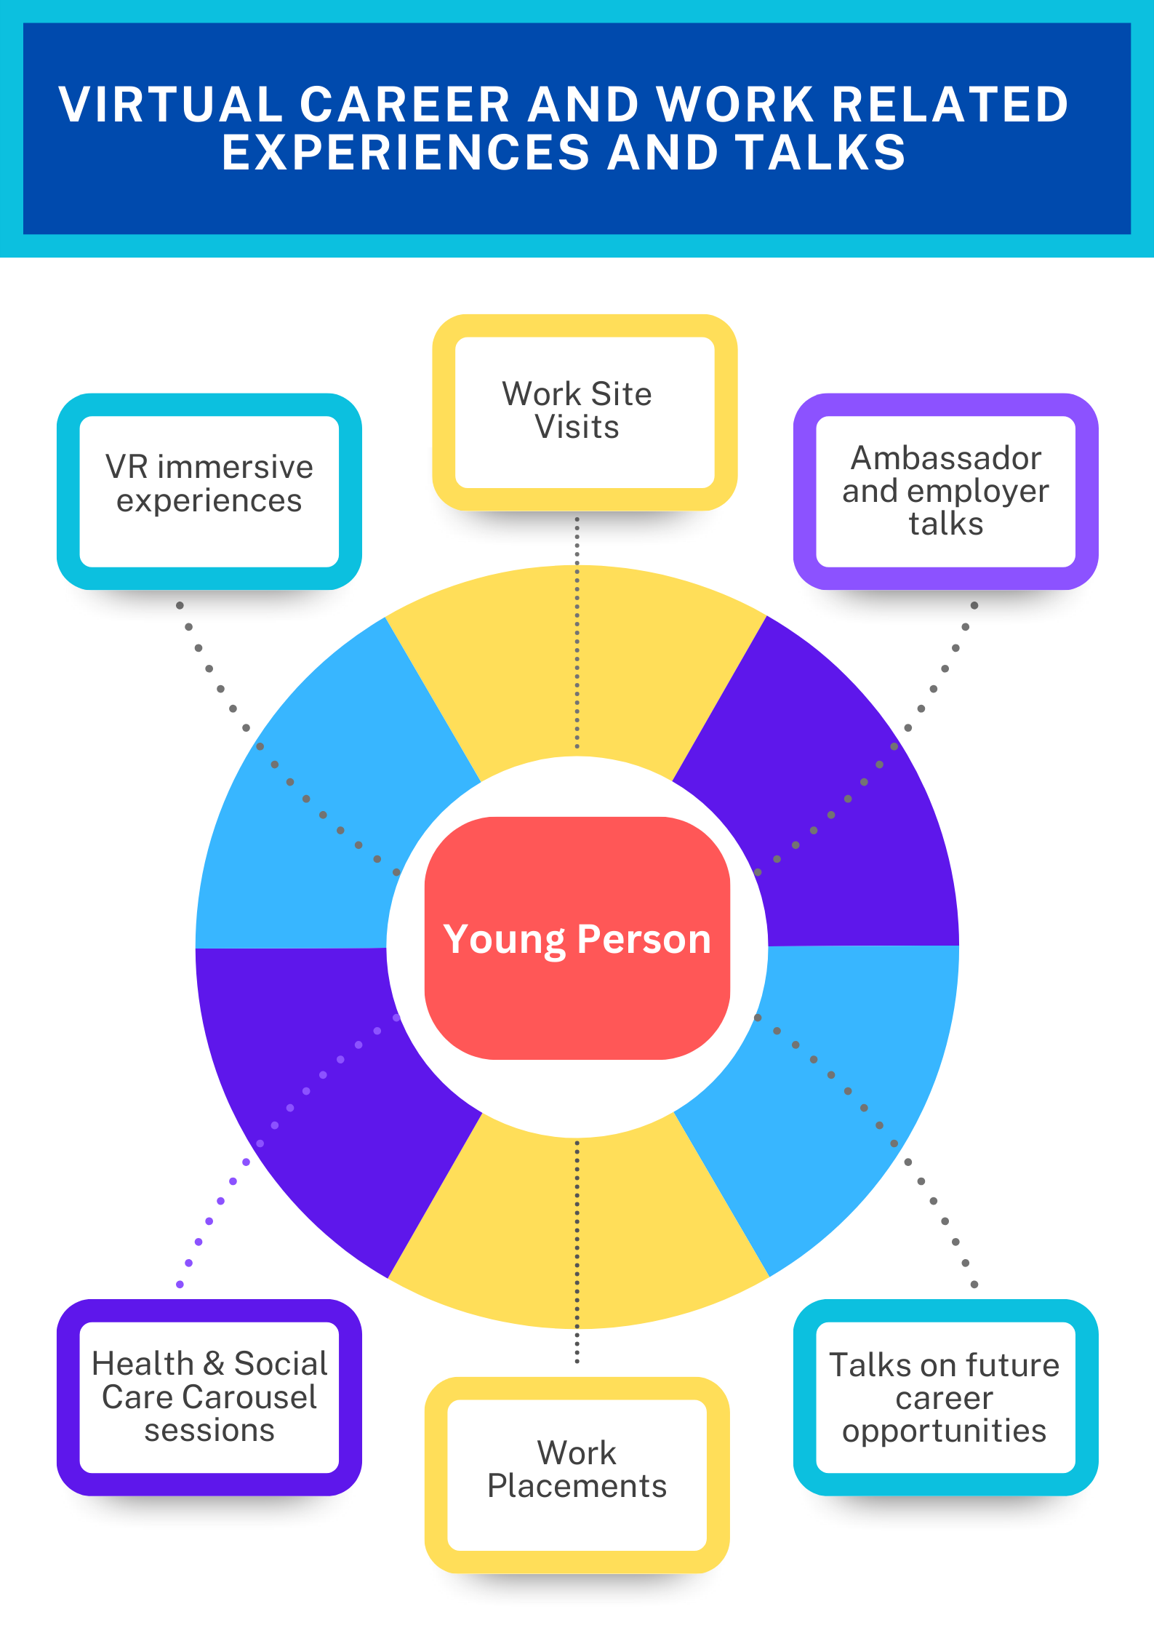
Ambition
School Offer

Slide 21

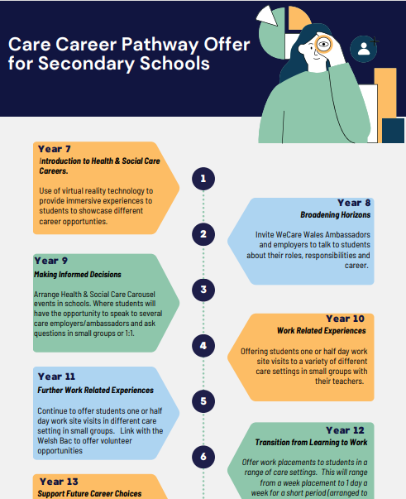
Ambition
Work-based Placement
Pathway

Slide 22
The journey has begun….
Research into the possibility of developing VR and AR content and immersive technologies to take to secondary schools in west Wales for year 7 students has already begun.
The team have met with a few VR content creators to test and discuss development of VR material in depth. Funding will be commissioned once a pilot has been agreed by the Recruitment and Retention group and Regional Workforce Board.
The R & R group have approved job roles to be covered e.g. residential childcare, residential carer, home carer, Physios and reablement.

Slide 23

How can your Organisation/Team
support the region’s ambition for future workforce planning?

Slide 24
Group Discussion / Feedback

Slide 25


Thank you for Listening!
Any Questions?

Slide 26
