Slide 1





6 Goals UEC Programme
Hospital
@
Home
What does
Hospital @ Home
for West Wales look like?

Slide 2
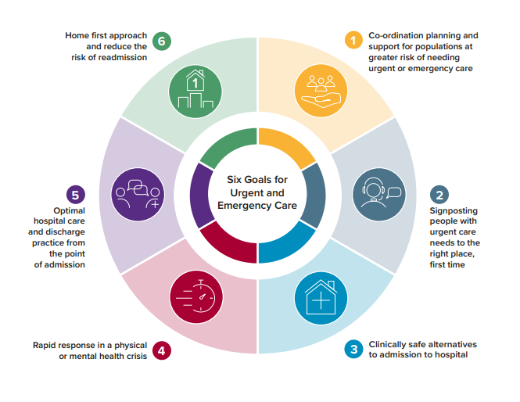
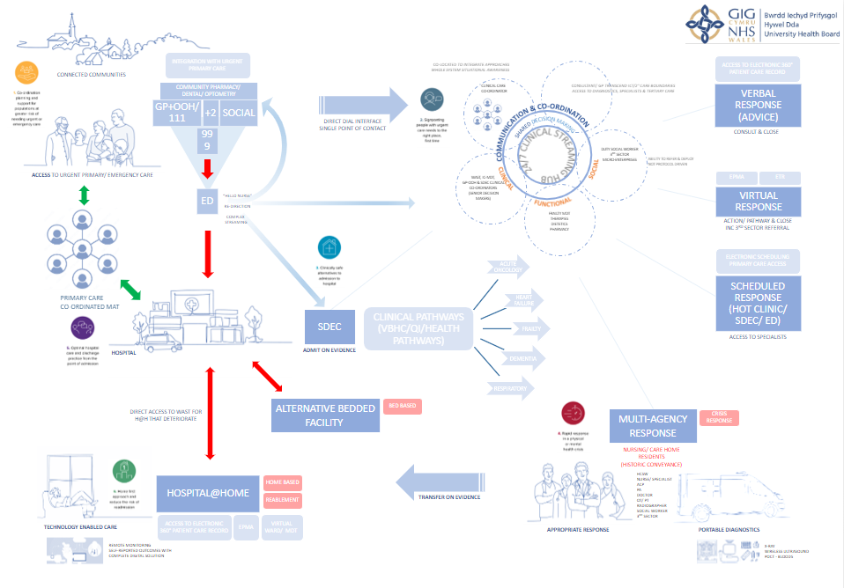
Hospital @ Home
Strategic Context

Slide 3
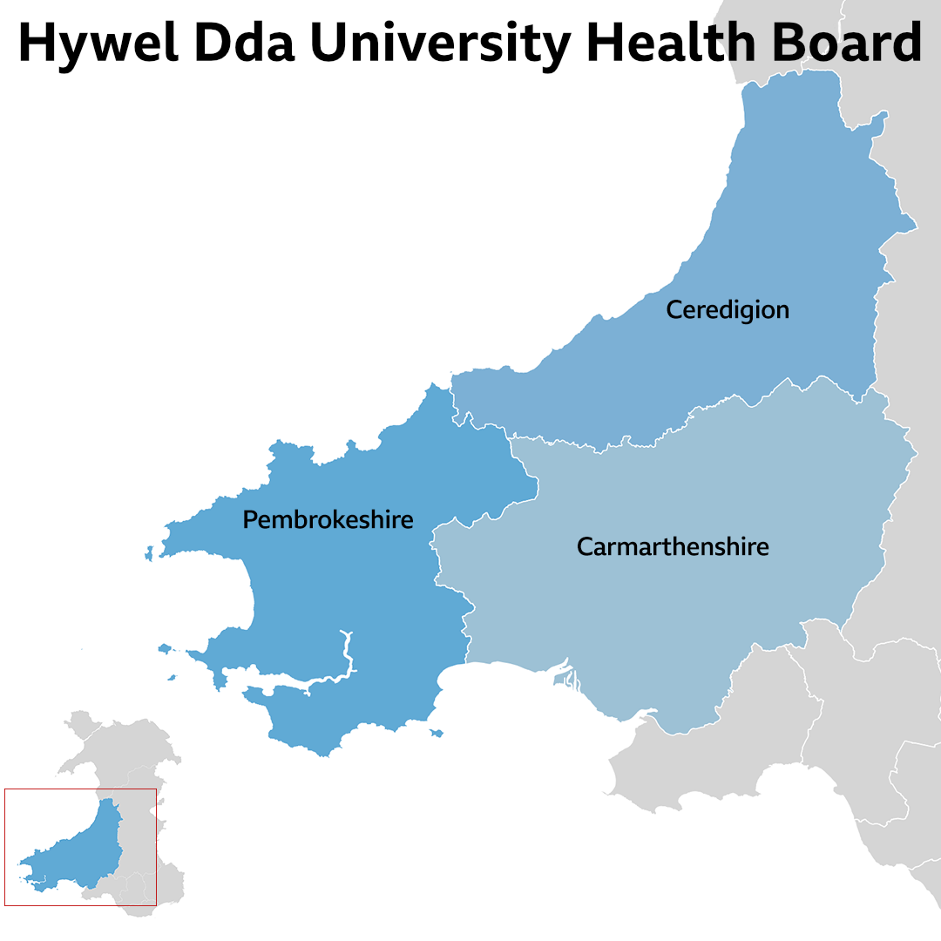

Hospital @ Home
Strategic Context
Integrated Urgent Care
Community based services
Primary care and community services
Community rehab
Enhanced community care
Hospital
Living well in connected communities
Maintaining health and wellbeing with primary care and community support
Support or equipment to remain well at home
Fast acting short-term support to enable individuals to stay well at home or get back home quickly
Specialist acute care and treatment to get individuals well
Inpatient specialist support and management (secondary/ tertiary level)
Notes:
H@H has been in existence in a number of countries across the world for 25 years.
More person-centred
Avoids risk of HCAI and institutionalization, unnecessary loss of independence and function, increased dependence leading to care at home or long-term care services, reduces disruption to a person's informal or formal support arrangements
Severity of the condition managed differentiates H@H from other community service provision
H@H must interface with existing service in a manner that is sensitive to the local context
Already a rang of well-developed services in the community providing support with the intention of preventing admission and facilitating early supported discharge. Many of multi professional and provide targeted and time-limited support.

Slide 4
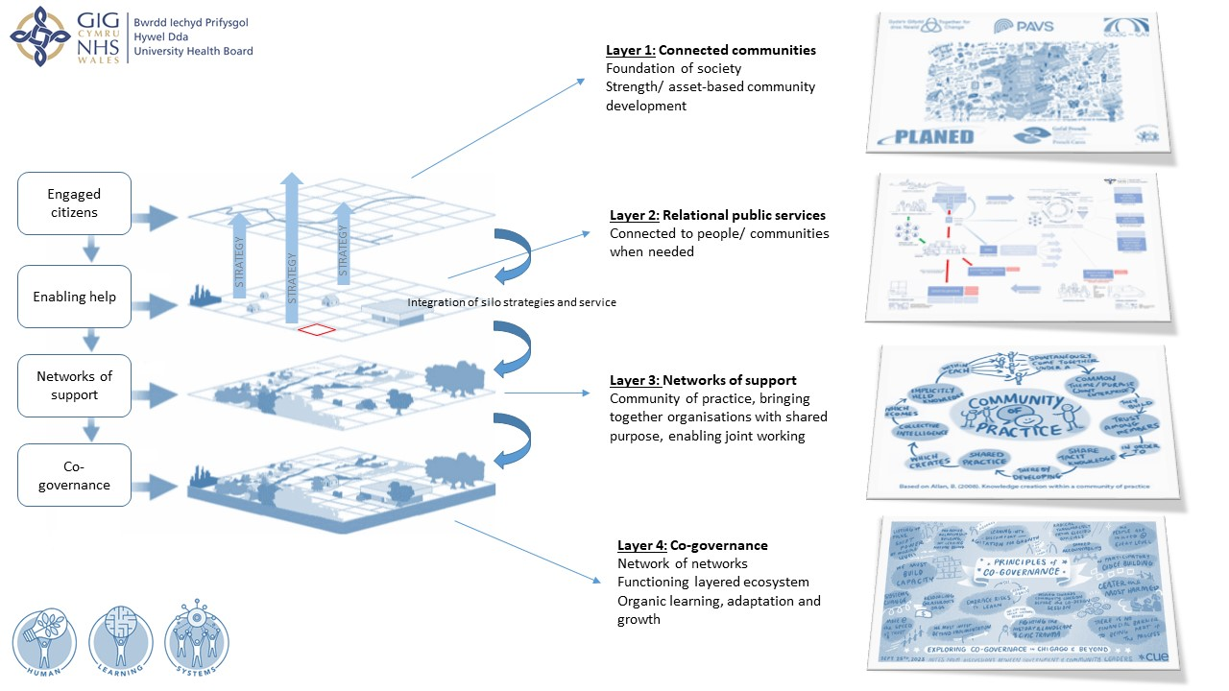
Hospital @ Home
Strategic Context
Notes:
H@H has been in existence in a number of countries across the world for 25 years.
More person-centred
Avoids risk of HCAI and institutionalization, unnecessary loss of independence and function, increased dependence leading to care at home or long-term care services, reduces disruption to a person's informal or formal support arrangements
Severity of the condition managed differentiates H@H from other community service provision
H@H must interface with existing service in a manner that is sensitive to the local context
Already a rang of well-developed services in the community providing support with the intention of preventing admission and facilitating early supported discharge. Many of multi professional and provide targeted and time-limited support.

Slide 5
Hospital @ Home
Hywel Dda Proposed Definition
A service that provides acute, hospital-level care by healthcare professionals in a place of residence for a condition that would otherwise require acute hospital inpatient care.

Slide 6


Hospital @ Home
Key Features Discussion
Hospital @ Home covers short, time-limited acute episodes of care and supports access to specialist acute care.
Hospital @ Home patients are treated as though they are admitted to hospital but are managed within their normal place of residence
Hospital @ Home supports acute and complex conditions in addition to established enhanced community care.
Hospital @ Home may be digitally supported through remote monitoring.
It provides hospital-level interventions (such as access to intravenous fluids, therapy and oxygen)
It has defined inclusion and exclusion criteria, with defined target population
It requires integrated working between acute and community with specialist leadership and clear lines of clinical responsibility.
Hospital @ Home is senior clinically led with medical oversight
Hospital @ Home requires daily input from a multidisciplinary team and sometimes multiple visits and provision of 24-hour cover with the ability to respond to urgent visits

Slide 7
Hospital @ Home is not:
Enhanced primary care programmes (e.g., GP extensivist roles or Virtual Wards)
There are many excellent examples of enhanced primary care provision and Hospital at Home should be complementary to these.
Chronic disease management
Hospital at home is about acute illness management and whilst it may manage acute exacerbations of chronic disease, as with hospital care the responsibility and expertise for ongoing chronic disease management remains with the primary care team and outpatient specialist care.
Intermediate care
It is an acute model for an acute medical condition potentially alongside rehabilitation needs but it is not designed for the management of medically stable patients.
Day Care
Hospital at home is not designed for the management of stable ambulant patients.
Admission prevention
Hospital at home is not intended to prevent access to specialist acute care. Admission prevention programmes that focus on chronic disease management and high-risk categories such as frailty are best placed to prevent decline leading to admission.

Slide 8
Hospital @ Home
Person Benefits
  Hospital @ Home would :
  enable a better experience for the person as they would be able to be receive care and treatment within their normal place of residence
  enable person choice as they would have the option to decide if they would prefer to be treated within their normal place of residence or in an inpatient hospital setting
  support the prevention of a person having to be readmitted into / re attending an inpatient hospital setting and support to their family/unpaid carer
  support the person to maintain and regain independence
  allow the person to receive the same level of hospital treatment but within their own place of residence
  reduce the exposure risk to the person of a hospital related complications such as infections and deconditioning.

Slide 9





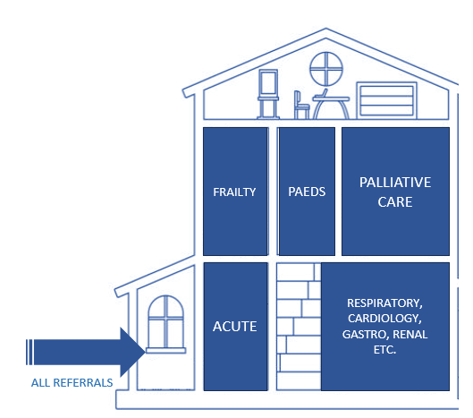
Hospital @ Home
Progress update
POCT / POCT Ultrasound
IV ABX / IV Diuretics
Oxygen
Remote Monitoring
Video conferencing
Patient Referral Process
Patient Admission Episode
H@H will provide the ‘umbrella’ to tie in silo services and teams around the patient and make every contact count
Single point of contact for referrals to H@H admin/ triage team aligned with Clinical Streaming Hubs to co-ordinate and communicate care
Priority areas: Respiratory, Heart Failure, Acute Oncology, Gastro and Palliative Care – Frailty runs throughout
Coordination and communication to enable further integration of teams who work across the system
Porth Cere
Porth Preseli
Eastgate

Slide 10
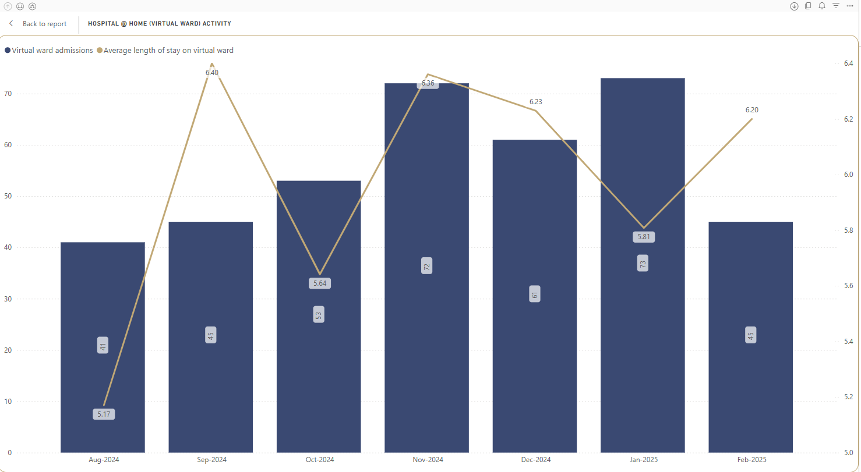
Hospital @ Home - Pembrokeshire

Slide 11
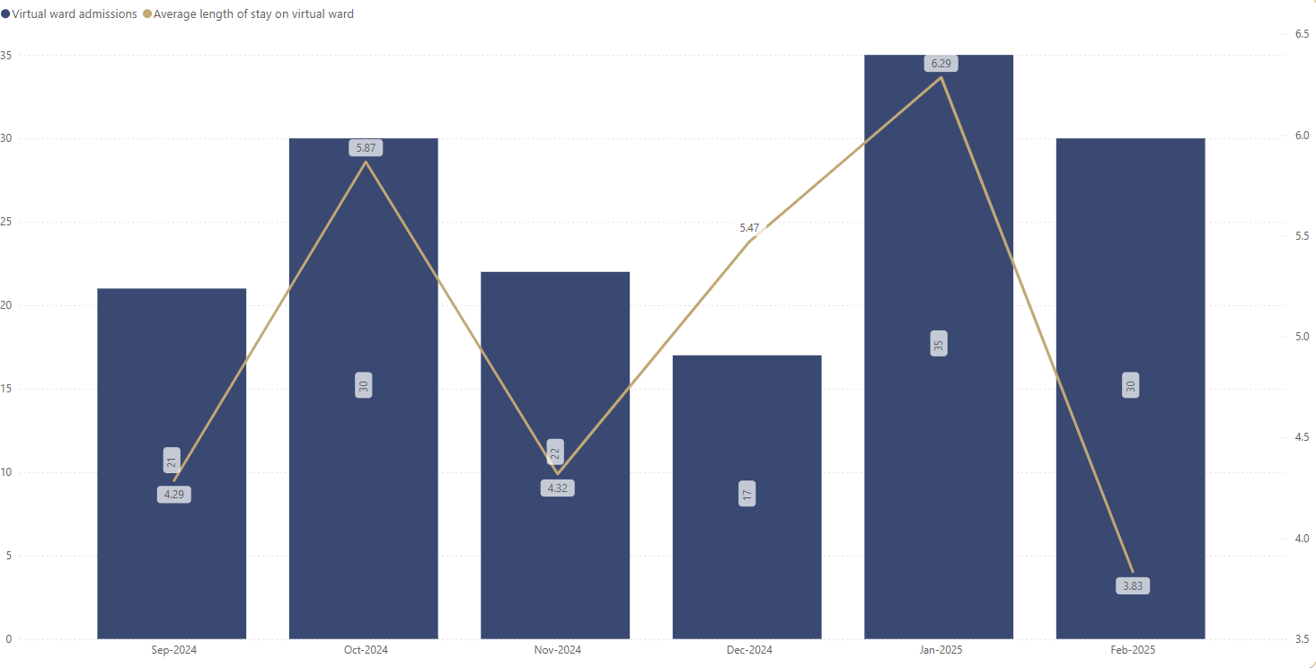
Hospital @ Home - Ceredigion

Slide 12
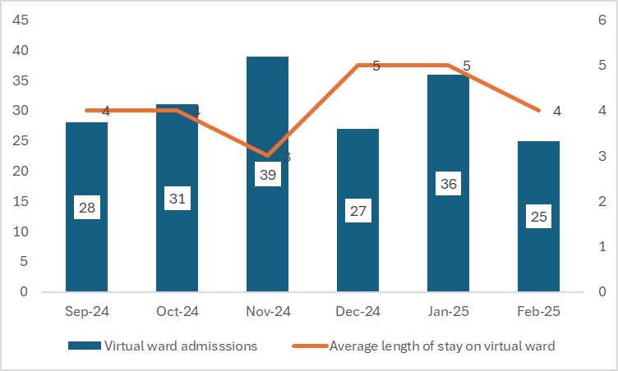
Hospital @ Home - Carmarthenshire

Slide 13





Hospital @ Home
Case Study
Mrs D
85 years old, lives alone
Called 999 due to shortness of breath
Daughter lives in Cardiff
Medical Need: Short of breath, acute exacerbation of heart failure
Social Need: Lives alone, no long-term care, usually independent
Functional Need:
Struggling to mobilise with the paramedic,
Cannot manage personal care due to being medically unwell
Paramedic: Called CSH via Consultant Connect for clinical advice re safe alternatives to hospital as observations stable and patient did not want admission if this could be avoided.
CSH Triage/Response: Intermediate care face to face assessment (‘crisis response’) – OT and ANP joint visit
Management Plan:
Medical Need: Increase oral diuretics to offload fluid, medically supervised by ICMDT GP
Step-up to future model for Hospital @ Home:
Patient does not respond to oral medication, visited by clinician who uses POCT to exclude infection and other causes of her symptoms including POCUS to identify worsening fluid build-up on the lungs.
Patient expresses desire to be looked after at home.
Decision to start home oxygen acutely and IV diuretics so patient admitted to H@H virtual ward with remote monitoring of observations using TEC to ensure wrap around care.
Patient discussed in virtual MDT to gain expert input with management.
Social Need:
Home based intermediate care to call 3 times a day to support through her acute exacerbation.
Delta wellbeing to install a lifeline and Delta Connect for future ‘crisis’ so she can access support quickly
Functional Need:
Commode x2, Zimmer frame

Slide 14
Hospital @ Home
Facilitator Session
Thank you
Any Questions?

Slide 15
Hospital @ Home
Facilitator Session
Hospital @ Home Rank Priority
How should we not implement Hopsital@Home?
What have we not thought about in order to develop the West Wales Hospital @ Home model?

