Slide 1


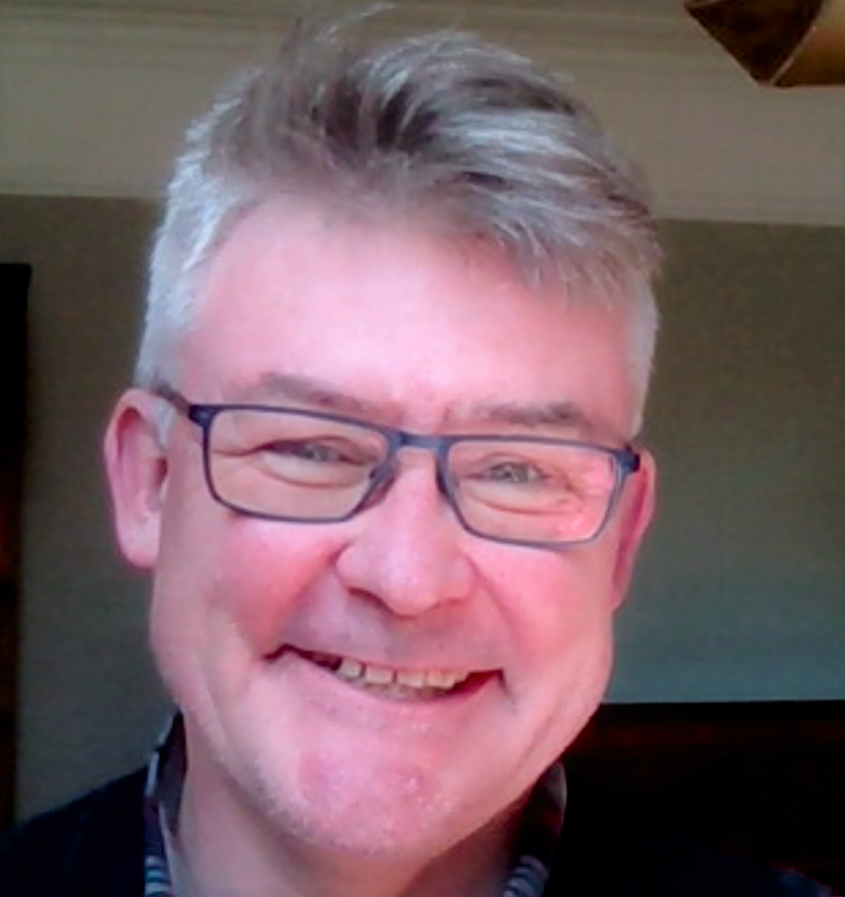
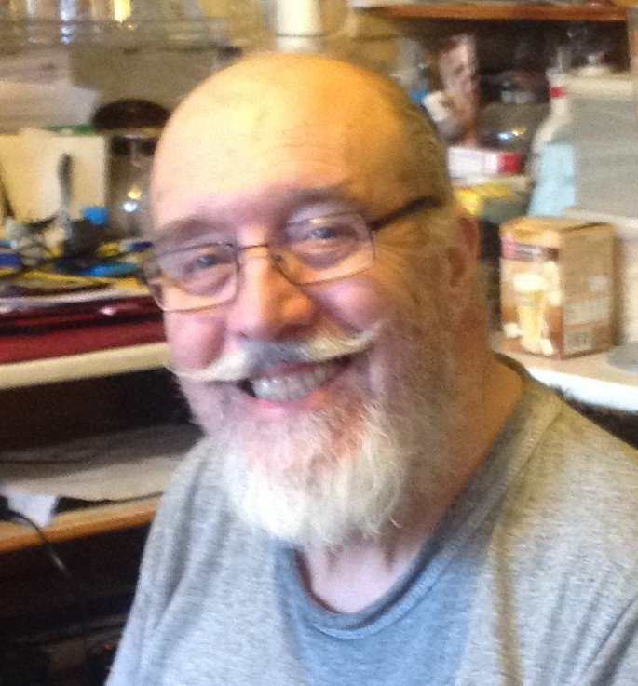
Hello, we are….
Damian Murphy Peter Clark
This Photo by Unknown Author is licensed under CC BY

Slide 2
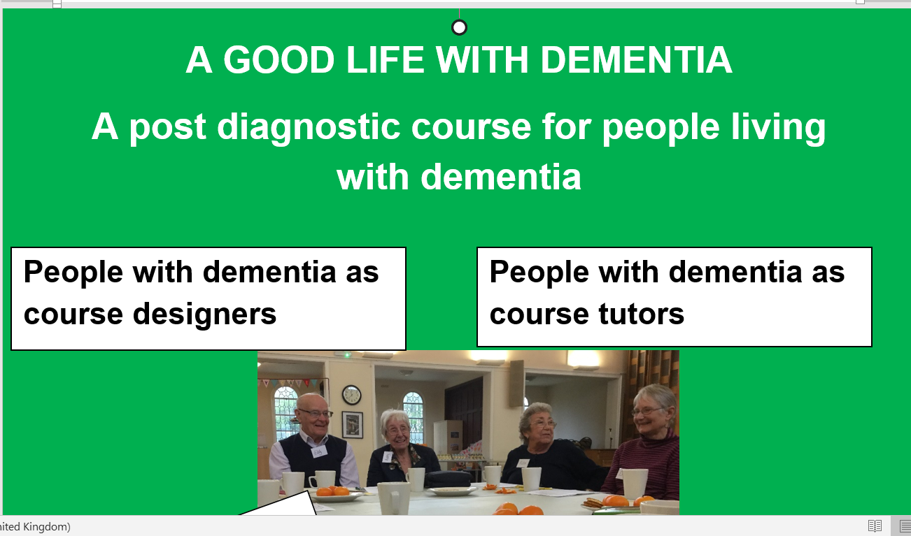
‘It’s nearly as good as toast’

Slide 3
Introducing A Good Life With Dementia
https://www.youtube.com/watch?v=XRS4Aha068Y

Slide 4
We have co-produced!
And…

Slide 5
…It’s Coming to Carmarthenshire
(Ammanford)

Slide 6

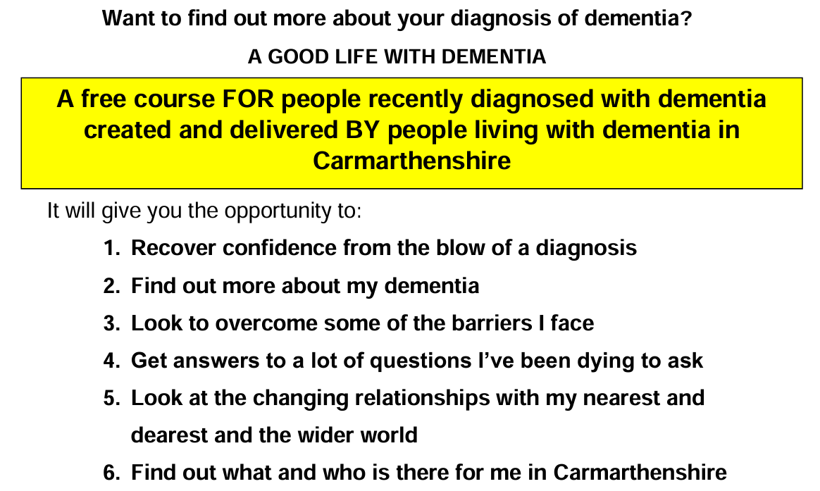

Slide 7
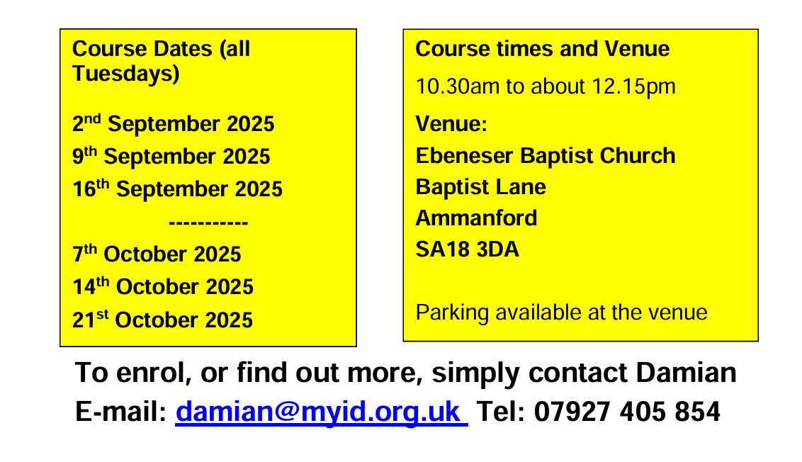

Slide 8
We want people to refer NOW
Don’t be a gatekeeper

Slide 9
Give me a call tonight!
I’m happy to visit folk this afternoon
and tomorrow too!
07927 405 854

Slide 10
Hywel Dda staff will be shadowing the whole process so they can help facilitate further Good life Programmes across the region

Slide 11
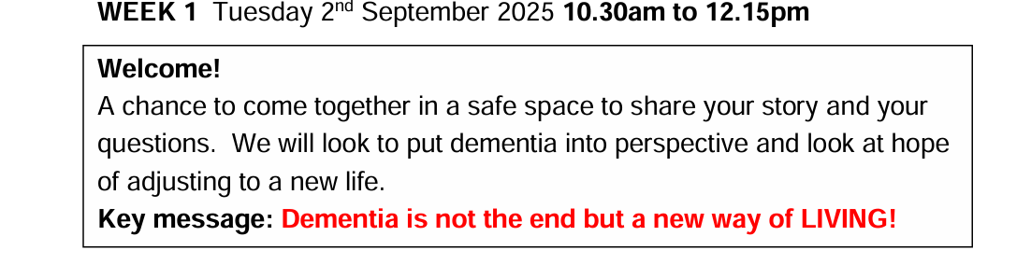

Slide 12
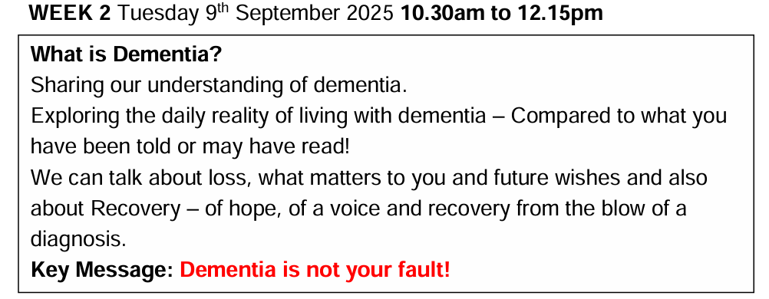

Slide 13
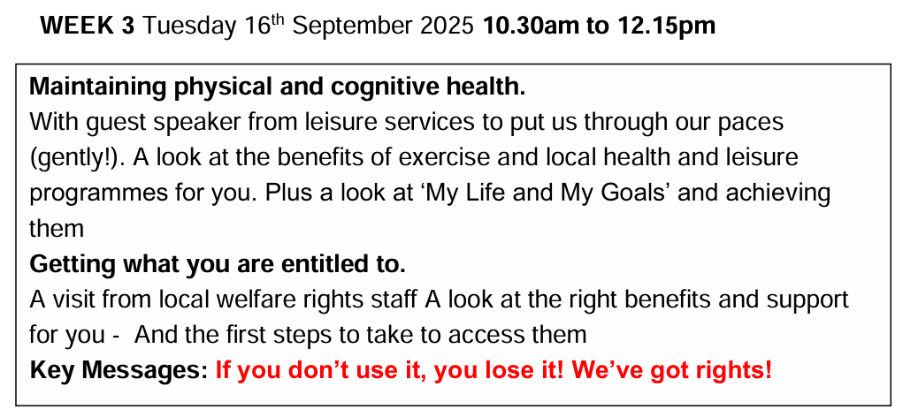

Slide 14
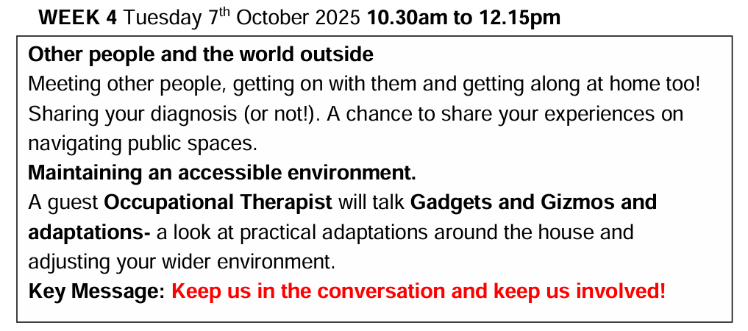

Slide 15
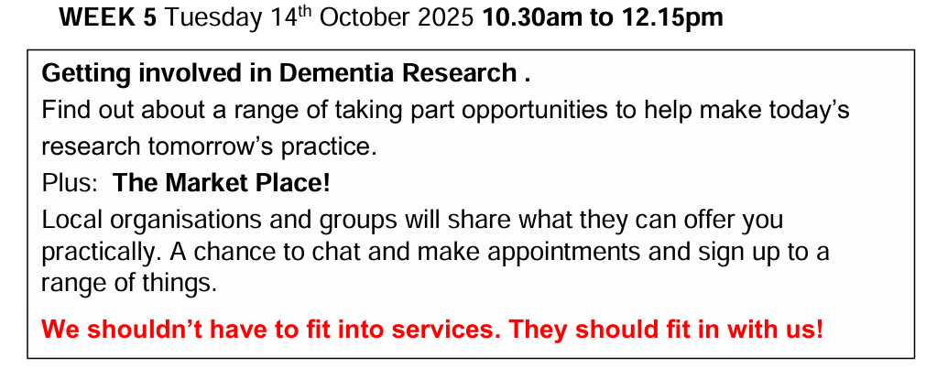

Slide 16
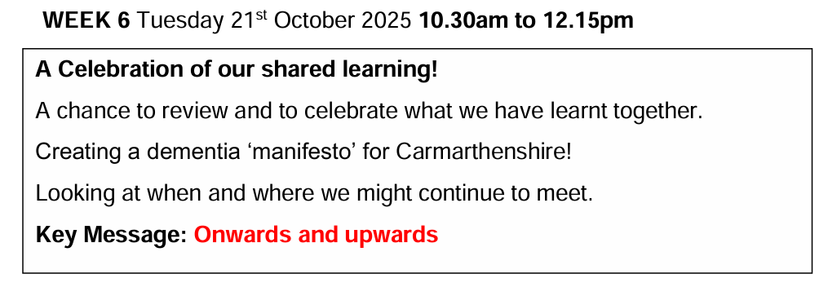

Slide 17
A G L W D does not stand alone
It WILL create
A new resource for you all at your finger tips.
A dialogue – we now need to keep the conversation going
A new active engaged interested groups of peers.
A virtuous cycle of learners becoming tutors.
Elements of a whole new culture of learning and development led by people with dementia
Perhaps a GLWD can be the glue that holds all this together?

Slide 18
A call to action
Take the lead from people with dementia
Properly tap into the hitherto untapped resource of people with dementia and their supporters
Involve people with dementia in the design and delivery of all dementia learning in your area
Don’t add this to your workload – revisit how you operate to enhance the contact you already have with people with dementia in your area.

Slide 19
Hearing Voices – a blog http://www.innovationsindementia.org.uk/2020/01/hearing-voices/
The dementia voices are out there, all the time, in the most eloquent and in the most impaired.
We must continue to listen and get comfortable with that discomfort!

Slide 20
And finally….
Send people to us to participate in the first Wales Good Life With Dementia programme.
Thank you

Slide 21
Thank you.
Any Questions?
Damian@myid.org.uk new-beginnings@peter-clark.com
This Photo by Unknown Author is licensed under CC BY

