Slide 1




Bwrdd Partneriath Rhanbarthol Gorllwein Cymru Cynhadledd Dementia
2025
West Wales Regional Partnership Board
Dementia Conference
2025

Slide 2
Overview of the day
Naomi McDonagh
Rheolwr Rhaglen a Newid
Bwrdd Partneriaeth Rhanbarthol Gorllewin Cymru
Programme and Change Manager
West Wales Regional Partnership Board.

Slide 3
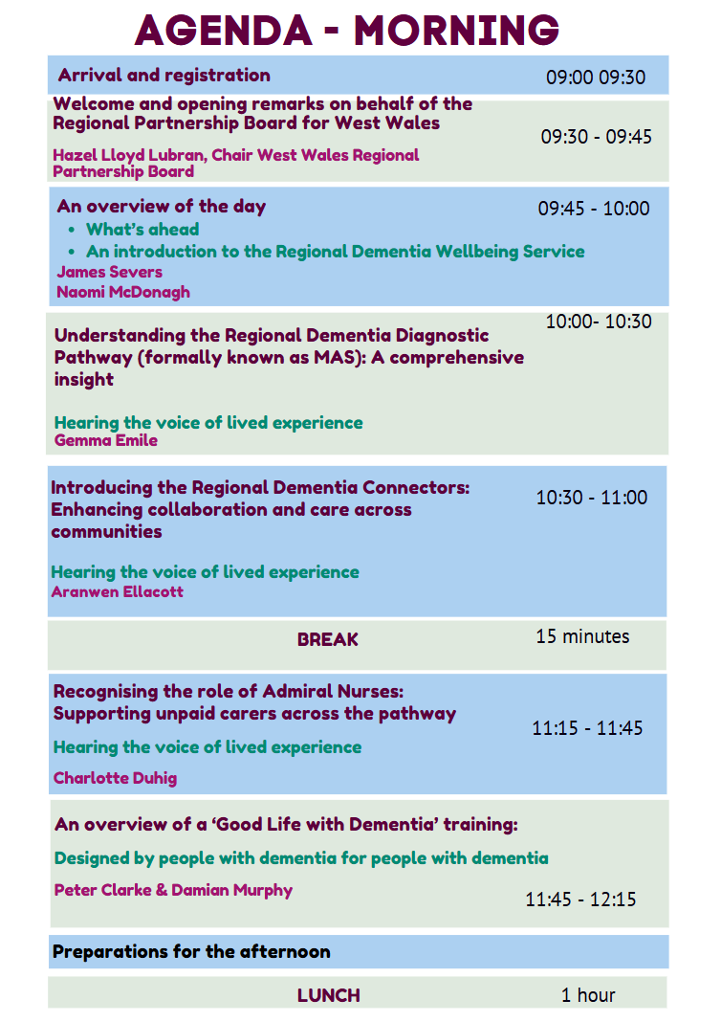

Slide 4
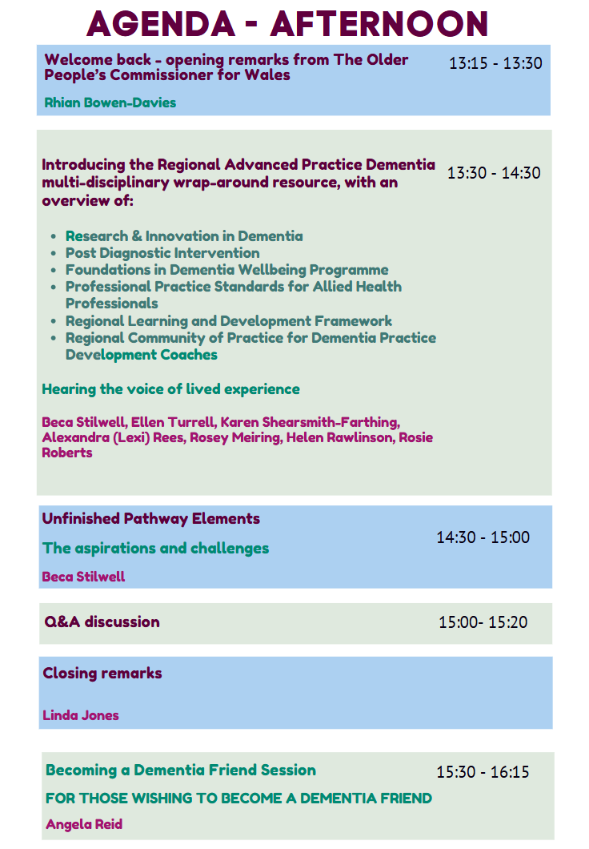

Slide 5
An introduction to the Regional Dementia Wellbeing Service
James Severs
Cyfarwyddwr Gweithredol Proffesiynau Perthynol i lechyd a Gwyddor Iechyd
Executive Director of Allied Health Professions and Health Science

Slide 6

Realising Dementia as everyone’s business
Secondary Care
Primary Care & public health
Hospitals – acute & community
Public and community
Voluntary sector
Notes:
Our vision for West Wales is to support each person living with dementia to live well and independently for as long as possible.
Today we want to:
Celebrate and take stock where we’ve got to as a region so far
Take a look at where next, how to spread & scale what works and what else
In reference to the slide:
I just want to give a few examples as to what we’re covering today. For example:
One initiative that will connect all these service areas is the community of best practice network which will be mentioned later, along with:
Primary Care and public and community example: Beca will be presenting later on the innovative work being undertaken by AHPs, as well as the support being offered by Helen to care homes
Voluntary sector: Aranwen from Age Cymru Dyfed talking about the Dementia Wellbeing Connectors
Unpaid carers: public and community
What we are reaching for is the delivery an holistic dementia wellbeing pathway needs all services to work together which places people living with dementia and their carers at its heart, providing support from diagnosis through to end of life.

Slide 7
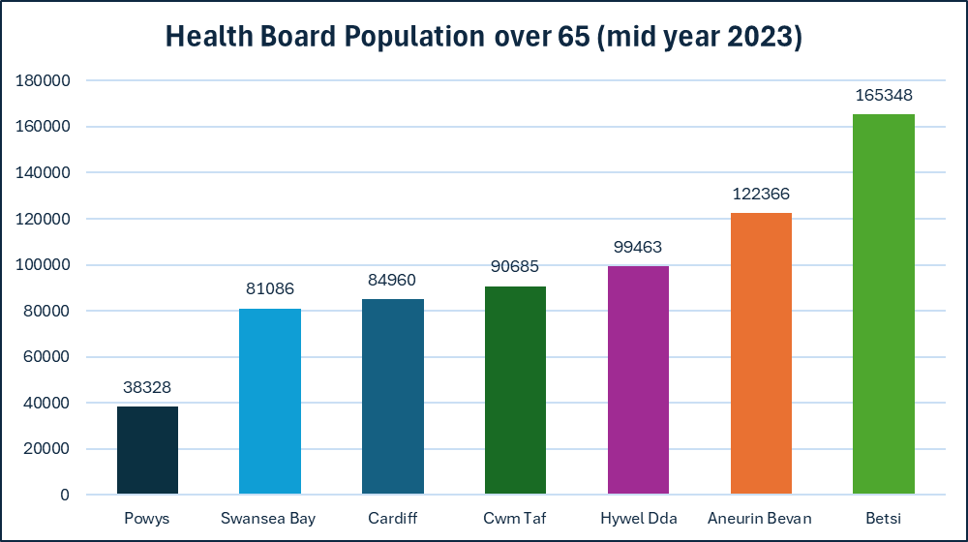
Key data points
Source: Stats Wales 2023
Notes:
Hazel referenced earlier about an ageing population but let’s look into that in a little more detail.
The graph on the left demonstrates the population profile for over 65s in Wales for each Health Board area
West Wales ranks among the highest in Wales with regards to an over 65 population, with just under 100,000 older adults.
But it’s important to note that in fact, Wales has one of the fastest-aging populations in the UK. By 2030, over 25% of the Welsh population is projected to be over 65 years old.
This demographic shift is already evident in West Wales. In 2023, Hywel Dda had a total population of 388,139—similar to Swansea Bay—but with a higher proportion of older adults (26% over 65, compared to the Welsh average of 22%).
Stats Wales (2023) Population estimates by local health boards and age

Slide 8
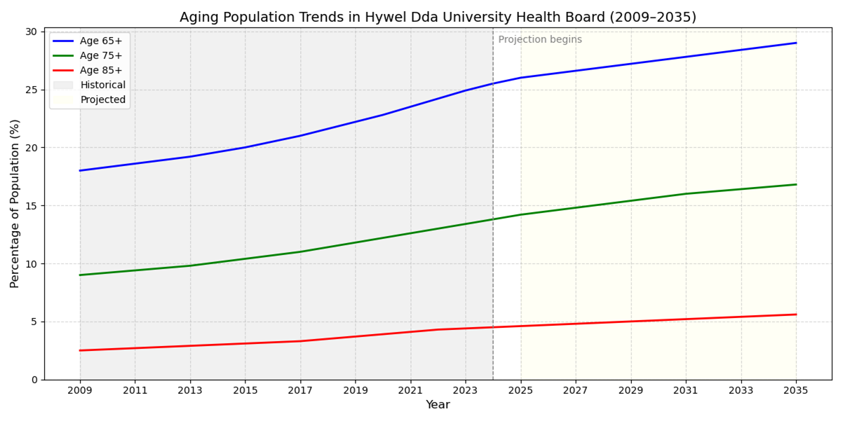
Key data points
Source: Stats Wales 2023
Notes:
Here you can see the aging population trend for West Wales
The blue depicts the growth of over 65s, the green is 75+ and ref 85+ highlights the absolute number of residents aged 85 and over. This is split historically to the left starting in 2009 with the lighter section on the right, depicting the projected increase.
All 3 age groups show steady growth with the 65+ group nearing 30% by 2035.
West Wales has an increasingly aging population, growing faster than the younger generation in the region.
Furthermore, by 2043, the population percentage of people aged 65 and over is expected to rise to 31.5%; projecting an increase in Carmarthenshire by 29.53%, Ceredigion by 32.54%, and Pembrokeshire by 33.4%. Which means people aged 65 and over in West Wales is expected to increase to 124,587 by 2043.
Stats Wales (2023) Population estimates by local health boards and age

Slide 9
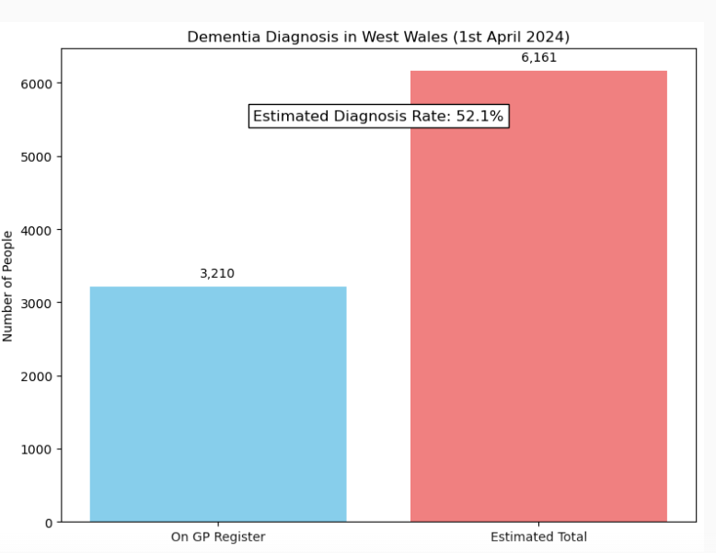
Dementia diagnostic rate April 2024
Notes:
In April 2024, data provided by GPs showed a diagnostic rate in West Wales of 3,210
You’ll note in the graph the estimated diagnosis rate is 52.1% meaning that…..
The total projected number of people with dementia in West Wales is 6,161.
We need to understand this data further……it could well be that the gap is due to
people perhaps waiting to recognise they have dementia (not everyone wants a diagnosis/ready for it and they are managing through their community/support)
GP registration who may not have an allocated the requisite ‘code’ for reporting numbers to Welsh Government
people living in care

Slide 10
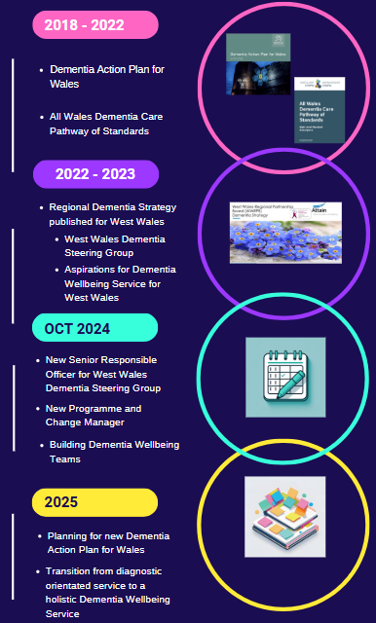
Timeline – where we are at now….
Notes:
*just run through the dates and key headings*
Some point you may wish to focus on:
2025 – with regards to planning for a Dementia Action Plan for Wales – we are pleased to have Joseph Lee, Senior Policy Advisor from WG in the audience – I understand that there is an intention to publish a consultation document for the new DAP towards the end of this calendar year, informed by continued engagement with stakeholders, encouraging people to submit their views to inform this work.
We will make every effort in West Wales to support this process.

Slide 11
2026 onwards - spread and scale…
New Dementia Action Plan for Wales
Review Regional Dementia Strategy
The following presentations will outline significant service developments that have been robustly evaluated and proven to be:
Innovative
Cost-effective
Evidence based best practice
Notes:
Key to all of this is co-production (whether it be the Dementia Action Plan for Wales , the regional strategy or services in West Wales)
What we now need the capacity to spread and scale equitably and consistently across the region

