Slide 1


West Wales
Dementia Wellbeing Service
Dementia Diagnostic Team
West Wales
Dementia Conference 2025

Slide 2

Context
Within West Wales Dementia Services continue to develop and align with the All Wales Dementia Care Pathway of Standards (2021), a Dementia Wellbeing pathway is beginning to strengthen and support the West Wales Regional Dementia Strategy Dementia Action Plan.
The four themes and twenty standards wrapped around the person include: accessible; responsive; journey and partnerships and relationships.

Slide 3
The introduction of the Dementia Connectors (Phase one) to individuals with a diagnosis from the Dementia Diagnostic Team (Memory Assessment Service) following diagnosis along with the Admiral nurses ensures the person living with dementia and unpaid carers are supported and offered individualised care and wellbeing plans.
Due to the numbers and ageing population, it is expected that this provision is only able to reach 20% of the population living with dementia in West Wales and continued investment is required.

Slide 4

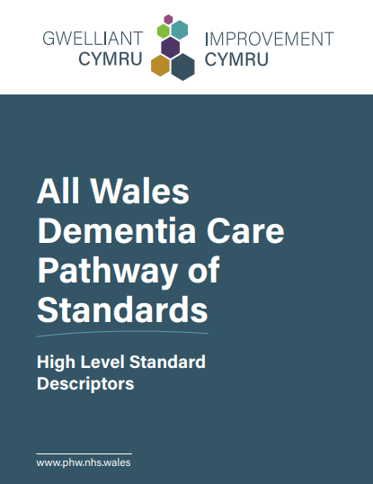


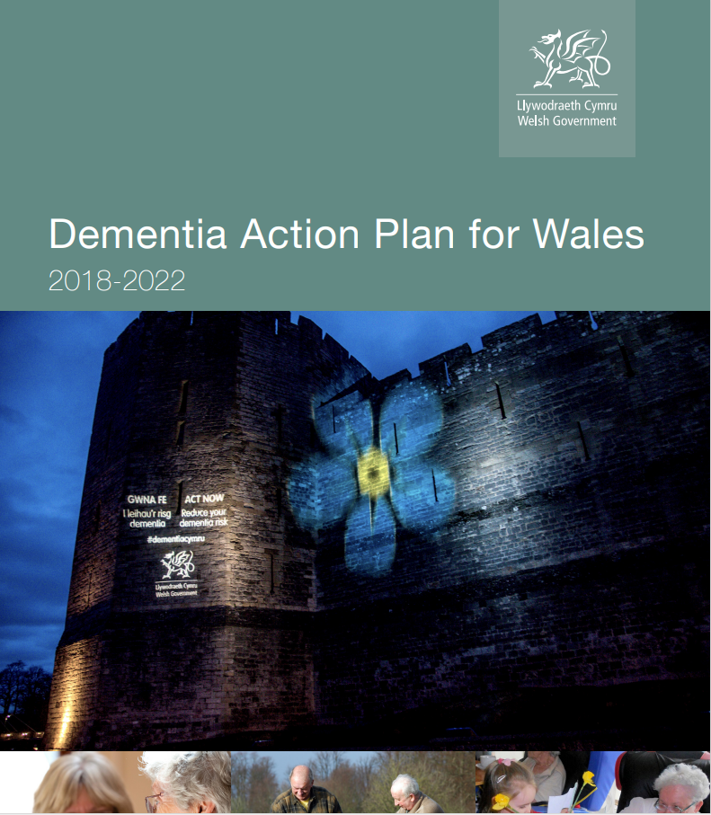

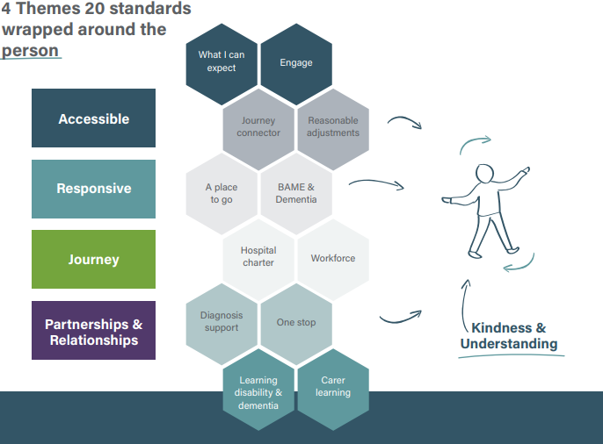

Strategies, Action Plans & Standards

Slide 5
Dementia Diagnostic Team
(Memory Assessment Service)
The Dementia Diagnostic Team is a primary care diagnostic pathway currently hosted by the Older Community Mental Health Team for people of any age with a suspected dementia. Referrals are predominantly from the GP.
The clinical team provides:
timely and sensitive diagnosis for people with dementia
tailored information and education
psychological and medical treatment dependant on need
a plan of care and post diagnostic support before return to the care of a GP
a seamless journey to their Dementia Connector if a dementia diagnosis is given

Slide 6
Diagnostic Teams
1 x Consultant Psychiatrist
1 x Service Lead
2 x Advanced Nurse
Practitioners
1 x Advanced Practitioner
1x Physician Associate
12 WTE Dementia Specialist Nurses (F/P time posts)
Consultant Neuropsychologist
Assistant Psychologist
Occupational Therapist
Administrative staff
Pembrokeshire
Ceredigion
North Carmarthenshire
South Carmarthenshire

Slide 7
Diagnostic Rates
There are 3210 people with a dementia diagnosis in HDUHB and 2951 people undiagnosed based on prevalence rates and general population data.
There are approximately 103,100 people aged over 65 living in West Wales and estimates indicate that 63 in 1000 over 65 live with dementia, equating to approximately 6,495 over 65 living with dementia in West Wales.
It has been estimated that 70% of care home residents have dementia on admission or develop it after admission, but that many do not have or receive a formal diagnosis of dementia (Aldridge et al 2024).

Slide 8
Challenges
Older Average population
GP Register
Expectations of Service
Timely referrals
Data Collection
Culture
Waiting Times
Equitable

Slide 9
Future Focus
Engagement - accessible; responsive; journey and partnerships and relationships
Accessible
Avoidance
Quality Improvement
Audit
Feedback
Care Home
Journey
Partnership
Registered READ Code

Slide 10
Service Feedback
Jan to March 2025
our specialist nurse explained everything in terms that it was easy to understand. She was very sympathetic and kind, and a very good listener!
staff at hospital were excellent
Very helpful
Very professional and caring and helpful staff throughout
I felt happy, relaxed and confident to express my feelings. K was 1st class and very professional. Perfect appointment and outcome, delighted
staff are excellent
was a good experience
A good experience
we had expected a very long delay before our first appointment, but we were seen within a month and that included Christmas. The follow up appointment was very quickly sorted and I found myself very relived that the process moved so quickly.
An excellent assessment
an overall good experience
Very kind, caring and professional lady
No, it was good
Felt very comfortable .
My spouse attended and was able to make useful contributions.
The wait for 1st appointment
Shorter waiting list for the 1st appointment
Professional staff, assessment was very comprehensive. Post assessment feedback was excellent
The lady we saw in Haverfordwest was friendly and put the family at ease straight away. Things were clearly explained and were free to contribute our concerns and worries. We were very impressed how swiftly my husband's health conditions were addressed. Many thanks
never felt we were rushed, always time to ask any questions. An excellent service
No improvements needed
Both assessors for my mum's appointment were kind, friendly and empathetic. Their caring approach made mum feel as comfortable as possible under the circumstances. Reception staff were also very helpful when organising the assessment and follow up appointments.
I took my mum for the assessment with AN, she was very professional and made the process very comfortable and made her feel at ease.
Compared to other departments, responses and attitudes - the MAS have been a completely eye - opening experience of what the NHS can do when it has a mind to.
They were very thorough and explained everything clearly so myself and my mum understood everything
very caring, professional, excellent at explaining everything
Assessor was very patient, explaining everything as she went along to the person being assessed, her spouse and wider family was reassured.
I would like to know whether I have dementia or not
Thank you to I who was king and handled everything professionally and sensitively.
From meeting J, I was made to feel relaxed and involved in the process as was my wife. The process was thorough professional and yet carried out with care in a relaxed manner. We were extremely impressed by the service and the professionalism and equally the follow up phone call from A explaining the conclusions were and what would happen next.
K was always very helpful. We were able to contact him at any time
very clear. Kind and helpful There was no waiting time at all, we were informed within a week which was great.
Ensure that if private scans are arranged as part of the diagnostic process, that they are requested from the GP and form part of the information upon which a diagnosis is made. There seemed to be a breakdown of communication in this respect for mum’s initial assessment end 2023/beginning 2024.
My father was treated with kindness by J. Everything was explained thoroughly and she listened to all our concerns with great empathy and patience. Very good job J!
J was very understanding and very pleasant. Explained everything clearly. She also stayed with my father whilst I went to get the car.
Very caring. Thank you
Gave me confidence to ask questions and always had an answer.
The specialist nurse I saw , D was extremely kind and listened to me. She was sympathetic and explained things clearly.
Find a cure
L was very patient and explained everything clearly to the patient
Talking to J was like talking to an old friend
Such friendly, informative staff. Made a difficult time much better

Slide 11
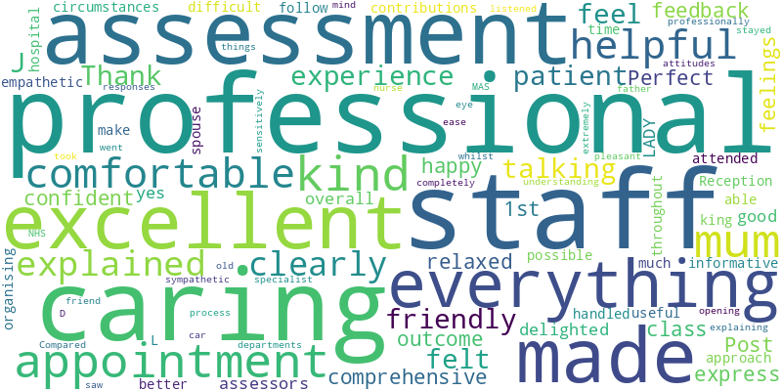
Feedback

Slide 12
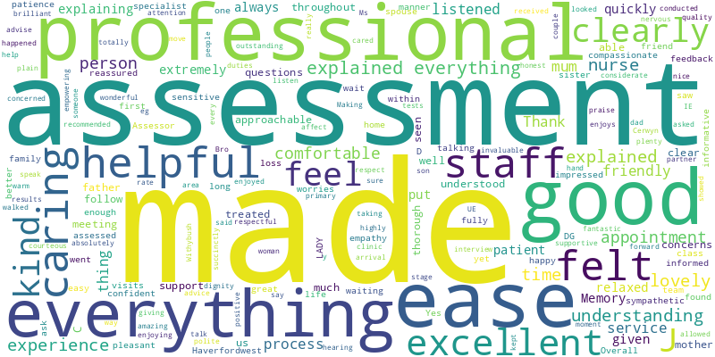

Slide 13
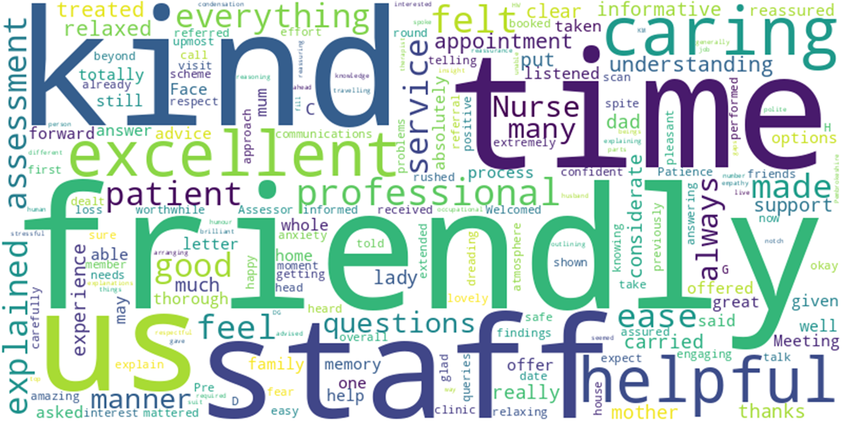
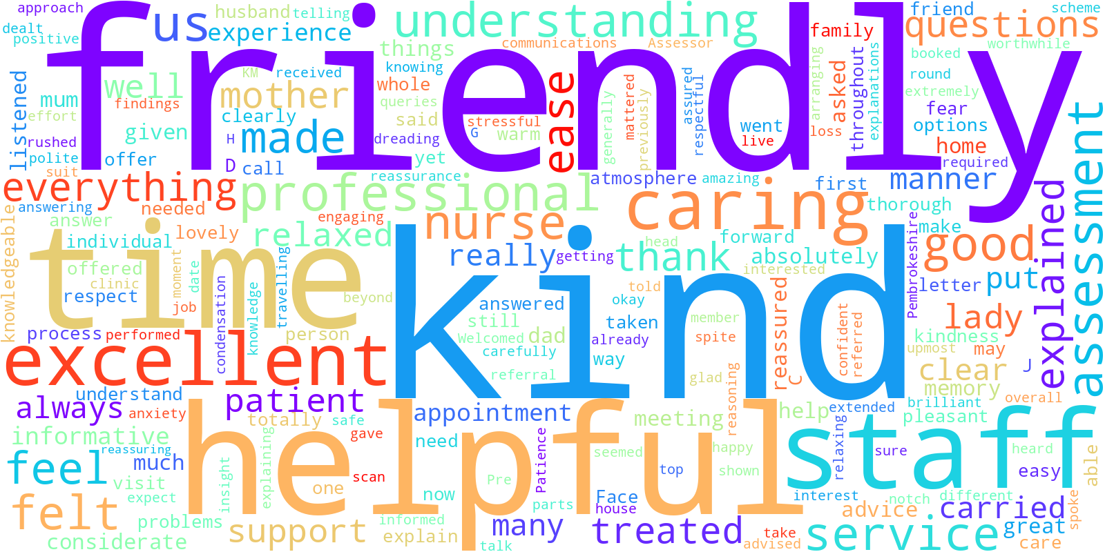

Slide 14
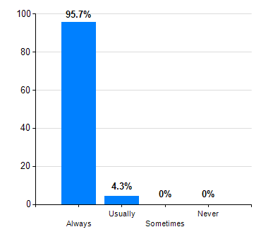
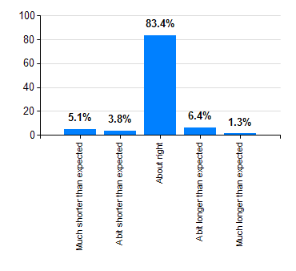
Service Survey analysis
November 2023 to March 2025
Did you feel you were listened to ?
Was the time you waited:

Slide 15
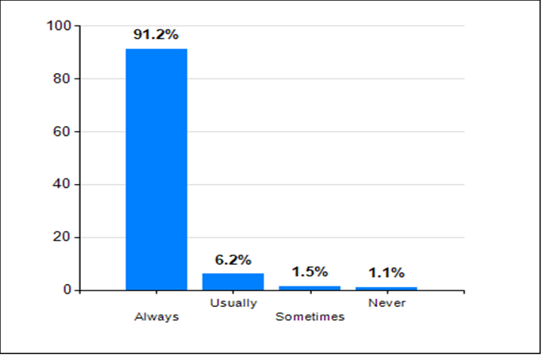
Did you feel safe and well cared for and were staff helpful and professional ?
Did you feel that you were informed of the assessment process?
Available Answers | Responses | Score (%)
Always | 270 | 98.2%
Usually | 5 | 1.8%
Sometimes | 0 | 0.0%
Never | 0 | 0.0%
Total | 275 | 100%

Slide 16


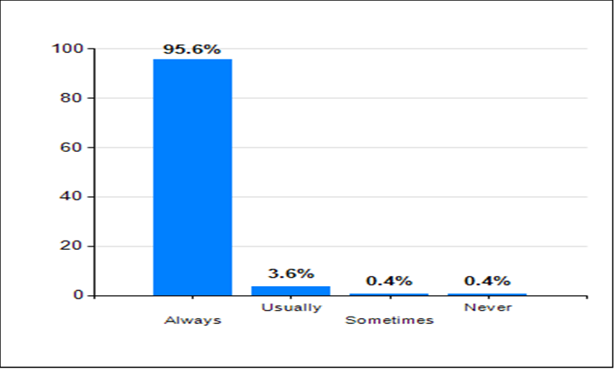
Available Answers | Responses | Score (%)
Always | 168 | 61.1%
Usually | 6 | 2.2%
Sometimes | 1 | 0.4%
Never | 1 | 0.4%
Not applicable | 99 | 36.0%
Total | 275 | 100%

Slide 17

Thank you & Questions
Contact:
Gemma Emile
01437 772844
gemma.emile@wales.nhs.uk

