Slide 1


West Wales Dementia Wellbeing Service –
Admiral Nurse team
Charlie Duhig 2025
Notes:
The Admiral Nurse service partnership with Dementia UK forms a part of the West Wales dementia wellbeing service, serving as a key wrap-around function to preventatively manage complexity and family/carer stress to pre-empt breakdown and crisis.

Slide 2
Background
All Wales Dementia Care Pathway of Standards (2021)
West Wales Regional Dementia Strategy Dementia Action Plan (2018 – 2022)
West Wales Carer Strategy (2020 – 2025)
Robust evaluation framework including outcome measures
Notes:
The service does not work in siloh and the importance of carers is recognised by WAG, the West Wales CP and Hywel Dda University Health Board, and the AN service meets these key strategies and priorities

Slide 3
Why carers?
57%
400,
000
65%
Carers
£8.1b
66%
57%
Notes:
Given the nature of dementia, people living with the condition become increasingly – and at times rapidly –dependent on others to, identify, articulate and have their needs met and can subsequently suffer considerably and often end up in crisis without adequate and timely wrap-around care.
There are approximately 400,000 unpaid carers in Wales
The Carers UK ‘State of Caring’ Survey 2024 (Carers Wales) found that:
57% of carers reported feeling frequently overwhelmed
65% of carers reported this was due to being unable to take a break from their caring role
66% of carers said that they needed more support with their health and wellbeing
57% of carers are experiencing long wait times for support
In Wales alone Carers save the economy £8.1 billion per year and without them Health & Social Care would collapse under the level of demand. The extent of carers support and the burden falling on them is probably greater for this client cohort than any others.

Slide 4
Reality of being a carer
Anticipatory grief
Feelings of guilt
Feeling lonely / isolated
Changing roles in relationships
Loss of self-identity
Juggling different roles
Notes:
Anticipatory grief – a sense of loss whilst the person is still living
Feelings of guilt – feeling guilty taking time for self, not wanting to be a carer
Feeling lonely / isolated –
Changing roles in relationships
Loss of self-identity -
Juggling different roles – looking after young families, working, time to self

Slide 5
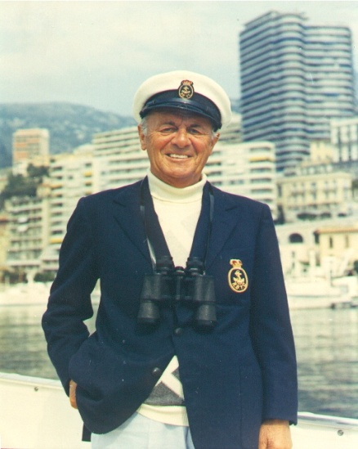
What is an Admiral Nurse?
Notes:
To give you a bit of history about the role - Admiral Nurses are named after a gentleman call Joseph Levy, nick named ‘Admiral Joe’ because of his love of sailing, following a diagnosis of vascular dementia, his family founded the charity Dementia UK after they experienced a lack of support following a diagnosis.
The primary focus of the Admiral Nurse role is to deliver person and, relationship centred carer’s support as well as supporting best practice in dementia care. We work collaboratively across health and social care pathways to provide support, expert guidance and practical solutions to families/carers as well as the person living with dementia.
The Admiral Nurse service partnership with Dementia UK forms a key part of the West Wales dementia wellbeing pathway, serving as a key wrap-around function to preventatively manage complexity and family/carer stress to pre-empt breakdown and crisis.

Slide 6
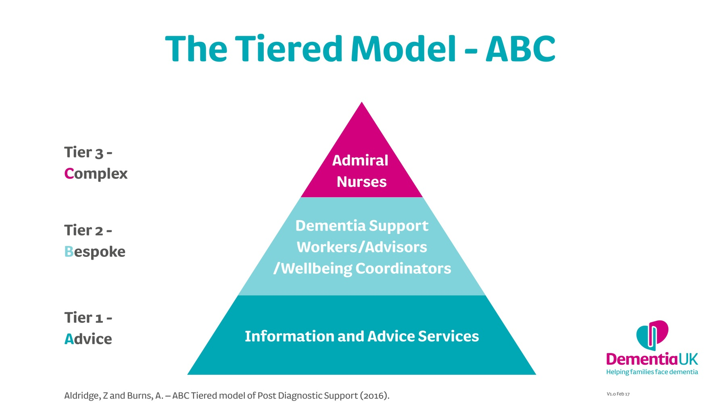
Working with families
Supporting Best Practice
Notes:
This is a tiered model to show how Admiral Nurses will hope to work collaboratively alongside other services.
Tier 1 - Represents services offering general information and advice e.g. Wales Dementia helpline. Carers information and advice services
Tier 2- Services providing more bespoke input/services, e.g. Age Cymru dementia connectors, Carers Outreach Workers, MAS, DUK helpline
Tier 3- Admiral Nurses offer specialist support and knowledge, working with families and carers of people with dementia who have identified needs and a degree of complexity. The Admiral Nurse Service will provide ‘wrap-around’ support for carers/families of people living with dementia to ensure consistency and to preventatively manage family/carer stress and to pre-empt care breakdown and crisis.
This takes us nicely on to our Admiral Nurse referral criteria.

Slide 7
Improve wellbeing and quality of life
Promote best practice
Aims of Admiral Nursing
Enhance ability to adjust and cope
Advice and education
Partnership working
Notes:
Admiral Nursing is about improving well-being and resilience through education, emotional support and specialist interventions to enable carers to feel empowered and informed.
Using a family and relationship centred approach, Admiral Nursing aims to:
Improve family carers wellbeing and quality of life
Enhance family carers adjustment and coping with their caring role
Improve the well-being and quality of life of the person with dementia
Enhance the ability to adjust and cope for the person with dementia
Work in partnership with multidisciplinary teams and third sector organisations
Provide advice and supportive education to colleagues
Promote and implement best practice in dementia care

Slide 8
Interventions provided
Holistic assessment
CBT techniques
DNACPR discussions
Advance and future care planning
Compassion Focused Therapy
‘Getting Along Programme’
Casework management
STrAtegies for RelaTives programme (START)

Slide 9
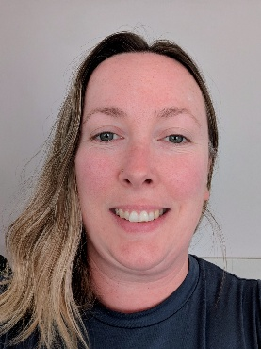
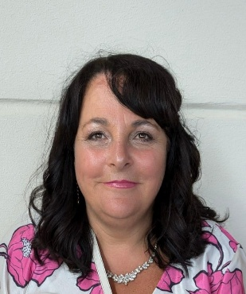
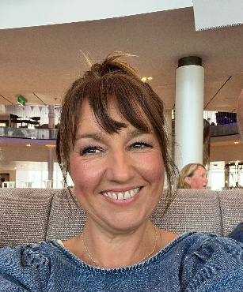
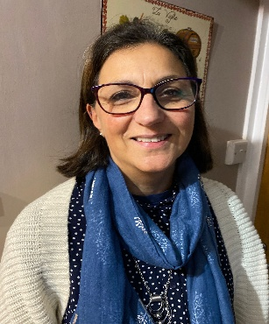
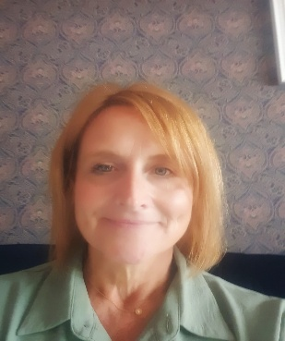
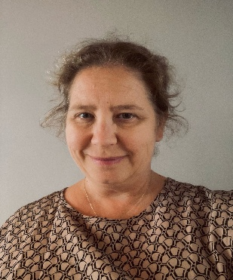
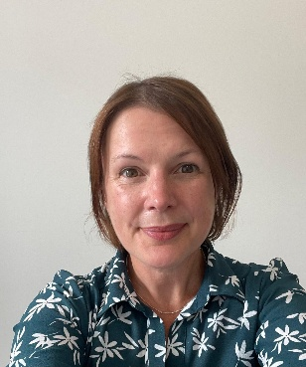
Meet the team
Charlie Duhig – Team lead
Carmarthenshire: Donna Owens, Liza Francis & Maria Evans
Pembrokeshire: Emma Venables & Donna Phillips
Ceredigion: Emma Birch
Notes:
We are a team of 7 nurses working across the health board, based mostly within integrated health and social care offices.
The Admiral Nurse service is made up of our team manager/clinical lead, and 7 nurses working across the health board. There will be 1 nurse based within each of the counties covering North and South Pembrokeshire, North and South Ceredigion, Carmarthenshire, Ammanford and Llanelli.
The nurses manage a caseload of clients working with them on average for around 6 months
We work closely with other teams are part of the dementia wellbeing pathway through joint working, advice and referrals

Slide 10
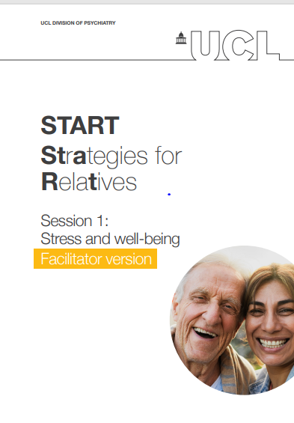
What is START?
Developed by University College London
Eight-week manualised intervention
Specialist intervention for carers of PLWD
LBD & PDD version
CBT approach
Improved anxiety and depression for carers
Improved Quality of life for carers & PLWD
Notes:
The programme was designed by University College London and originally psychology graduates and Admiral Nurses.
It is an eight-week manualised intervention to support the development of coping strategies of carers of people living with dementia.
It is available in 8 languages and also has a separate version for carers of people living with Parkinson’s disease dementia & dementia with Lewy Bodies.
The programme uses a CBT approach.
In the RCT evaluating START, anxiety and depression scores were improved in both the short term (8 months later) and in the longer term (2 years later).
Originally developed as a 1-1 intervention but can be delivered as a group.

Slide 11
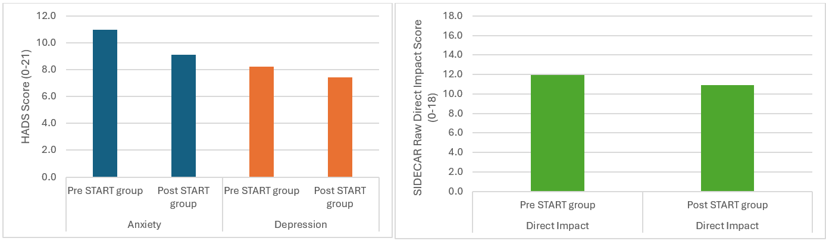
Evaluation and outcomes
Notes:
We have delivered 8 groups since the pilot in 2023 and these are the outcomes as part of our intervention.
The mean HADS Anxiety scores went from: 11 to 9.1
The mean depression scores went from 8.2 to 7.4
The mean SIDECAR direct impact scores reduced from 12 to 10.9

Slide 12
Feedback
“The START programme made me feel very supported and cared about. The Admiral Nurses were kind and very helpful. They treated us with compassion and understanding. I cannot rate them and the START course highly enough. Meeting other carers was really helpful too. We got along really well and supported one another. It's so important not to feel you are the only one caring for someone with dementia. It's good to feel you are not alone and that is what the START programme did for me. Thank you.”
“Doing the START course helped me no end. To be able to understand the behaviour and more importantly change how I reacted to it, was amazing. I'm not scared of the future now; we just enjoy every day as it comes.”
“Excellent course full of useful information and expertise. Don't feel so alone - Admiral Nurse wonderful support.”

Slide 13
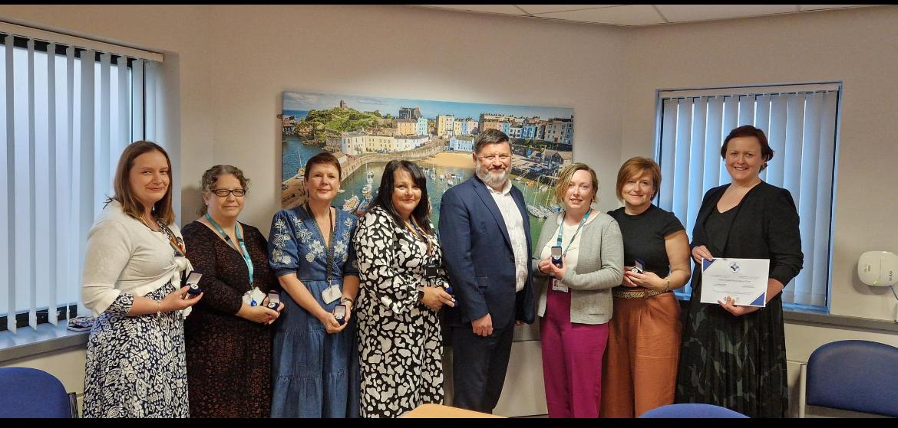
Achievements to date
Nomination for RCN Wales Nurse of the Year Award - Chief Nursing
Officers of Wales ‘Excellence Award’
Presentation to Pre-registered nursing students in Aberystwyth
Attendance at the Eisteddfod in Tregaron
Article in carers newsletter
Bronze Investors in Carers award –
working towards Silver
Chairs commendation award

Slide 14
Lived experience
Notes:
Our take home message today would be for you all to think when you are next involved in a discussion with a carer

Slide 15
‘If you love someone living with dementia, you’re living with it too’
Notes:
Our take home message today would be for you all to think when you are next involved in a discussion with a carer

Slide 16
Charlie Duhig
Admiral Nurse Clinical Lead
Email Address: Charlotte.Duhig@wales.nhs.uk
Notes:
Any Questions?

