Slide 1
National
Overview
Marc Forster
Partnerships and Communications Officer
HOPE, Age Cymru
21 May 2024

Slide 2

What is Independent Advocacy?
Supporting people to express their views, wishes and feelings,
Upholding people’s rights,
Enabling them to have a voice,
Getting access to services,
Supporting them to challenge injustice.
Independent advocates do not have conflicts of interest like some professionals.

Slide 3
History of advocacy
1950s – scandals in long stay hospitals
1960s – increasing awareness of rights and the way people are treated who need services
1966 – Wolf Wolfensburger established the first Citizen Advocacy project in America
1979 – first Citizen Advocacy project in London
1983 and 1984 – developments in advocacy for mental health patients, people with learning difficulties, and children
1980s – to date – legislative and policy changes based on the rights of individuals to have a voice, choice and representation

Slide 4
Types of statutory advocacy
Statutory advocacy for adults
Social Services and Well-being (Wales) Act (2014)
Mental Capacity Act
(2005)
Mental Health Act
(2007)
National Health Services (Wales) Act
(2006)

Slide 5
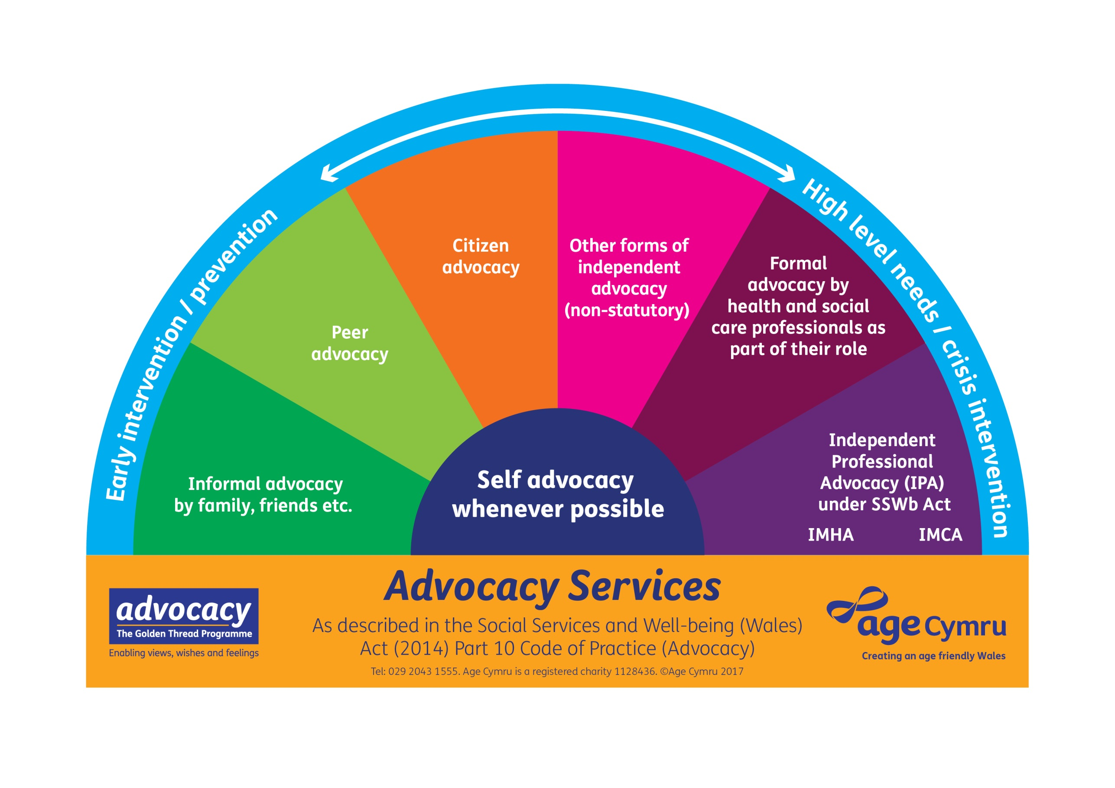

Slide 6
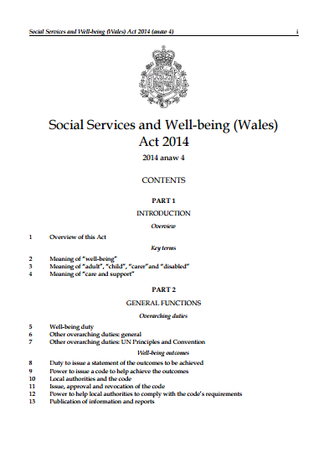
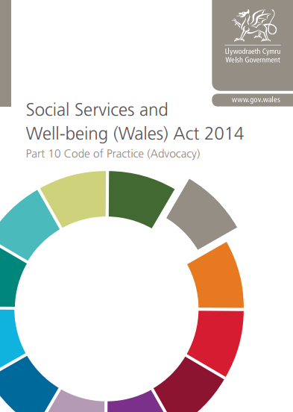

Slide 7
Golden Thread Advocacy Programme (GTAP)
Welsh Government Funded
  Sustainable Social Services Grant
4 years from April 2016 – 2020
To support the implementation of the ‘Act’ in relation to advocacy (Part 10)
Working with commissioners and providers and potential service users

Slide 8
Outcome 1: Supporting the commissioning of IPA
Worked directly with local authority commissioning teams across Wales
Self-assessment questionnaires leading to a Maturity Matrix for local authorities
Regional workshops across Wales
National Framework for Commissioning Advocacy for adults in Wales developed

Slide 9
Outcome 2: Building the capacity of the advocacy sector
Regional and national networks
Self-assessment forms to assess providers own readiness for commissioning
A maturity matrix for providers
Provider workshops as part of co-producing commissioning strategies
National Advocacy Conference

Slide 10
Outcome 3: Greater awareness of advocacy
Advocacy Counts Reports
Advocacy newsletters
Suite of awareness resources
Mapping advocacy provision
Comprehensive advocacy website

Slide 11
What did GTAP reveal?
Lack of low level early intervention advocacy for older people
Concerns that commissioning of IPA would lead to the end of other non statutory forms of advocacy
A need for training
A need to continue supporting the advocacy sector in Wales
A need to do some further work to ensure a strategic approach is taken by LA’s in line with the Framework
A need for an integrated approach to awareness of advocacy that went beyond leaflets. The word advocacy can still be a confusing concept!

Slide 12
What is Age Cymru doing now?
Filling in some of the advocacy delivery gaps:
  HOPE – low level advocacy support for older people
  Dementia Advocacy Project
Supporting the Welsh adult advocacy sector
  Training and conferences
  Networks
Mapping advocacy provision
Comprehensive advocacy website
Research
  Advocacy Counts 9
  Advocacy during Coronavirus
  National challenges and legislative developments

Slide 13
Wider Wales perspective
IPA commissioned in 21 local authorities
Many commissioned more than once
Mix of joint regional commissioning and single area commissioning
No other area with formal consortium agreement with multiple providers
Mix of direct provider referral pathways and external gateway hub
Half of local authority areas with an advocacy strategy

Slide 14
Wider Wales perspective
IMHA and IMCA contracts continue to be commissioned with WG funding
CHC complaints advocacy becoming Llais and also covering social services complaints
Liberty Protection Safeguards delayed
RISCA only applies to children’s advocacy
Advocacy qualification restructured
Quality Performance Mark and Advocacy Charter being reviewed

Slide 15
Advocacy challenges across Wales
Continued impact of Covid
Cost of living crisis on clients, advocates and services
Standstill or reduced budgets
Continued lack of WG funding for IPA
Some non statutory advocacy services have ceased due to funding
Reduced range of advocacy being available
Lack of knowledge about advocacy from professionals in statutory bodies

Slide 16
Advocacy challenges across Wales
Increased demand
Increased complexity of cases
Many advocacy services with waiting lists for the first time
Challenges of recruiting and retaining advocates
Impact of increased inclusion as parental advocates in child care cases
Lack of other support services to signpost people to for support
Lack of awareness of advocacy by the public

Slide 17
Contact details
Marc Forster
Partnerships and Communications Officer
HOPE, Age Cymru
Email: marc.forster@agecymru.org.uk
Tel: 07932 989656
www.agecymru.org.uk/advocacy

