Slide 1
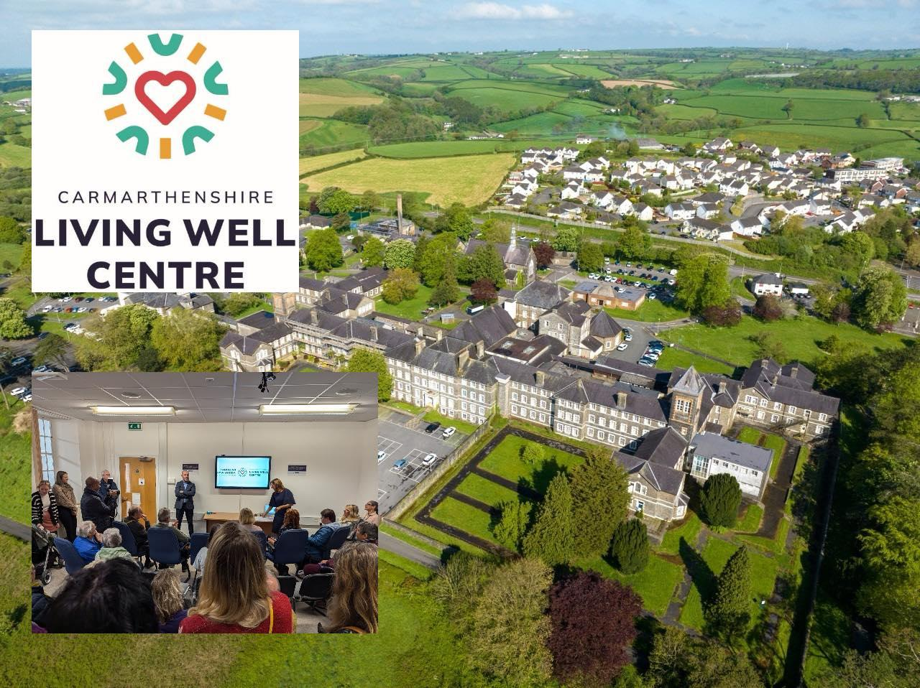
CARMARTHENSHIRE LIVING WELL CENTRE
Lucy Cummings – PLANED

Slide 2





Sharing the same vision for a preventative living well centre, the Tywi Taff Cluster provided funding to support the innovative pilot project that has been co-produced, developed and implemented and the lead tenant is now PLANED in Carmarthenshire with partners in the form of the “Carmarthenshire Living Well Centre”.
The creation of a co-located space with over 29 organisations now working together, that further enhances communities and availability of services, with partners that promote wellbeing, resilience, and the promotion of accessibility, is a new concept of free support for communities and service users.
In addition as a free point of delivery and access for the public, it also serves as a free co-working space focused on community, for organisations to support genuine co-production in practice, shared learning, outputs, and deliverables that would not have been routinely realised by these organisations.
Through co-production and evidence from service users and wider partners, an opportunity arose to take on a shared space partnership within Parc Dewi Sant at Carmarthen, where projects and service providers can co-locate, in one shared large space, to strengthen new and existing provision for local people in need of access to information, specialist support, and advice at times of their choice.

Slide 3
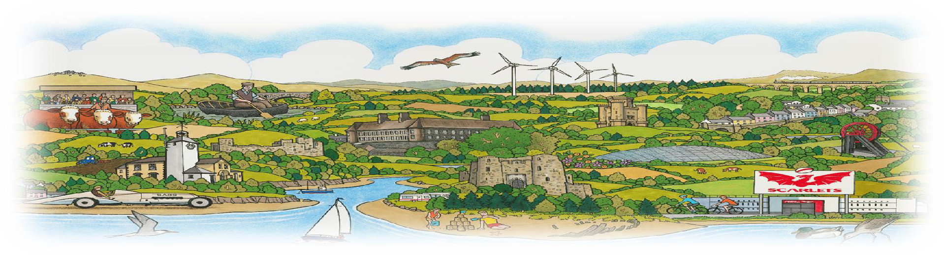
Being a shared space not only delivers benefits for all the providers and agencies in terms of financial savings to be realised for front line delivery, but also in terms of co-production and facilitation of shared delivery and efficiencies that enable the public and service users in an inclusive permanent way, which is not promoted or delivered currently elsewhere.
From the welcome and much appreciated initial funding received to deliver this concept into a reality during a 4 month period, we were able to open at the start of December 2024, and enable this pilot to commence. The evidence since then has proven that with clear service user demand from our public within communities, and also the wider benefits of co-location and co-production, this is a Centre, not a hub, which has increasing value, impact, meaning, and sustainability for our population,

Slide 4
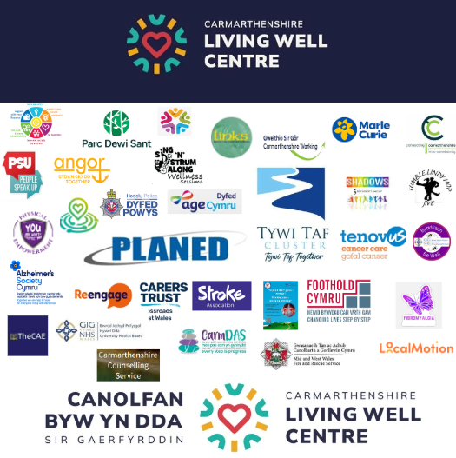
PARTNERS
29 Organisations offering drop-in sessions and support
Delta Wellbeing
Dyfed Powys Police PCSO’s
Age Cymru Dyfed
Mid and West Wales Fire Service
People Speak Up
Carers Trust Crossroads West Wales
PLANED - Catalyst for Care
Carmarthenshire Counselling Services
The CAE
Shadows
Carmarthenshire Working
Foothold Cymru
Links Mental Health
Angor (Tai Chi and Sing N Strum)
Alzheimer’s Society
Tenovus Cancer Care
Barclays Bank
Physical Empowerment (domestic abuse – self-defence)
Hywel Dda Be Well Service
Re-Engage
Marie Curie
Carmarthenshire Council Hwb
Tumble Lindy Hop
Be Well Service
Local Motion
Carmdas
Stroke Association
Connect Carmarthenshire
Hywel Dda Health Board (Primary Care)
(Smoking Cessation, Infant Feeding Group, Antenatal Clinic’s,
Weight Management Clinic)

Slide 5
Currently we already have the following sessions operating from the Living Well Centre, with a mixture of weekly, fortnightly, and monthly sessions all freely delivered and offered by local, regional, and national partner organisations & projects
Weekly Examples | Fortnightly Examples | Monthly Examples
Unpaid Carers (Via Carers Trust) – Community Outreach Discharge Team re pre or post hospital support General wellbeing advice from Delta Wellbeing Employment Support from Carmarthenshire Working Digital/Veterans/Dementia and other information & befriending support from Age Cymru Dyfed Support for migrants and diverse communities Arty Afternoons Elevenses Dementia Group Infant Feeding Group Over 75’s seated exercises tai chi Antenatal clinics Smoking Cessation Support Weight Management Clinics | Life Limiting Disease Drop in Support Group (Angor) Energy Wellbeing Advice and Support (Foothold) Mental Health Advice, Support and Wellbeing (Shadows) Money management and debt advice, with support on completing forms etc Mental Health Support for individuals and families Therapeutic Dance Sessions for all ages Neuro Diverse Support Group and Advice Camera Club and Digital Visual Support & Advice Money Matters Team – drop in support re advice for benefits etc | Tai Chi to improve physical and mental wellbeing Veterans Breakfast Club Craft workshops PTSD support group (Shadows) Chronic Illness Support Group Fibromyalgia Support Group Physical Empowerment classes promoting self defence classes and drop-in support and workshops (over 12 weeks) Community banking support sessions Ukulele Sing N Strum for wellbeing Collaboration Time For Me & Time For You – Carers with Carers Trust and the cared in a facilitated session, different rooms Bereavement support group

Slide 6
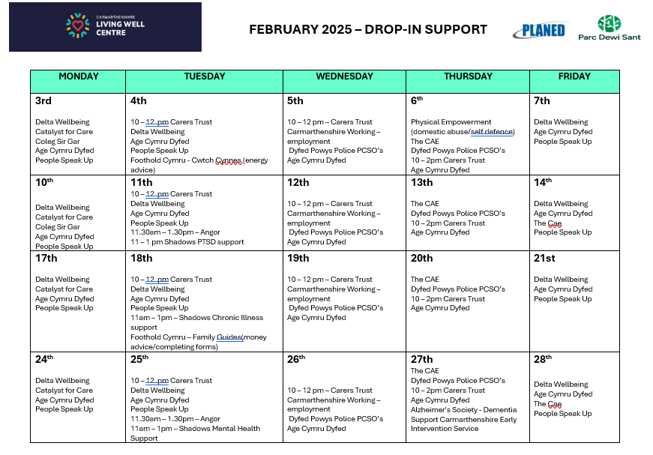
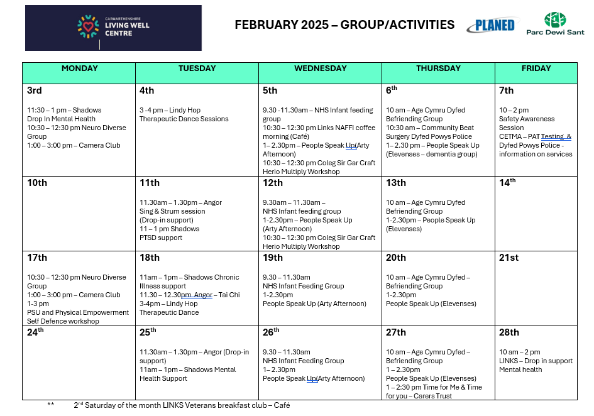

Slide 7
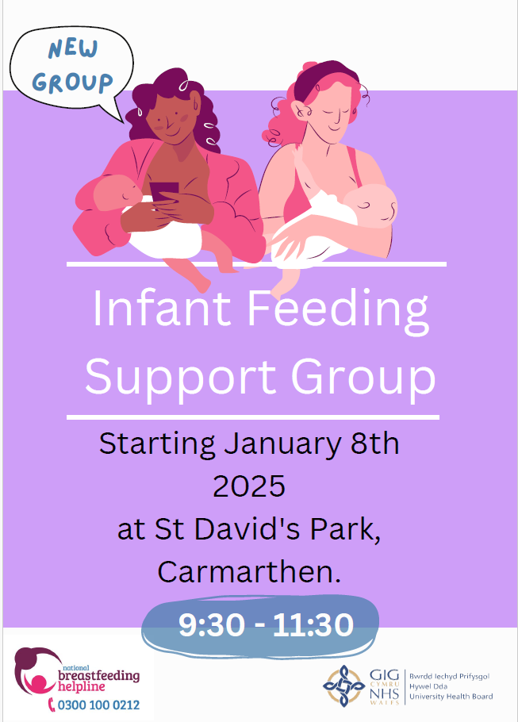
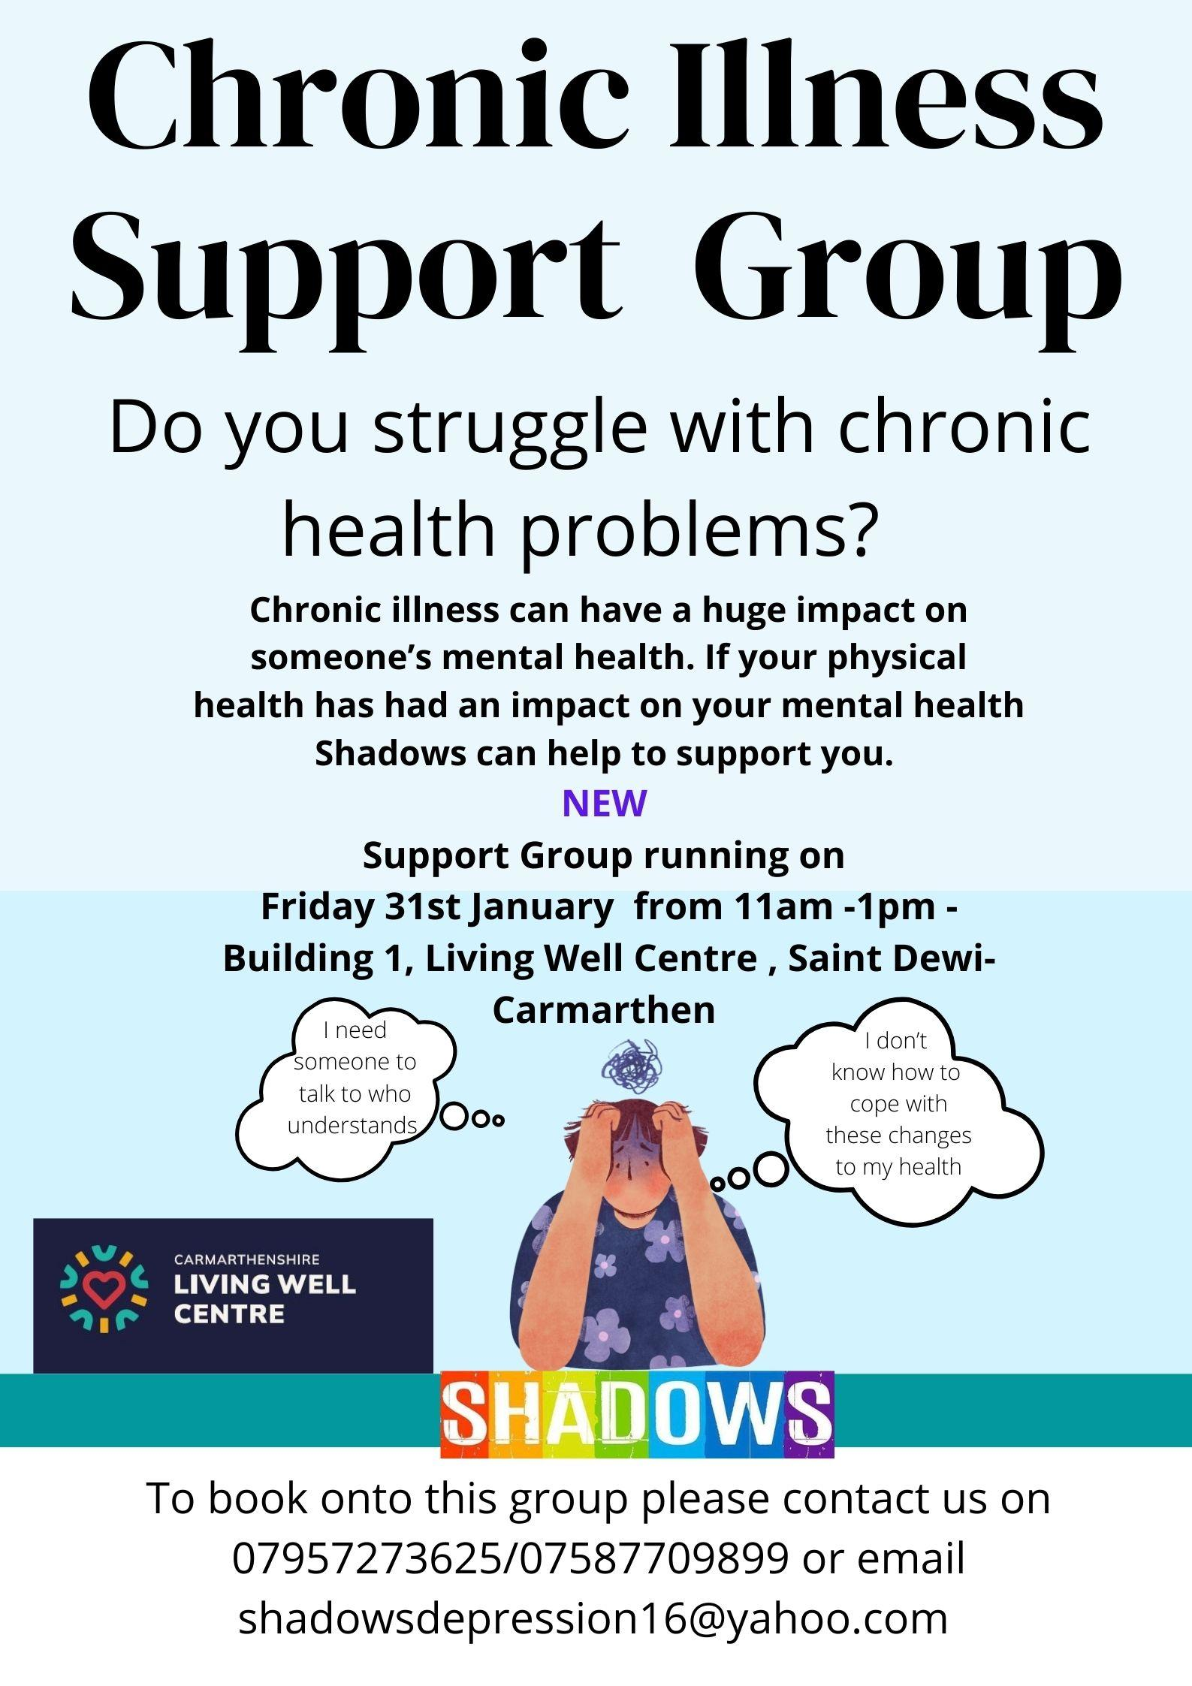

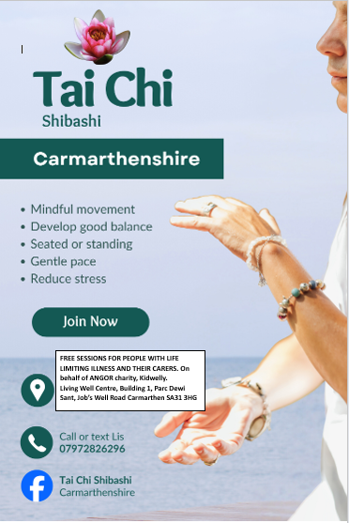
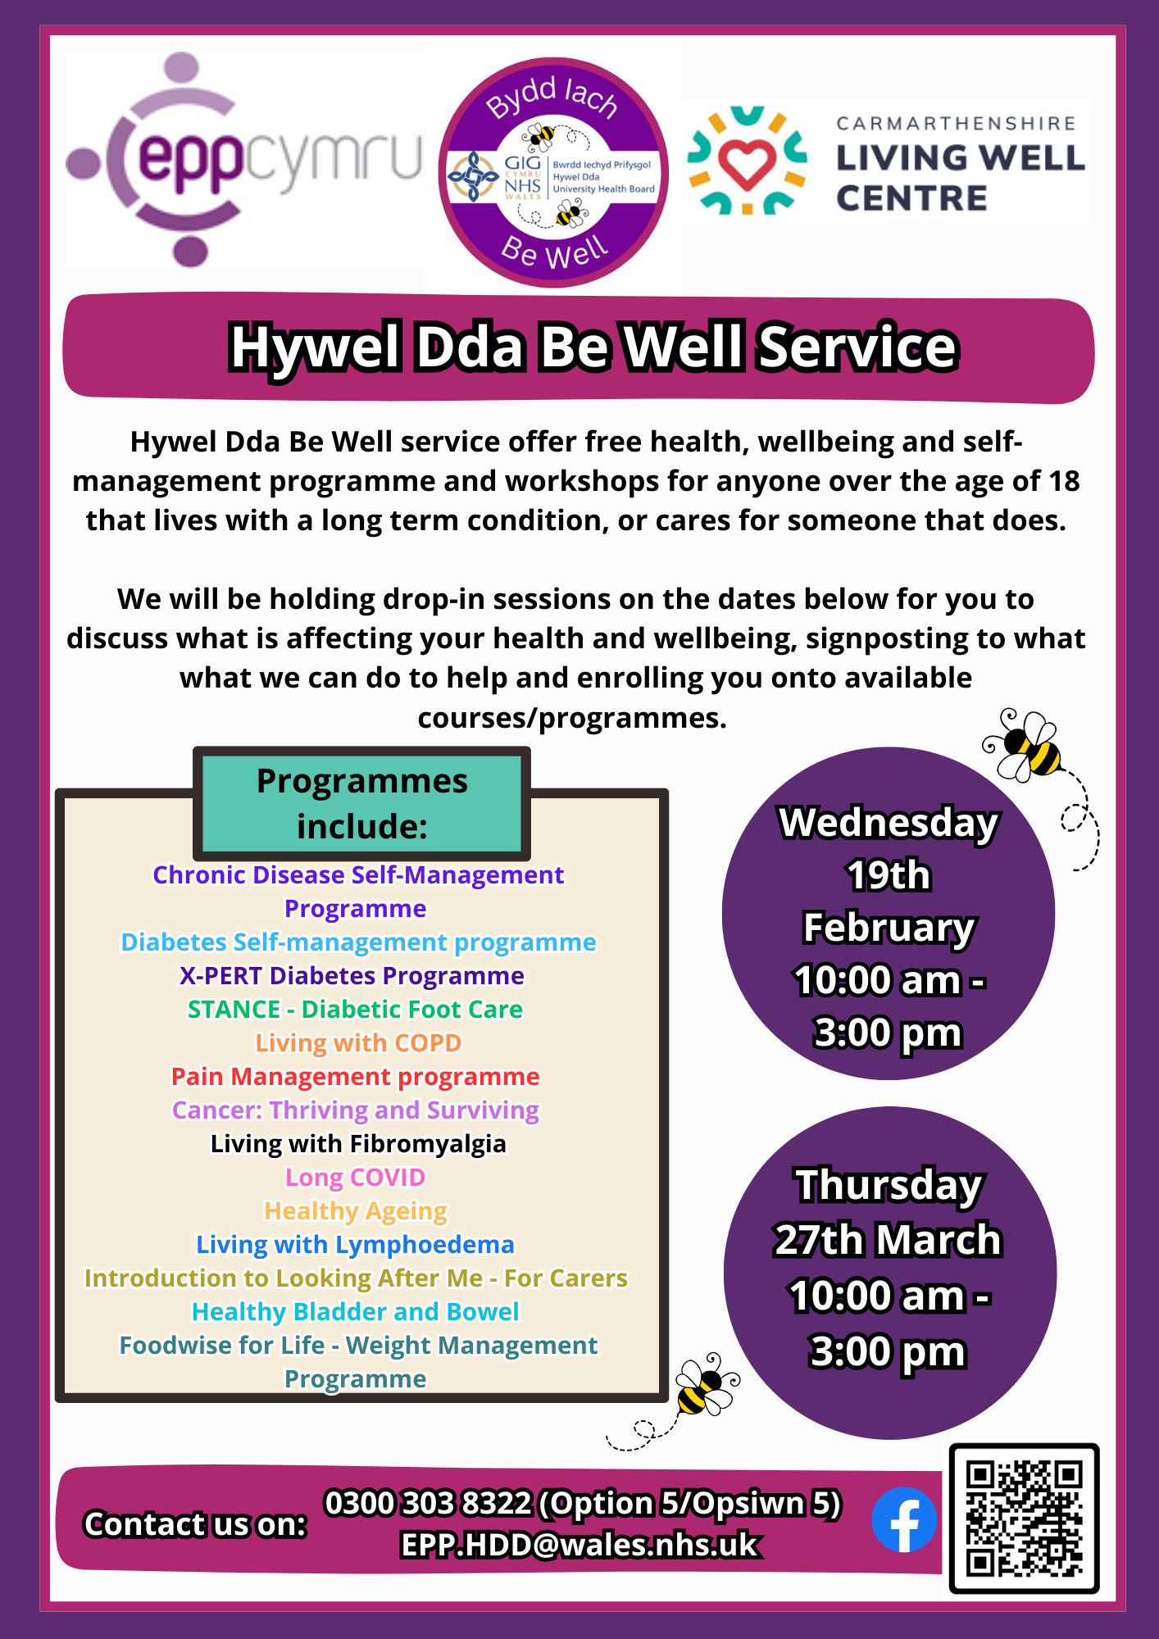


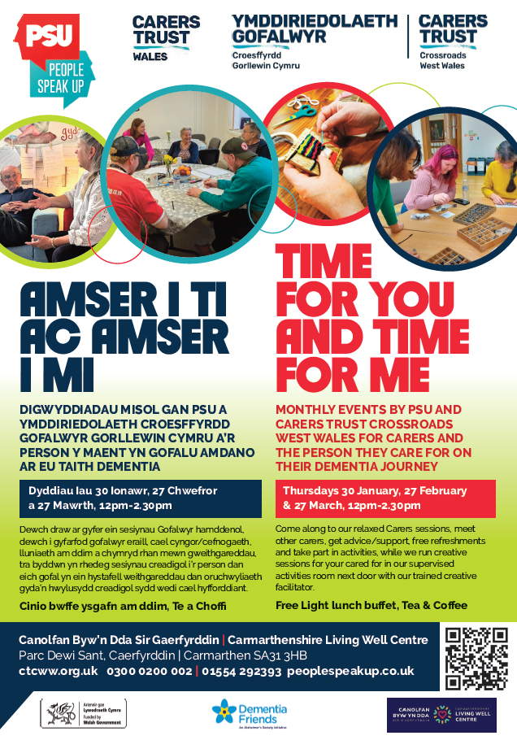
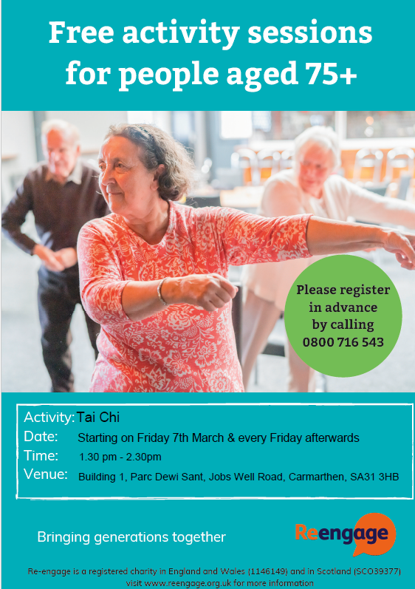
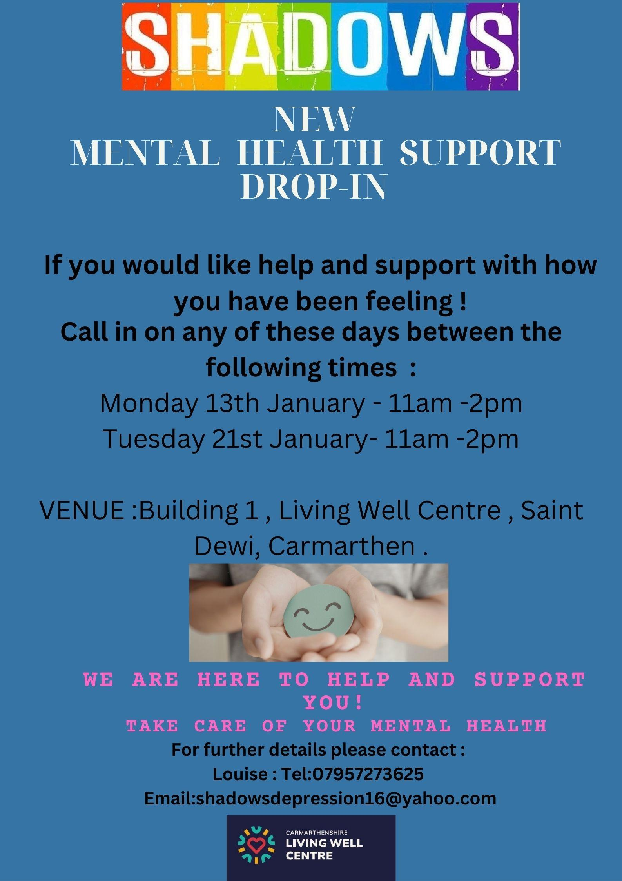
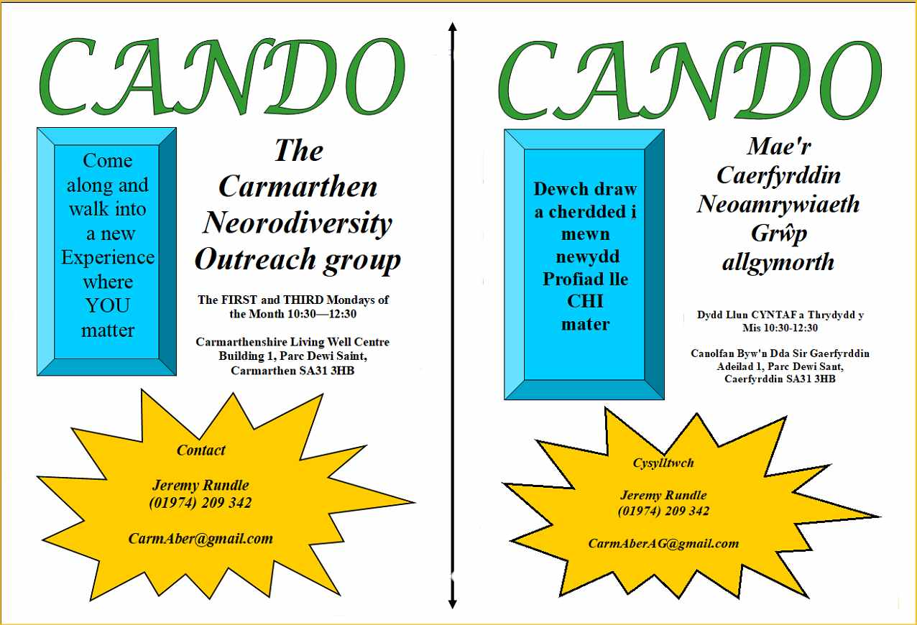
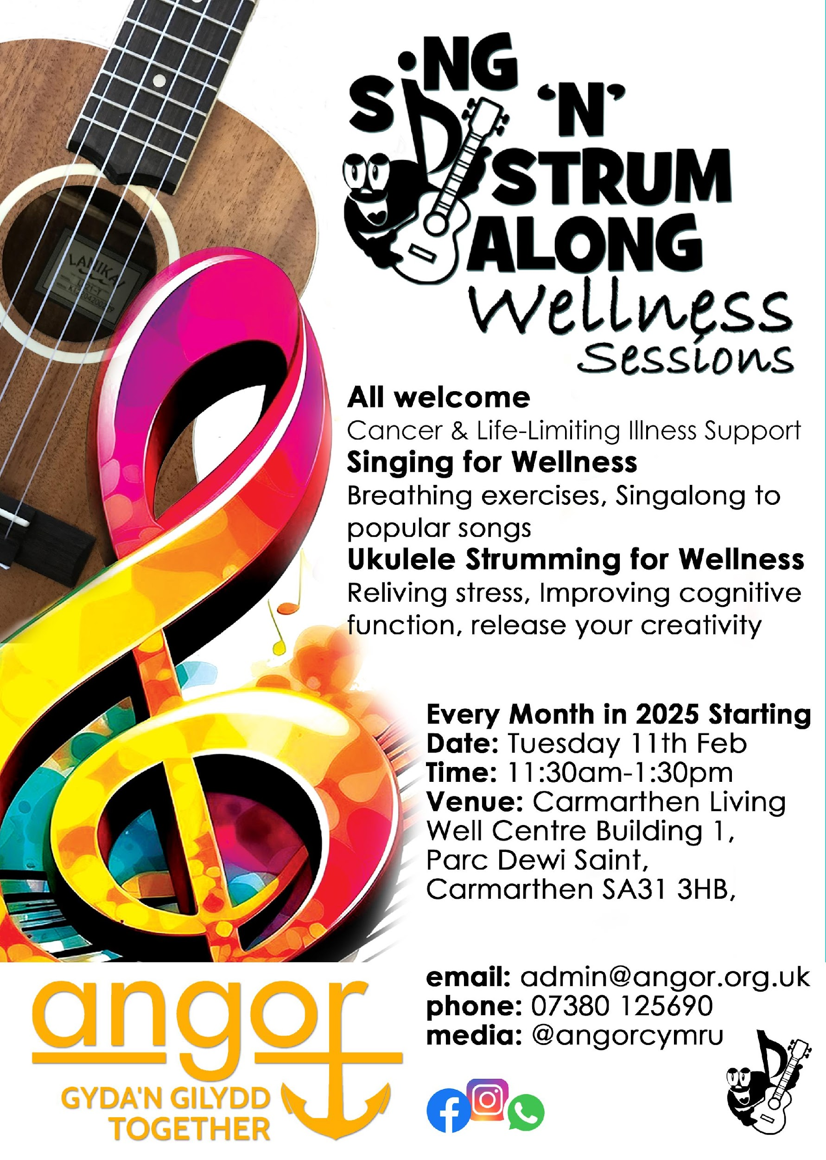
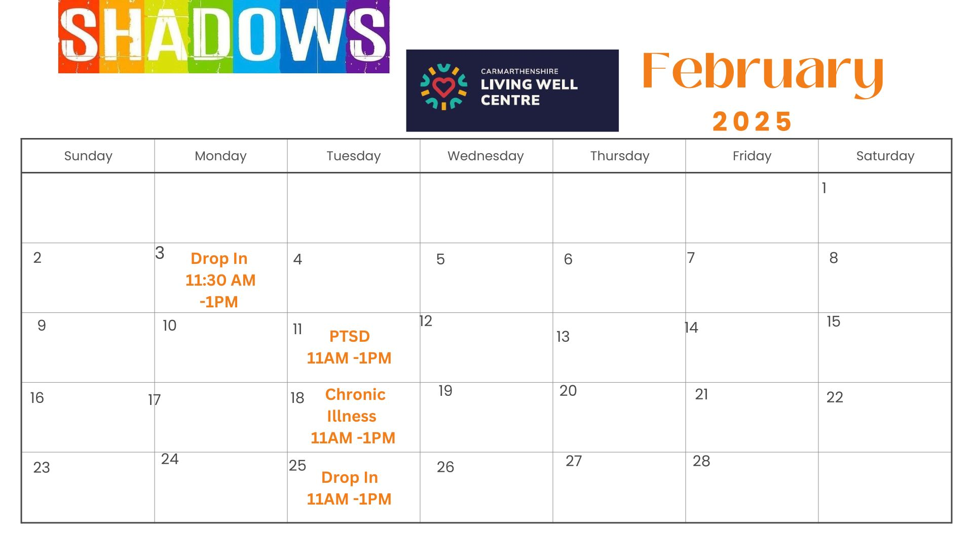
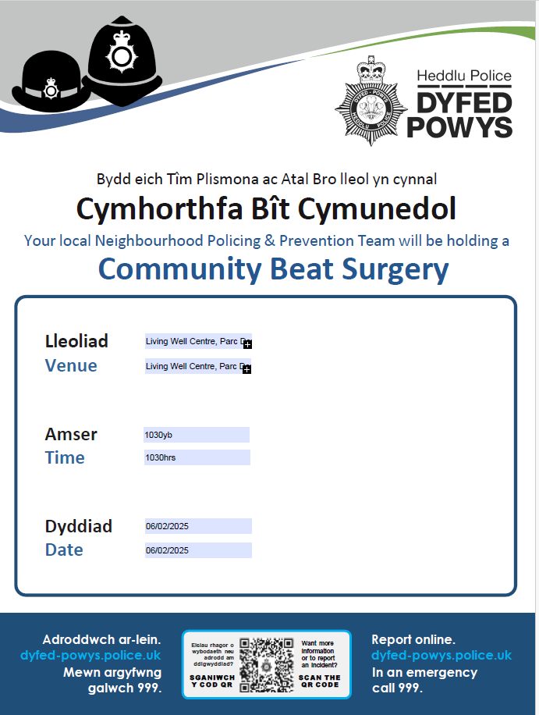
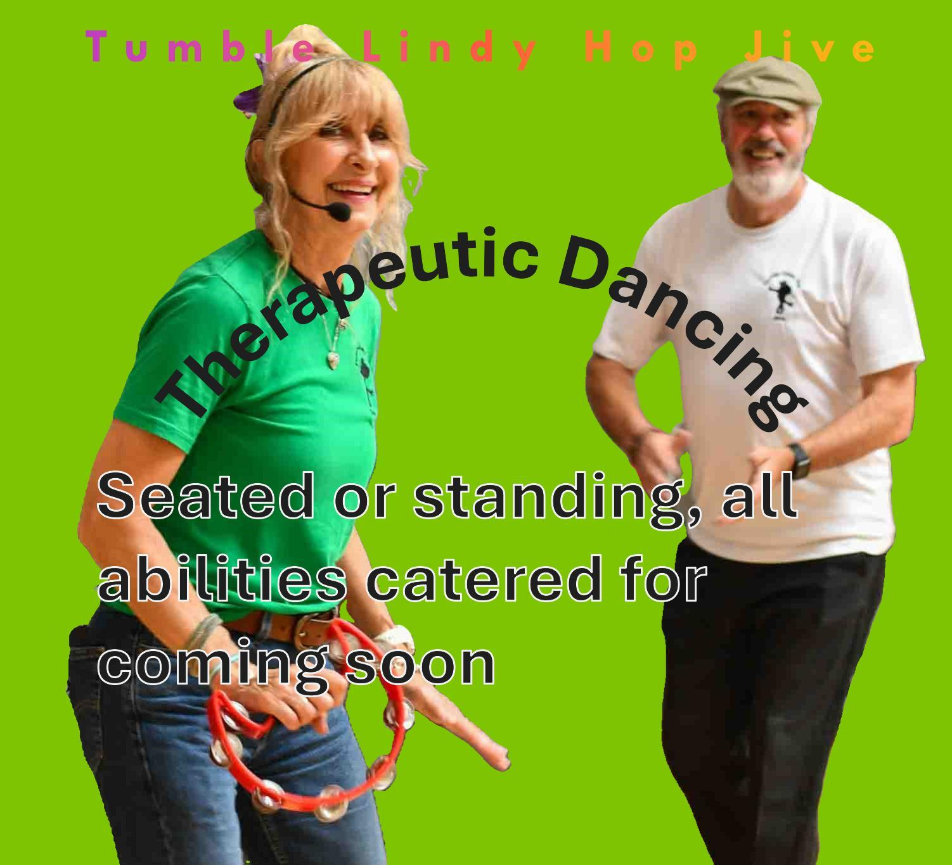
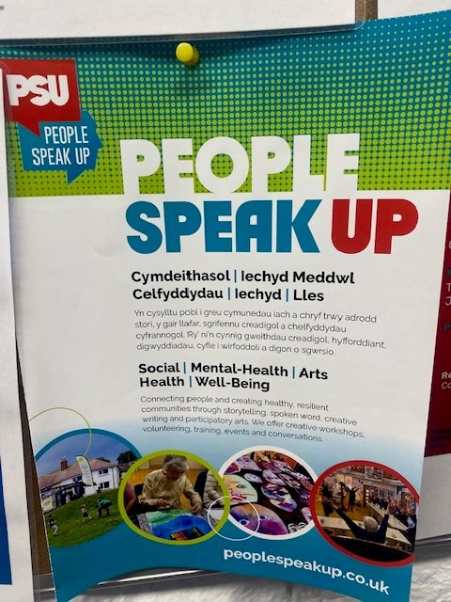
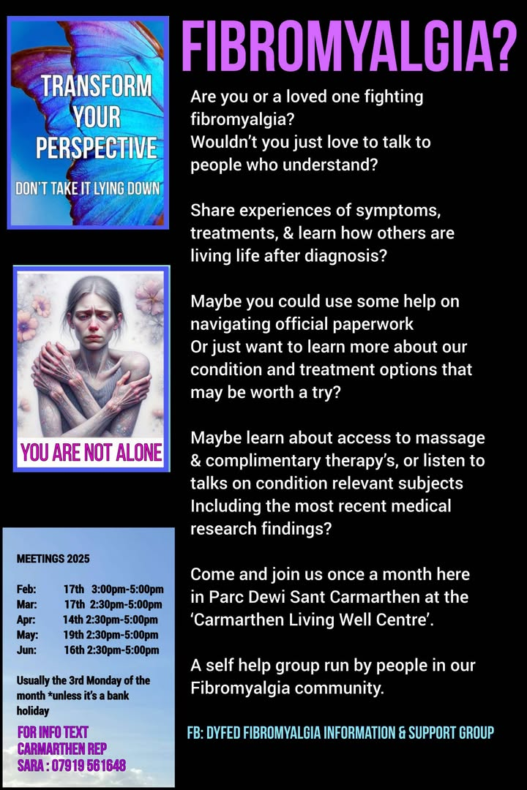
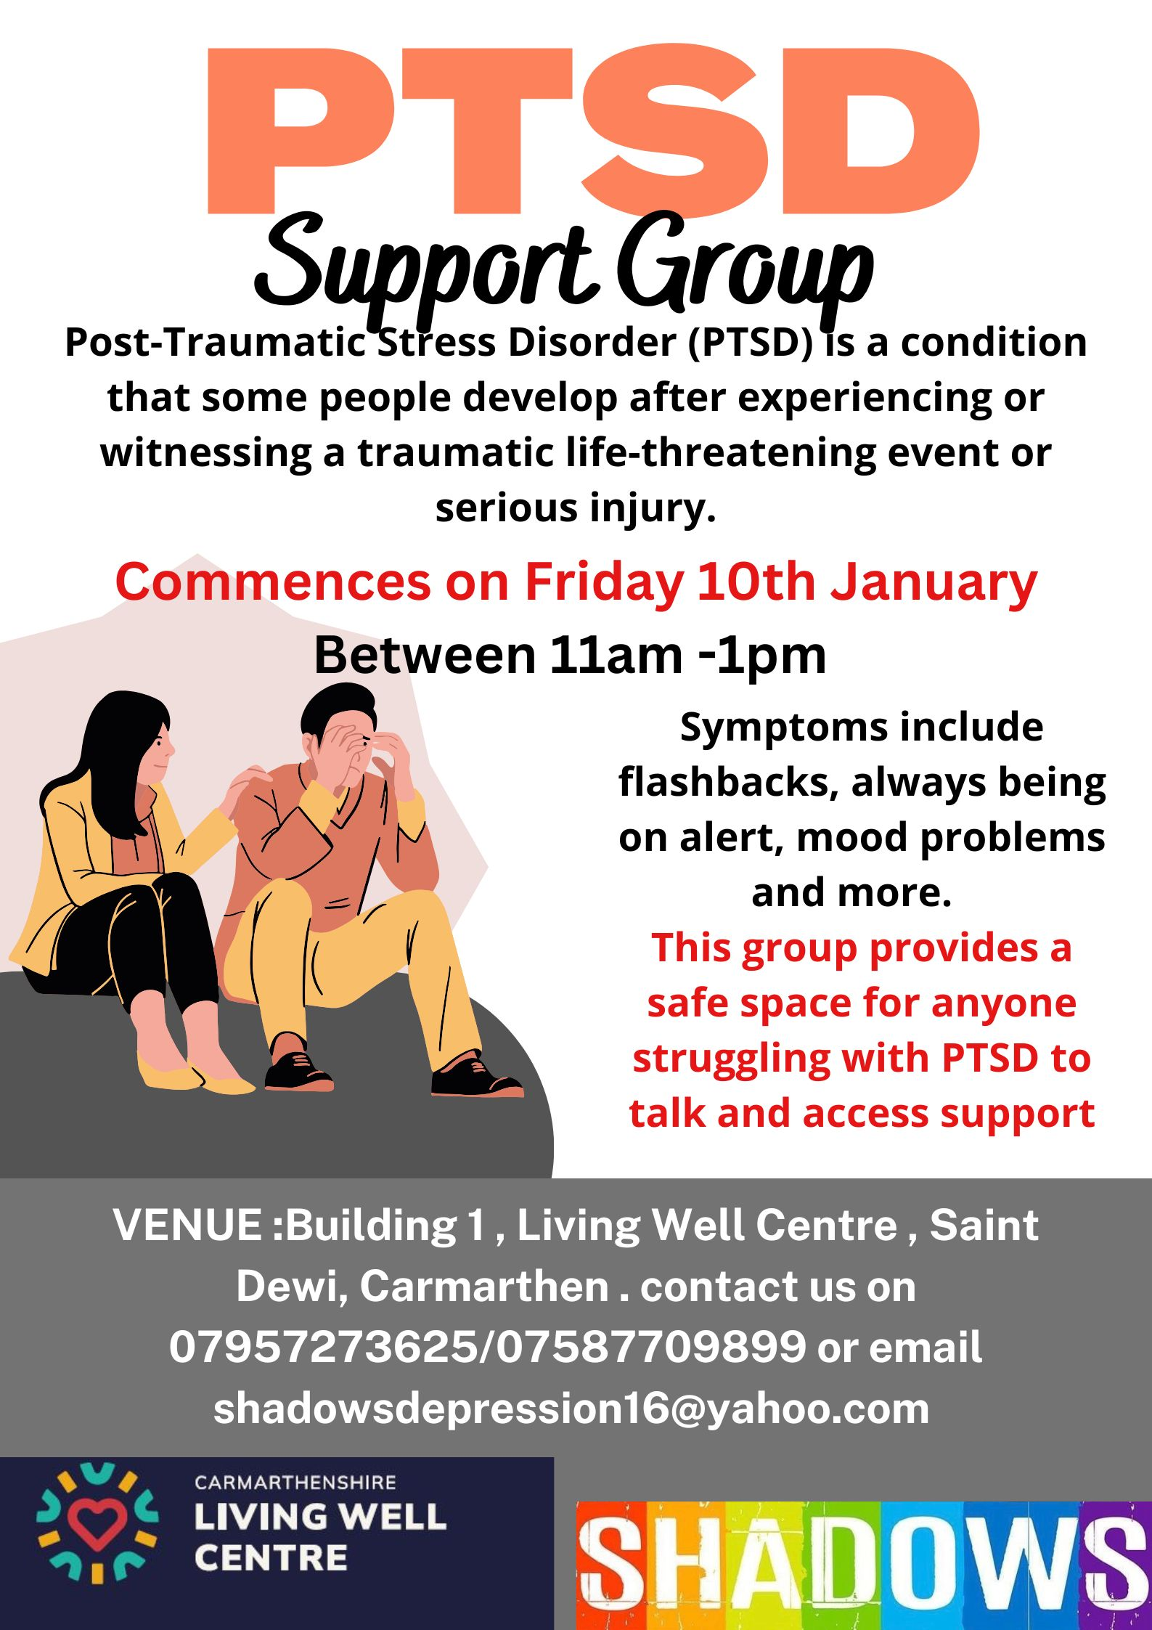
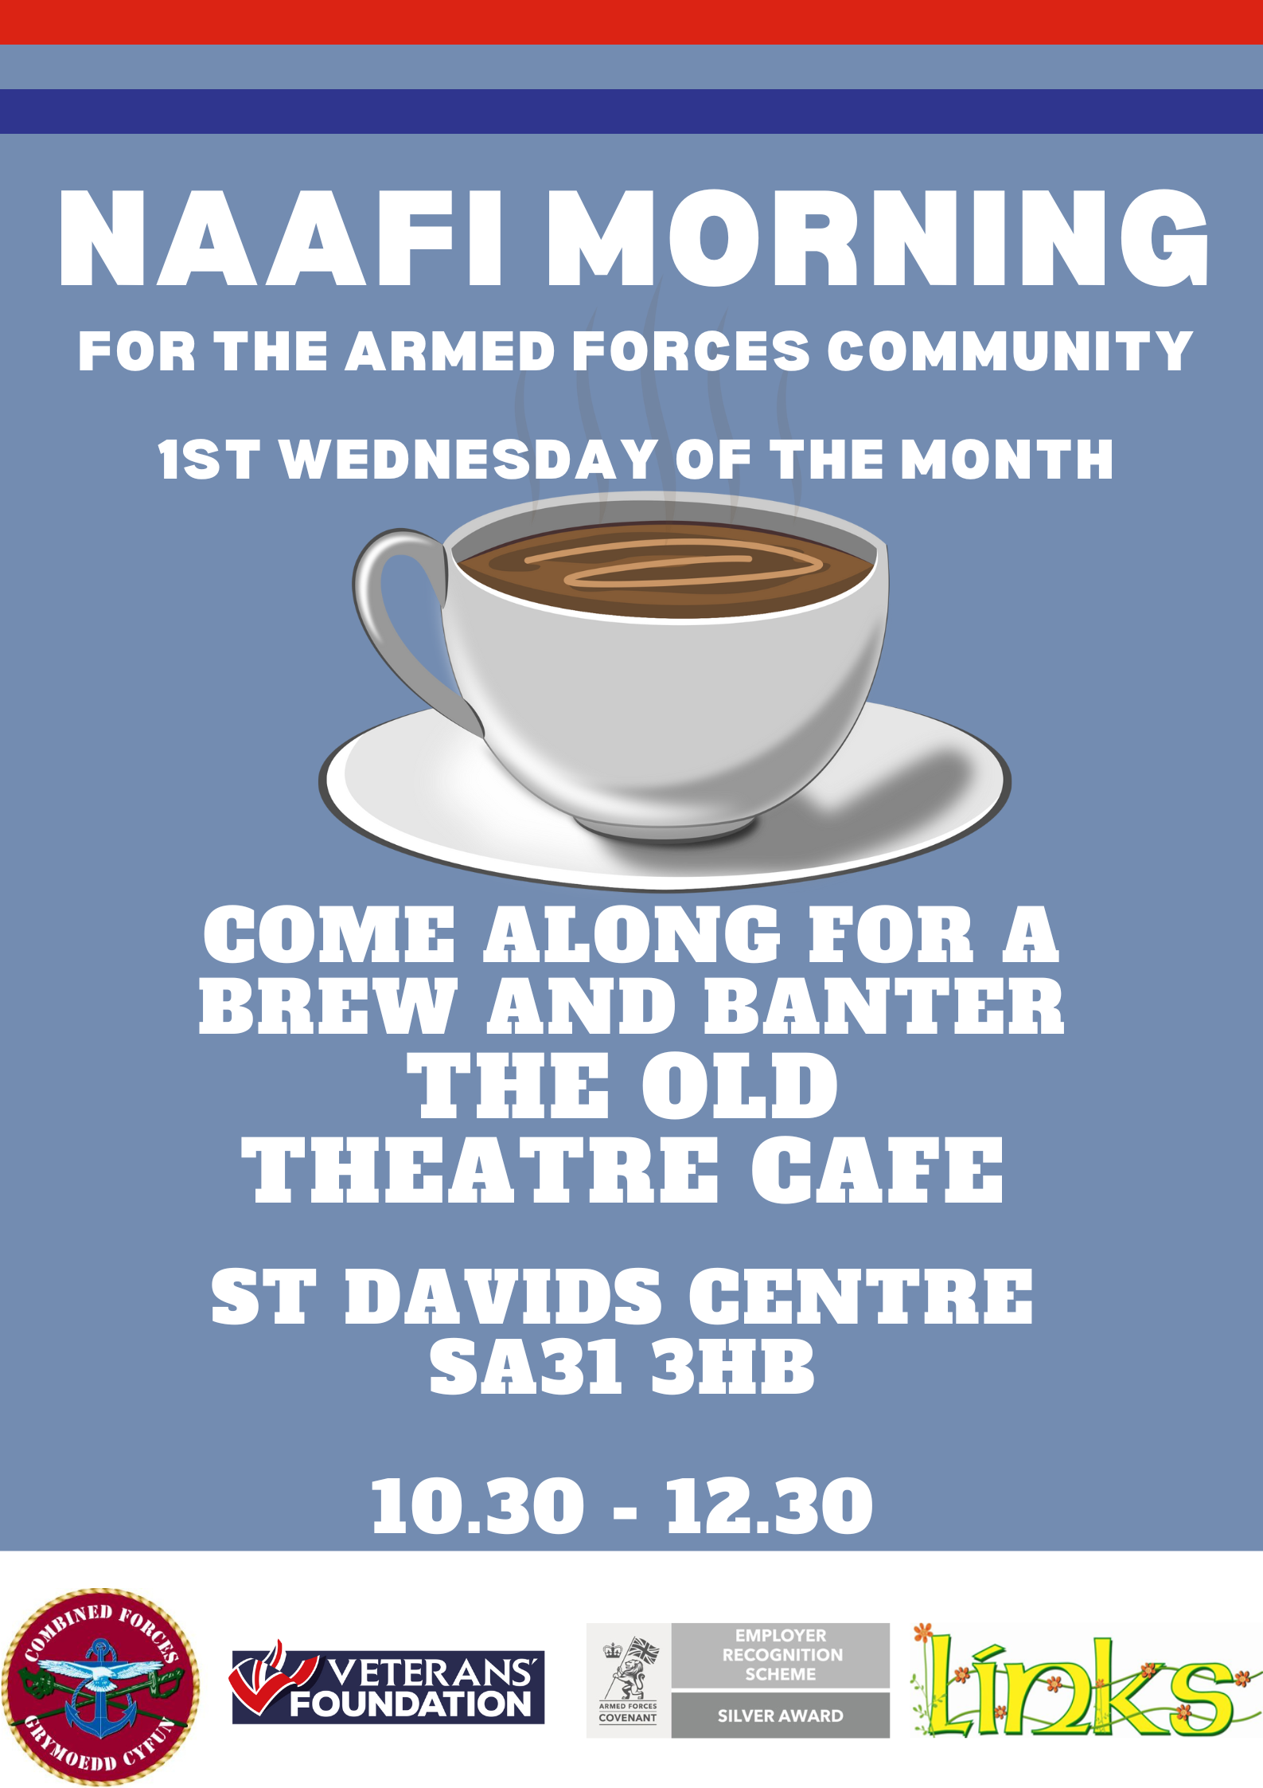


Slide 8
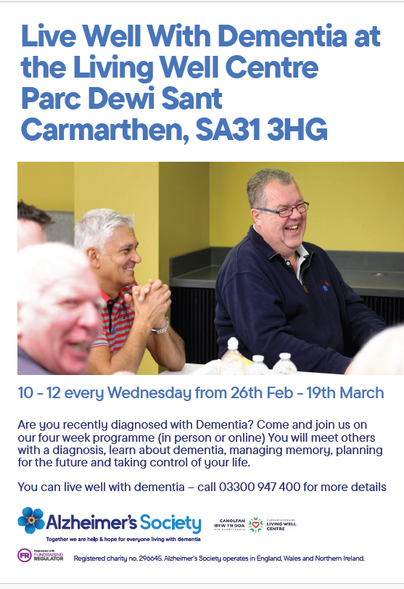
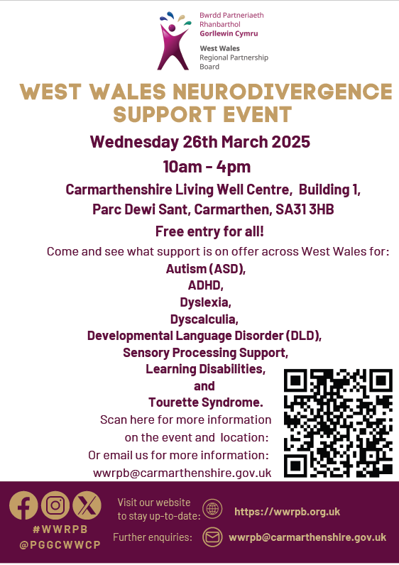
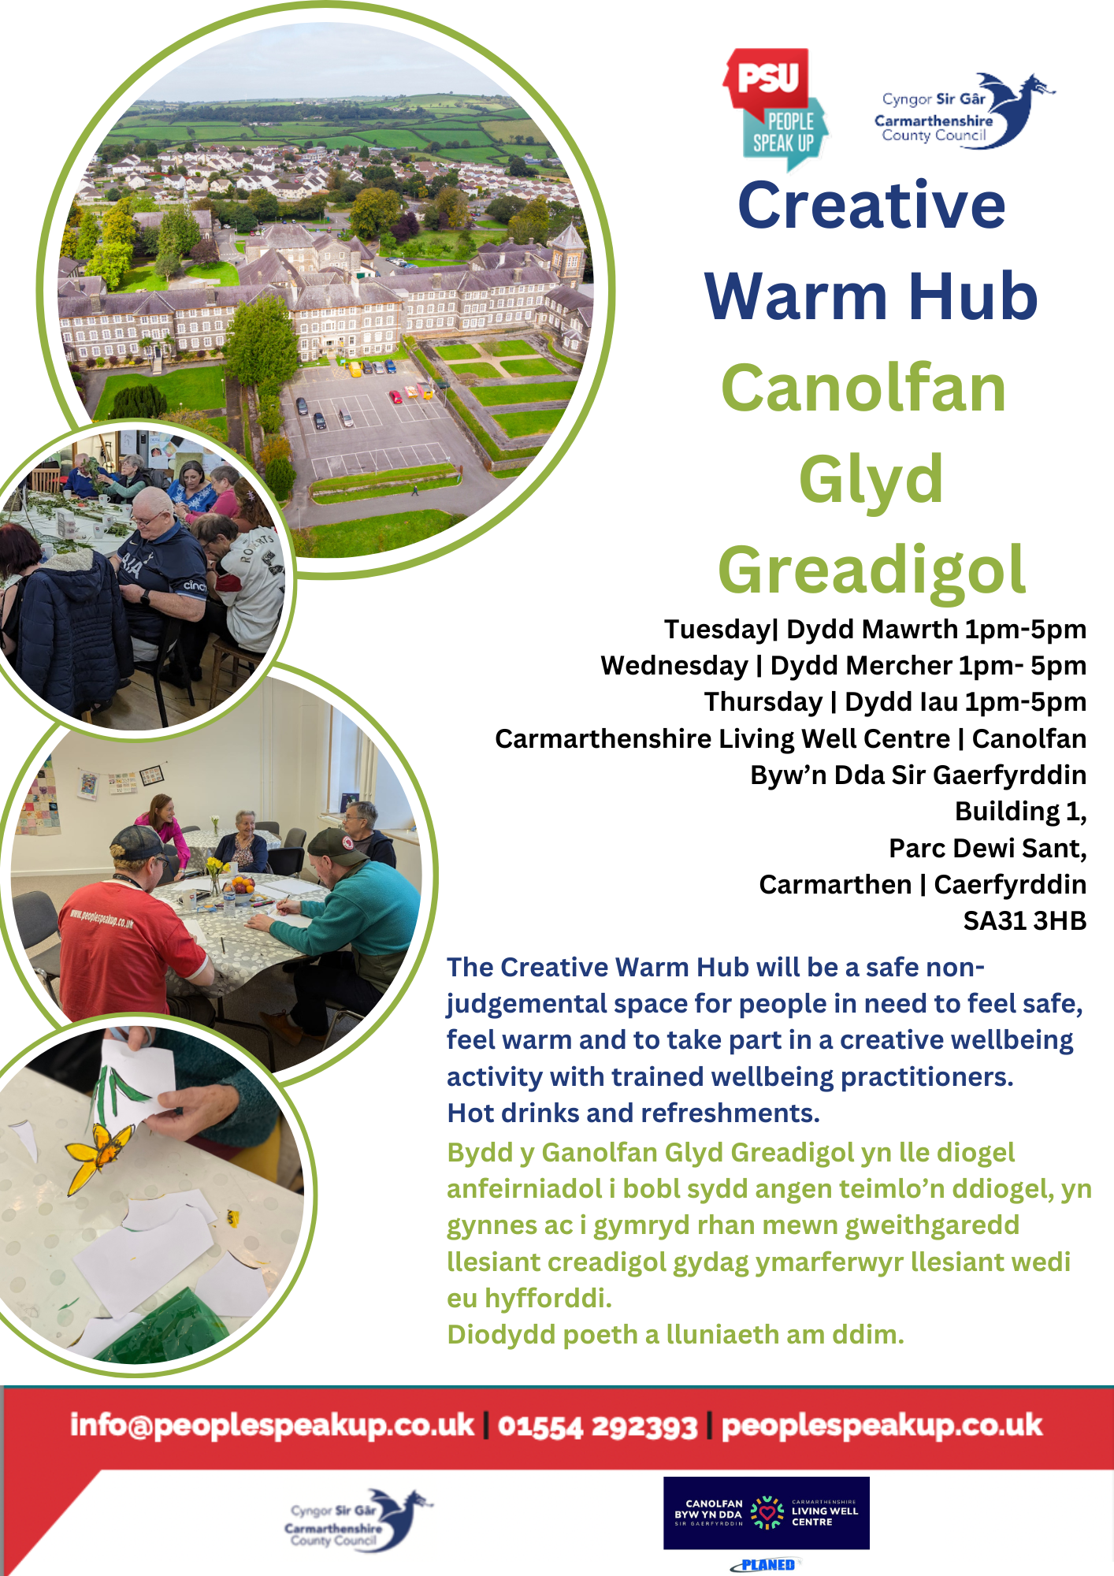
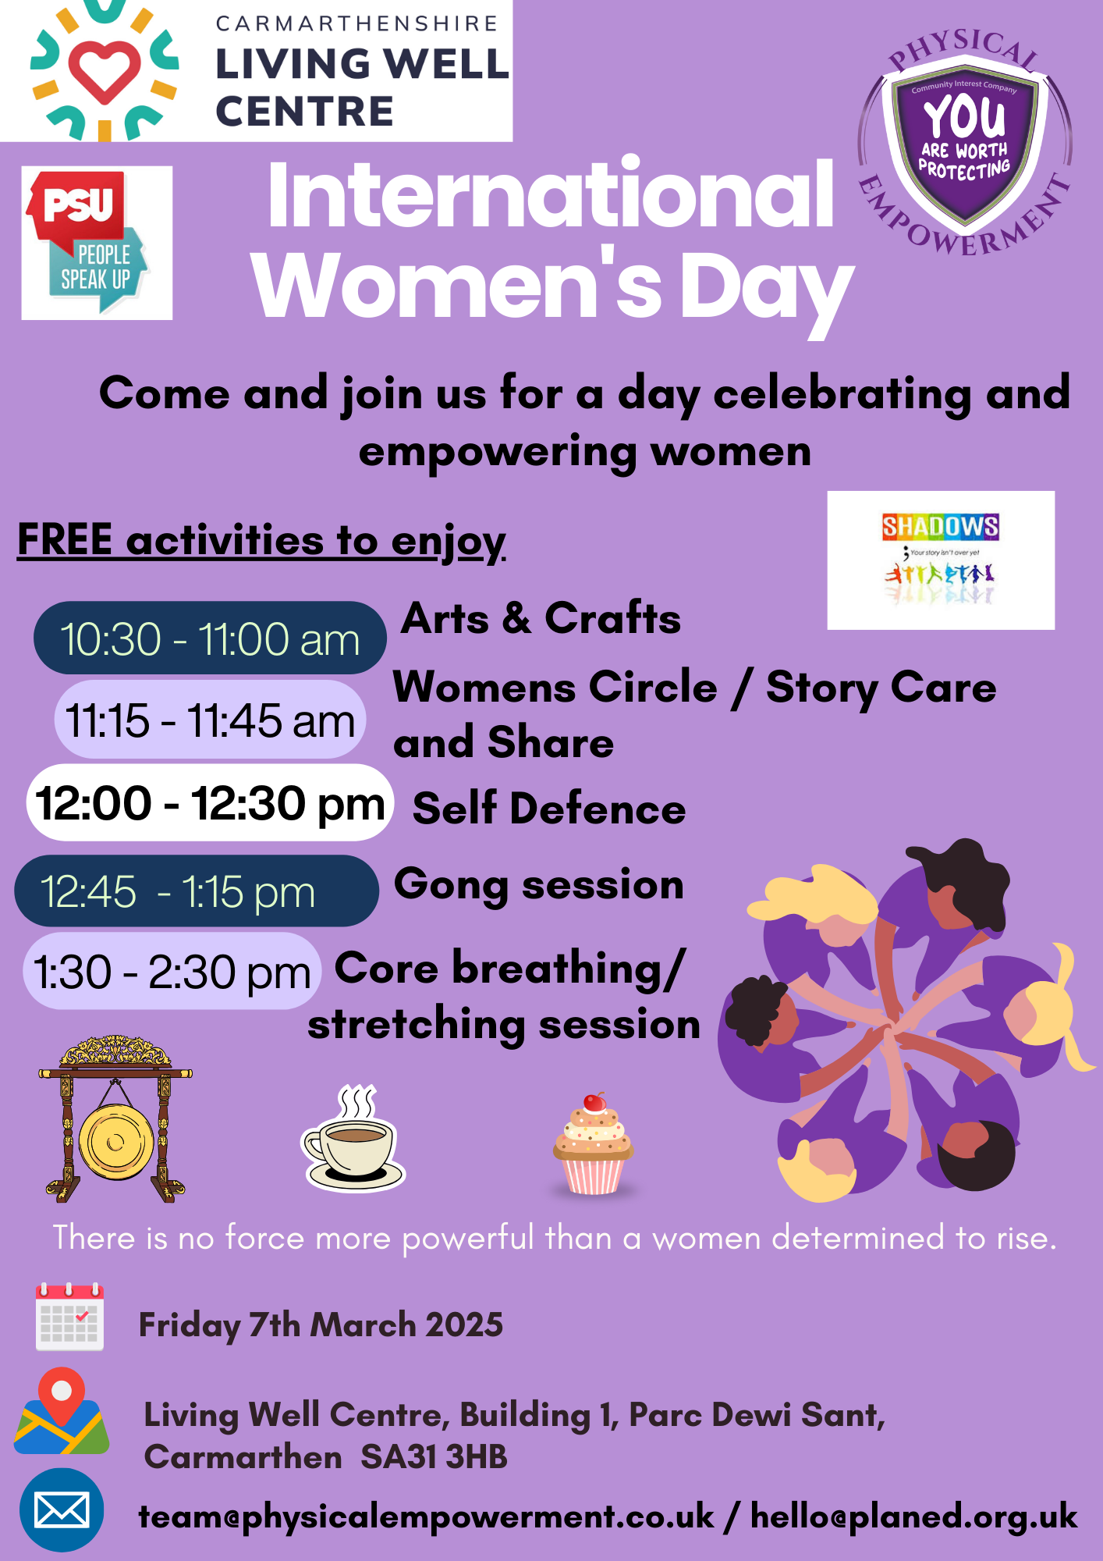

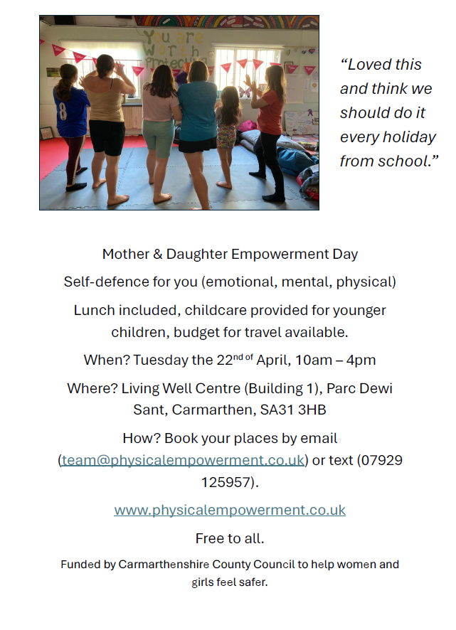

EVENTS AND WORKSHOPS AVAILABLE FROM THE CENTRE

Slide 9
The impact of the centre, which with funding can be further developed, to reach even more members of our communities, and collaborate and co-locate with partners, is demonstrated by a number of key outputs and headlines.
In addition to the collated evidence of circa 1,200 people accessing the centre for activities, support, advice and training since December 2024, (9 weeks) there are activities and events happening which would not be realised, would it not be for the Living Well Centre.
Prior to the Centre coming into being, there was no recent infant feeding group in Carmarthen, due to a lack of space and availability. Thanks to the Living Well Centre being available, the NHS are now able to offer this vital support with ourselves on a weekly basis.
The Neuro Diverse group initially support by Mencap no longer had premises within Carmarthen within which to meet with clients and families, and the group was therefore at risk of disbanding. Thanks to the Living Well Centre, they are able to continue to meet for free, and with our support, increase the number of sessions from monthly to fortnightly.
The waiting times for clients and individuals looking to engage the services of Carmarthenshire Counselling Service has decreased thanks to the space and capacity provided for free by the Living Well Centre. They are now able to operate sessions weekly at no cost, which enables people to seen sooner, and cross-refer to other projects within the Centre as required and identified.
Recently of what would have taken two weeks on average for a cross-project/service referral, only took 30 minutes, due to projects being co-located and over-riding lengthy administrative processes by sharing applicable information to the benefit of the clients and individuals.
Since pre-COVID, the Weight Management Clinic has now been able to operate an in-person service for various reasons. Now thanks to the Living Well Centre, members of the community can access the service on a weekly basis, thanks to the free clinical space we provide.
We are able to also support 2 full antenatal clinics at the Living Well Centre each week, due to the additional capacity we can provide, and the wider benefits of co-location with other services and projects to provide additional benefit to the members of the public engaged.

Slide 10
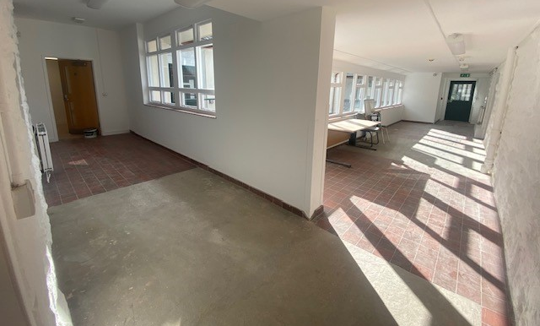
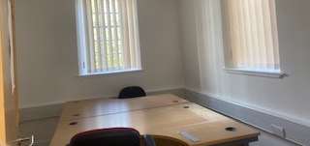
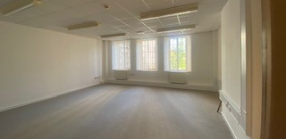

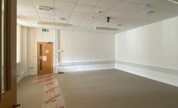
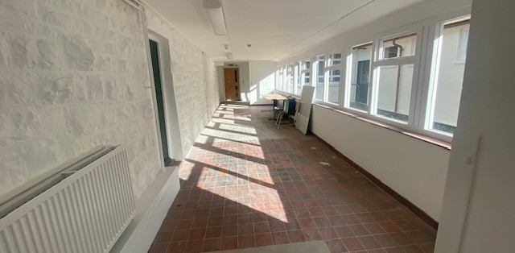

Slide 11
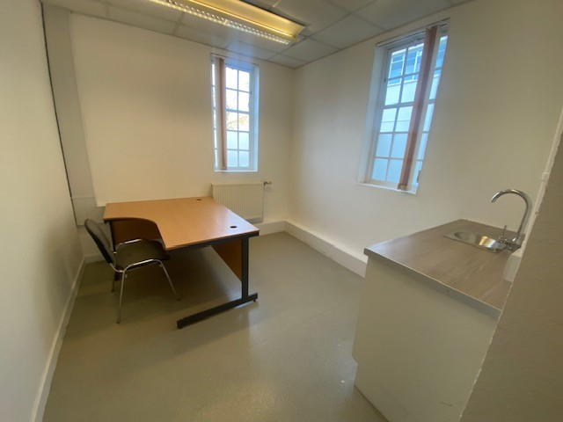
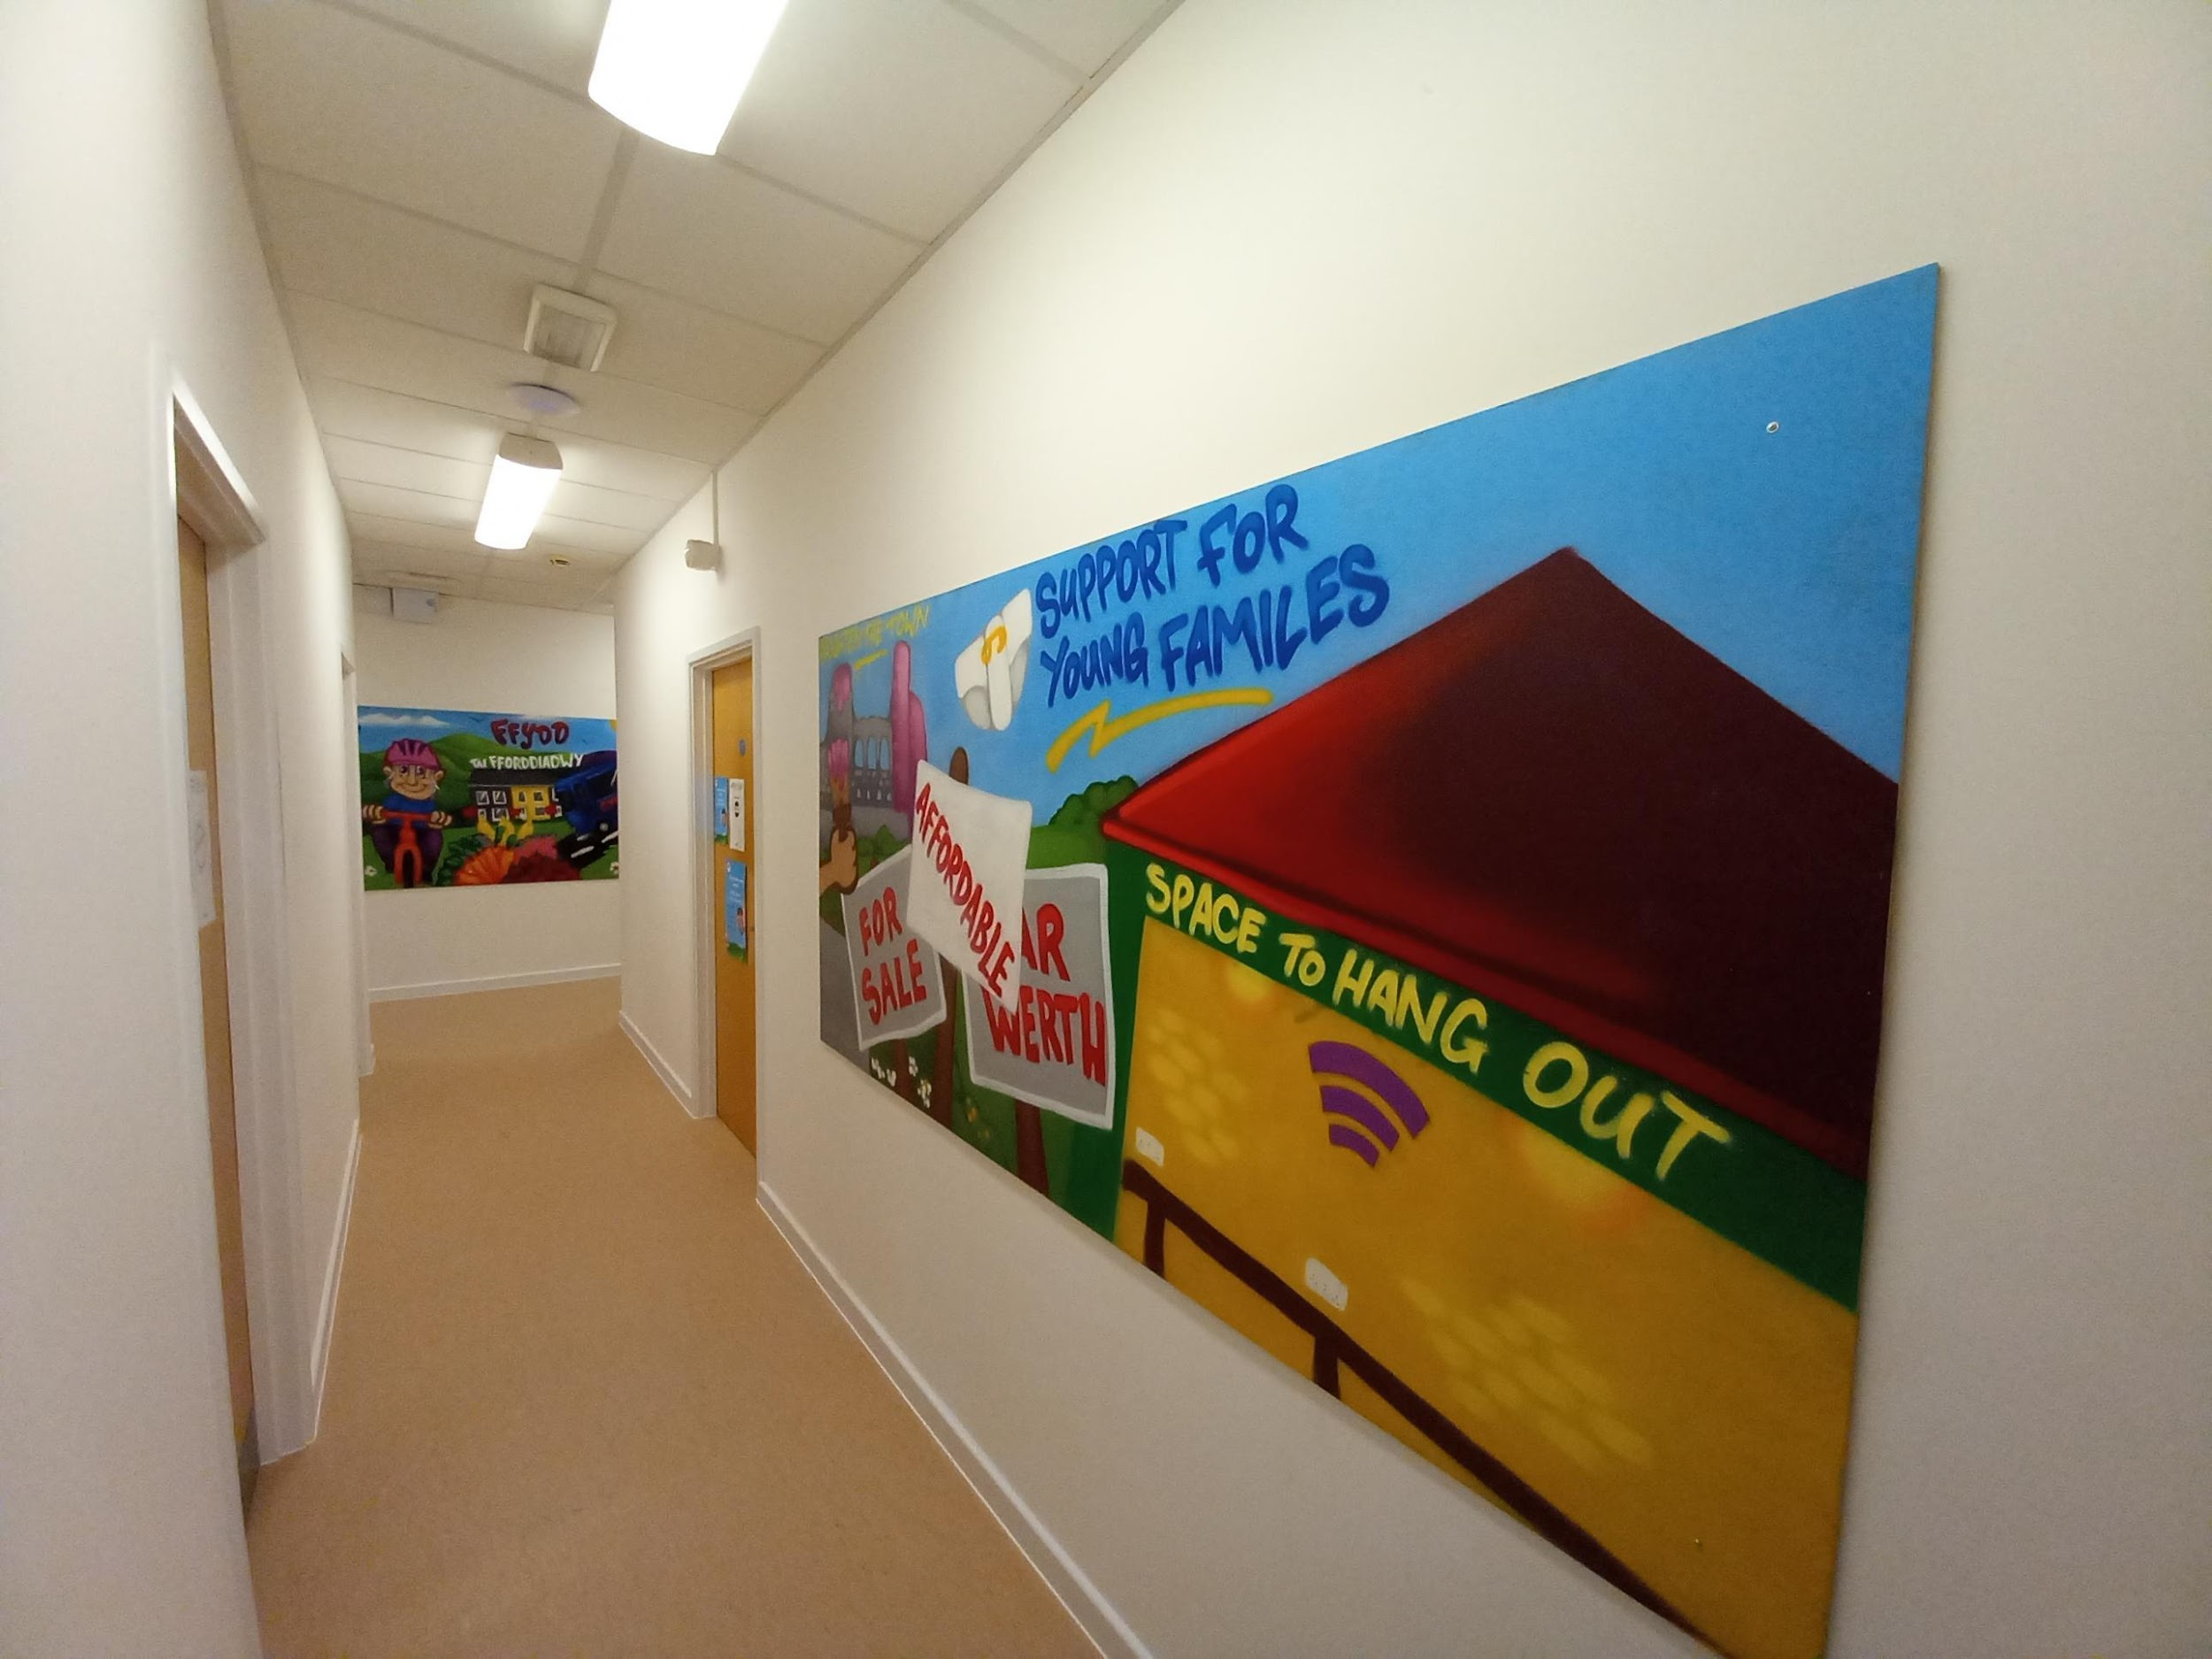
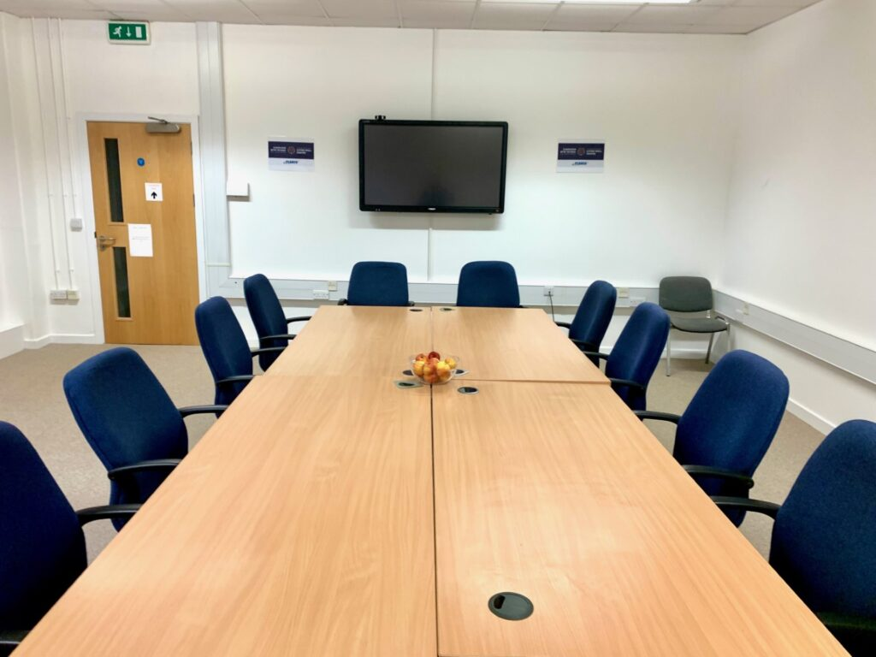
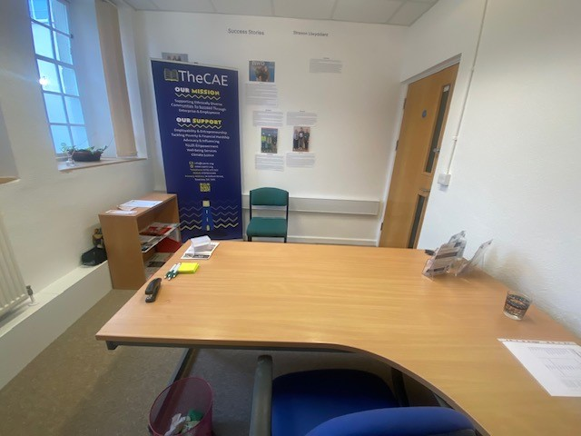
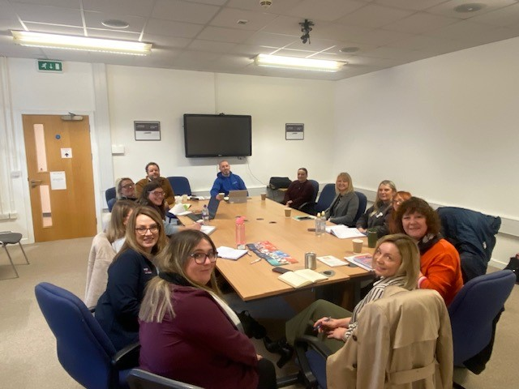
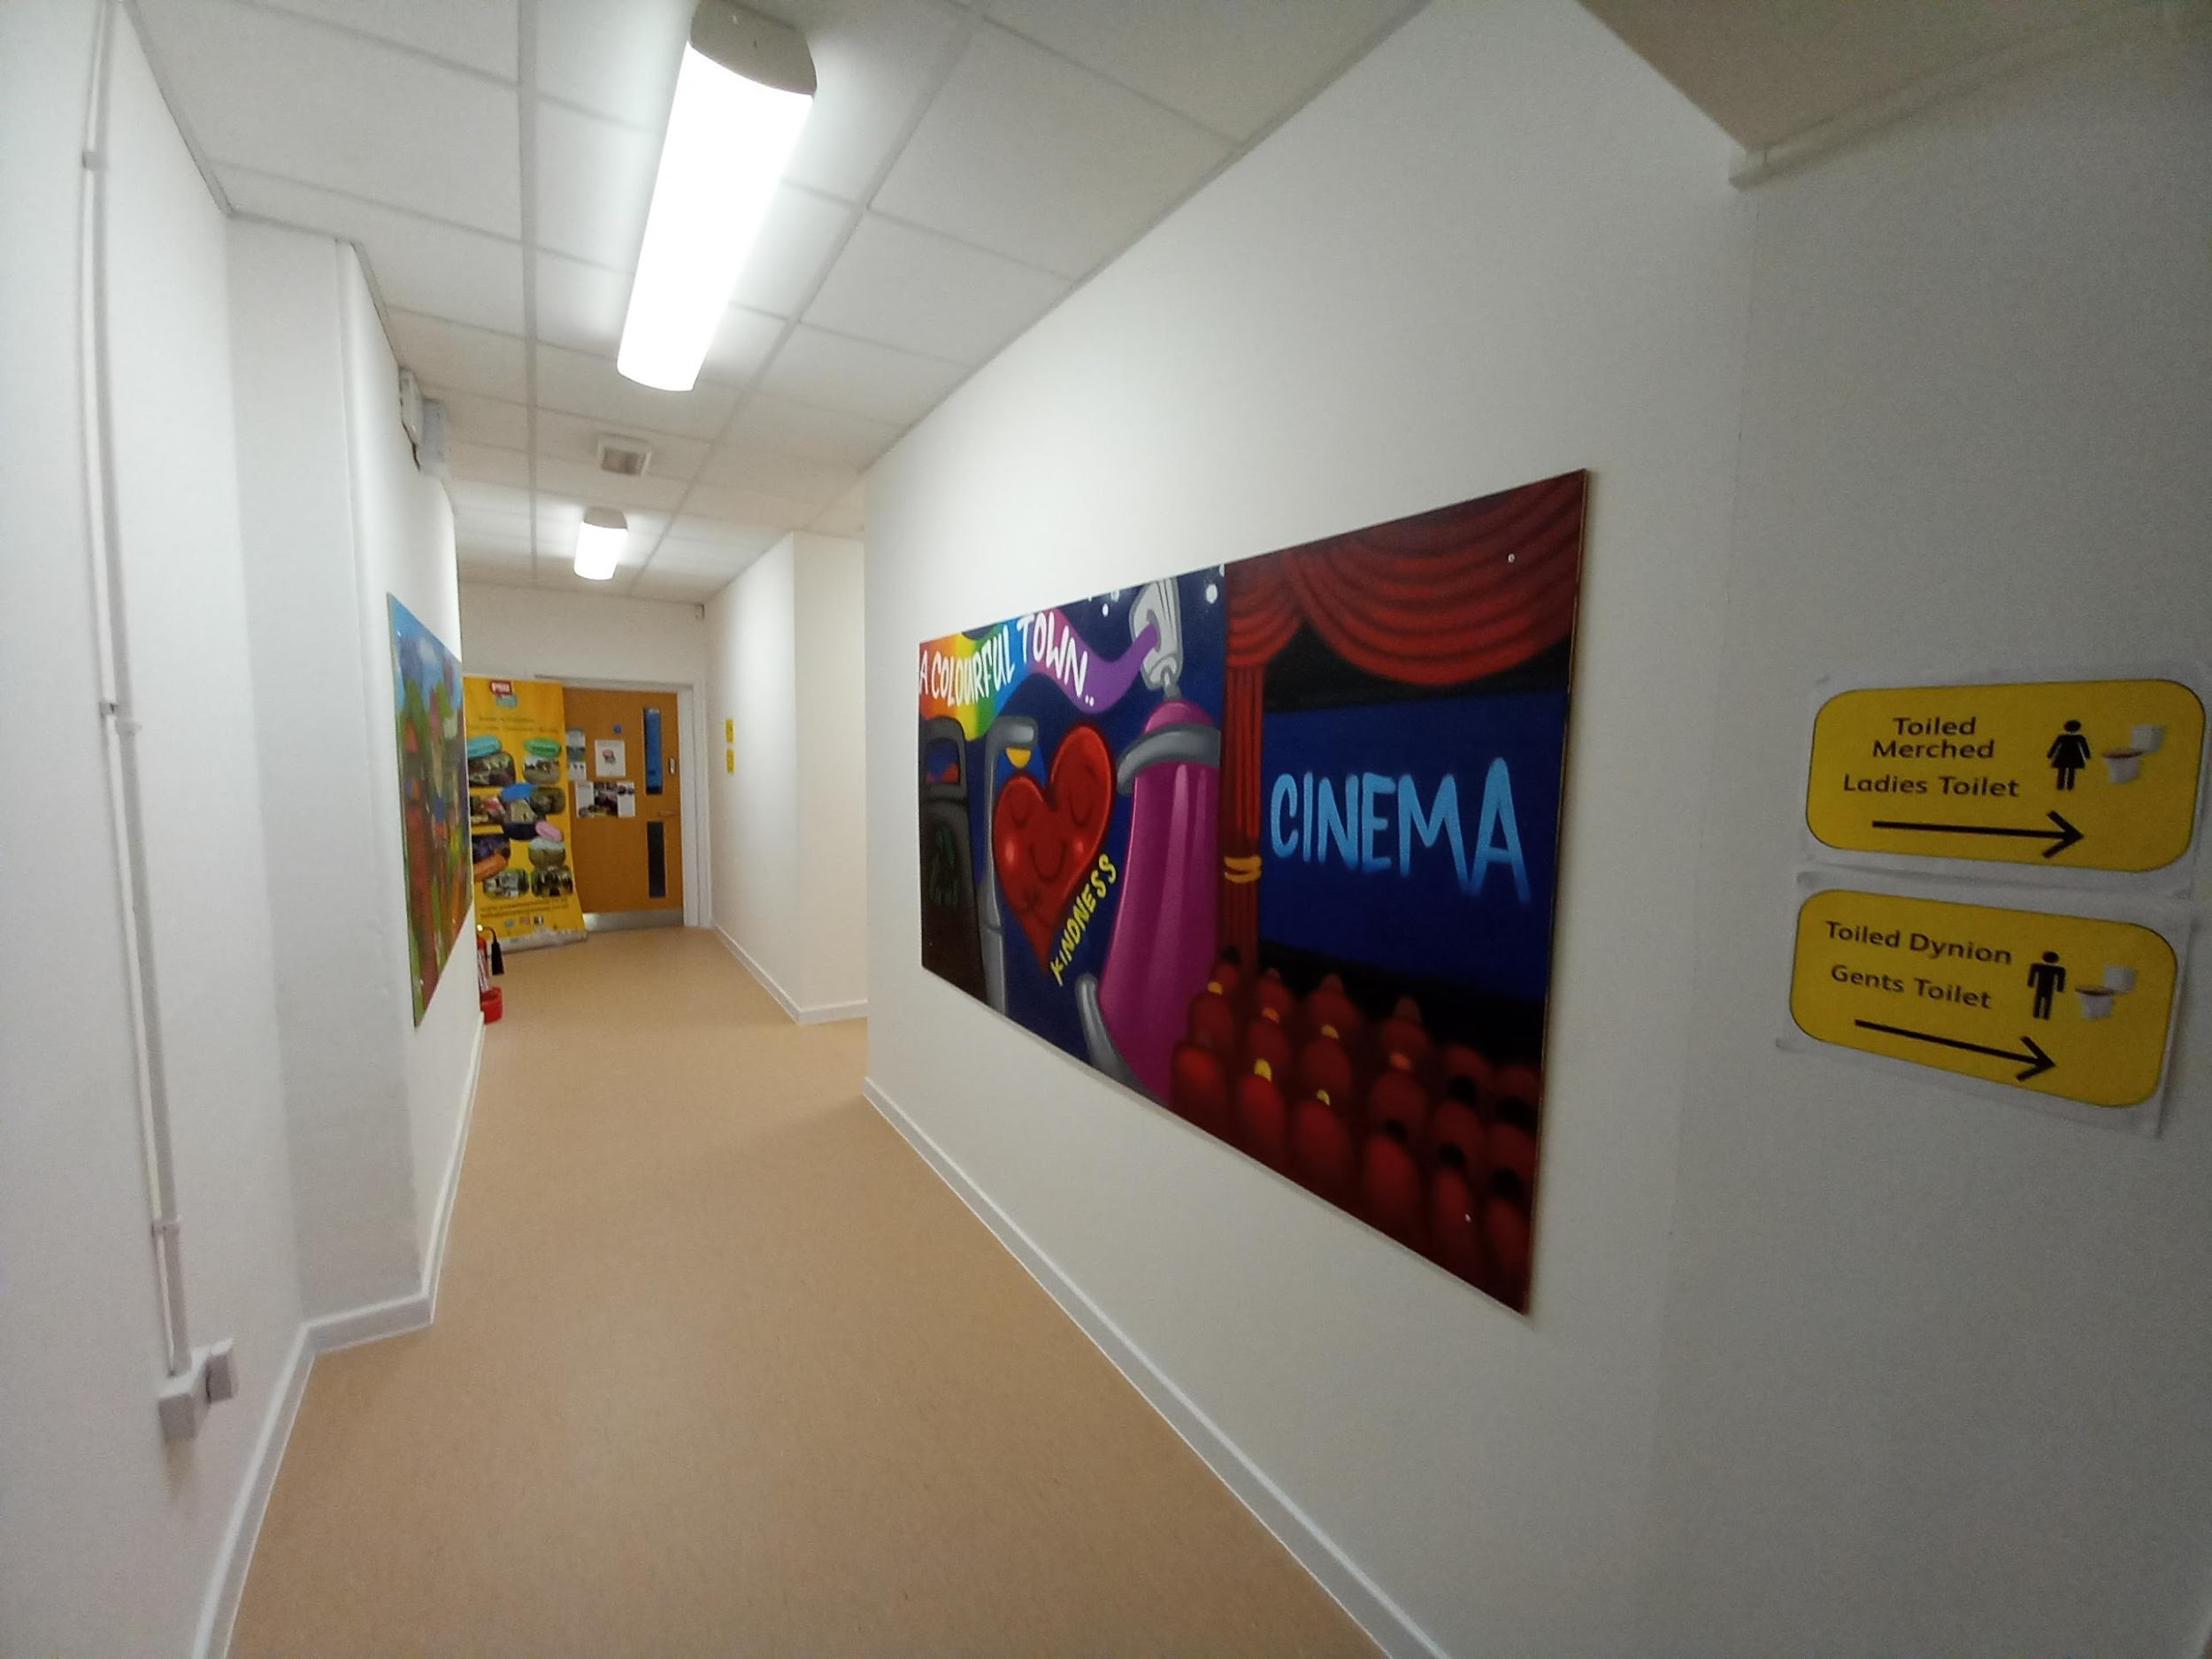
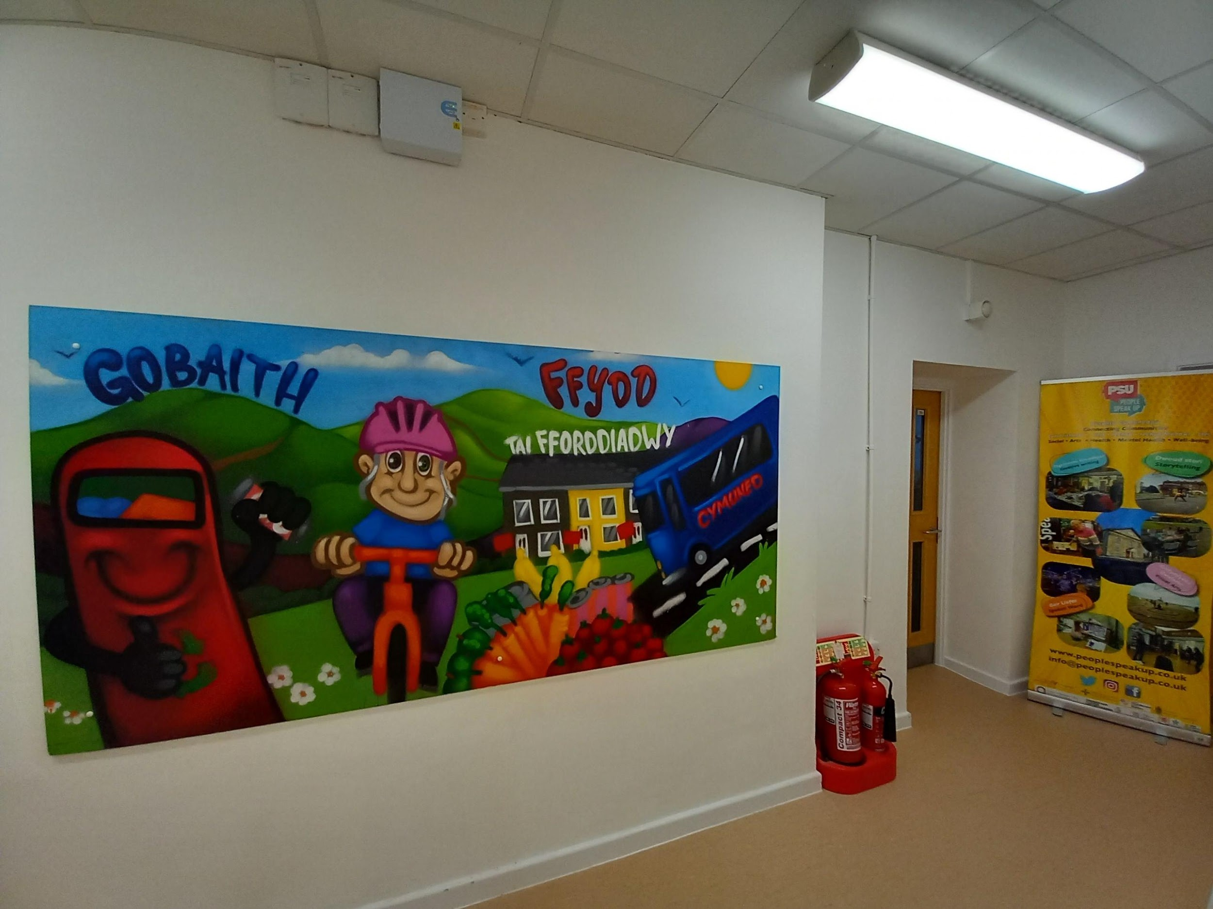
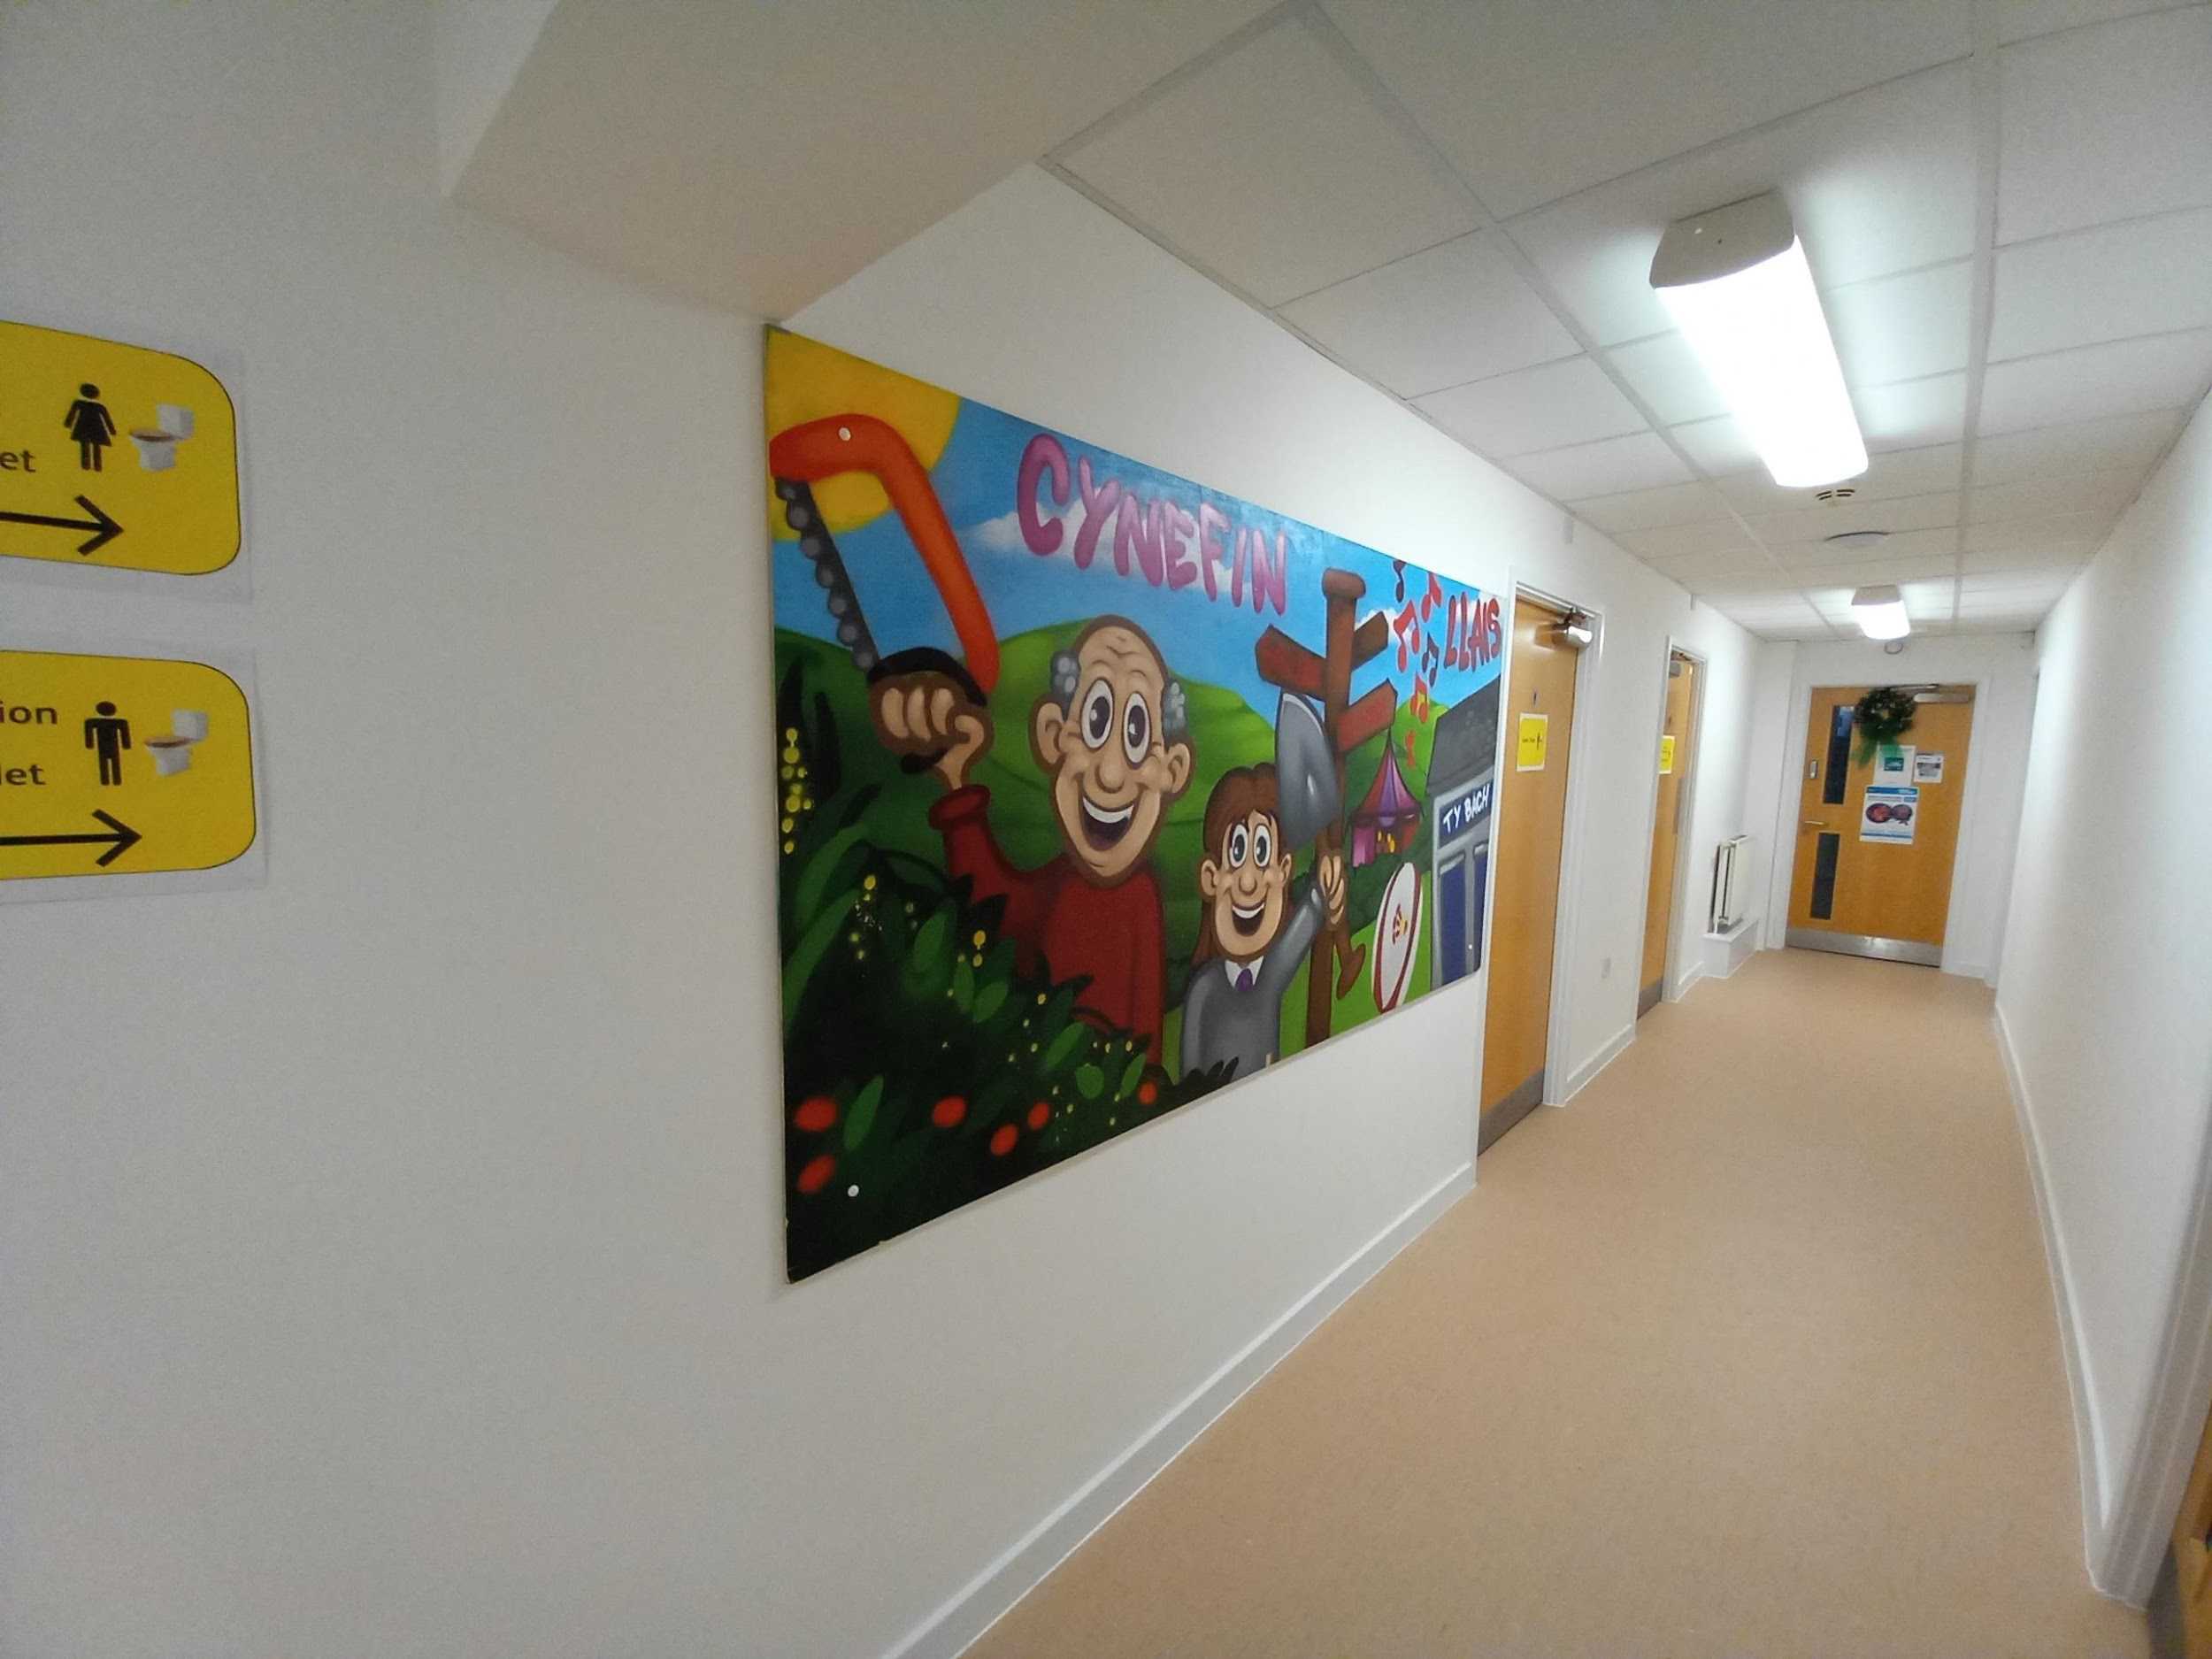
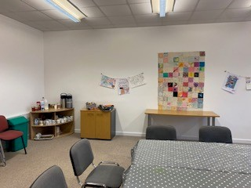
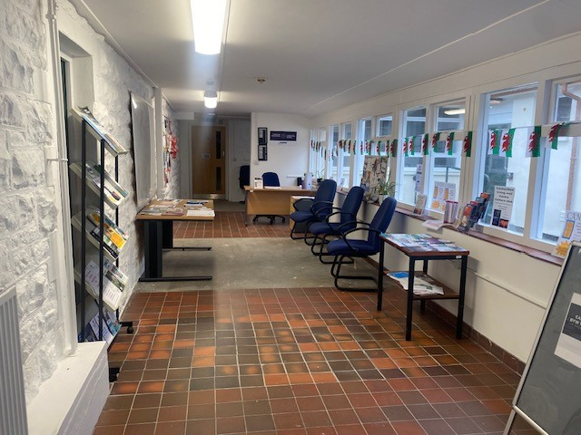
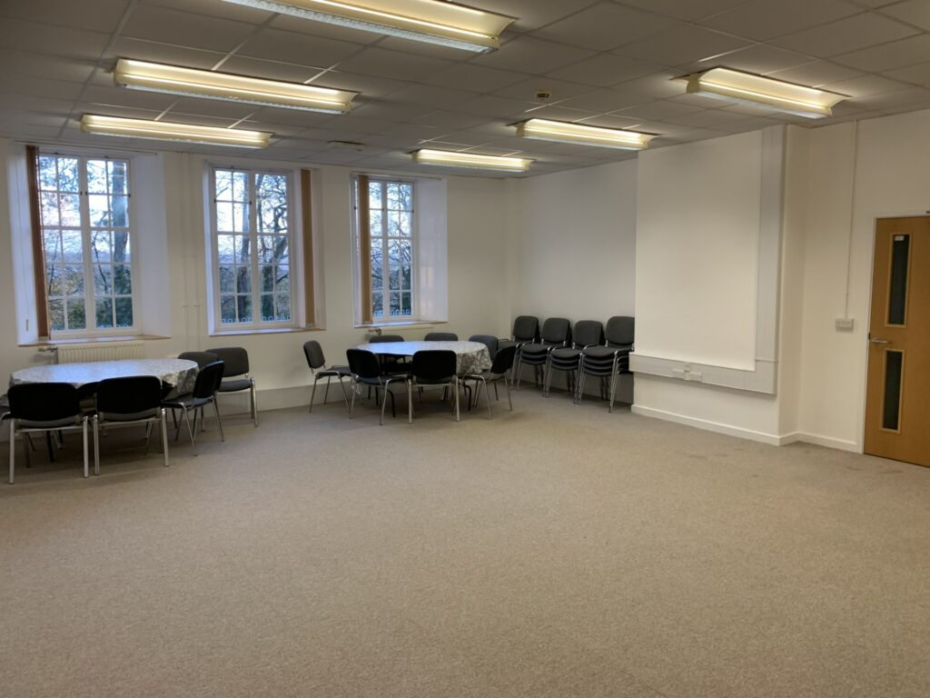
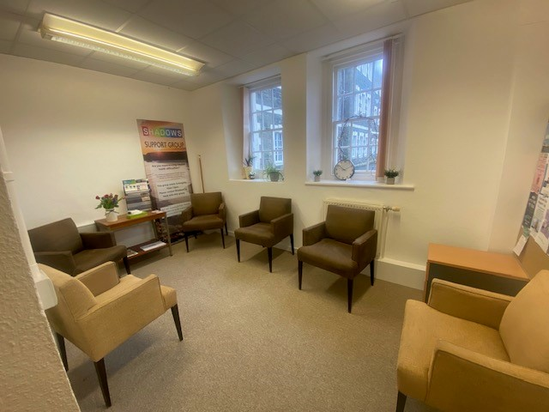

Slide 12
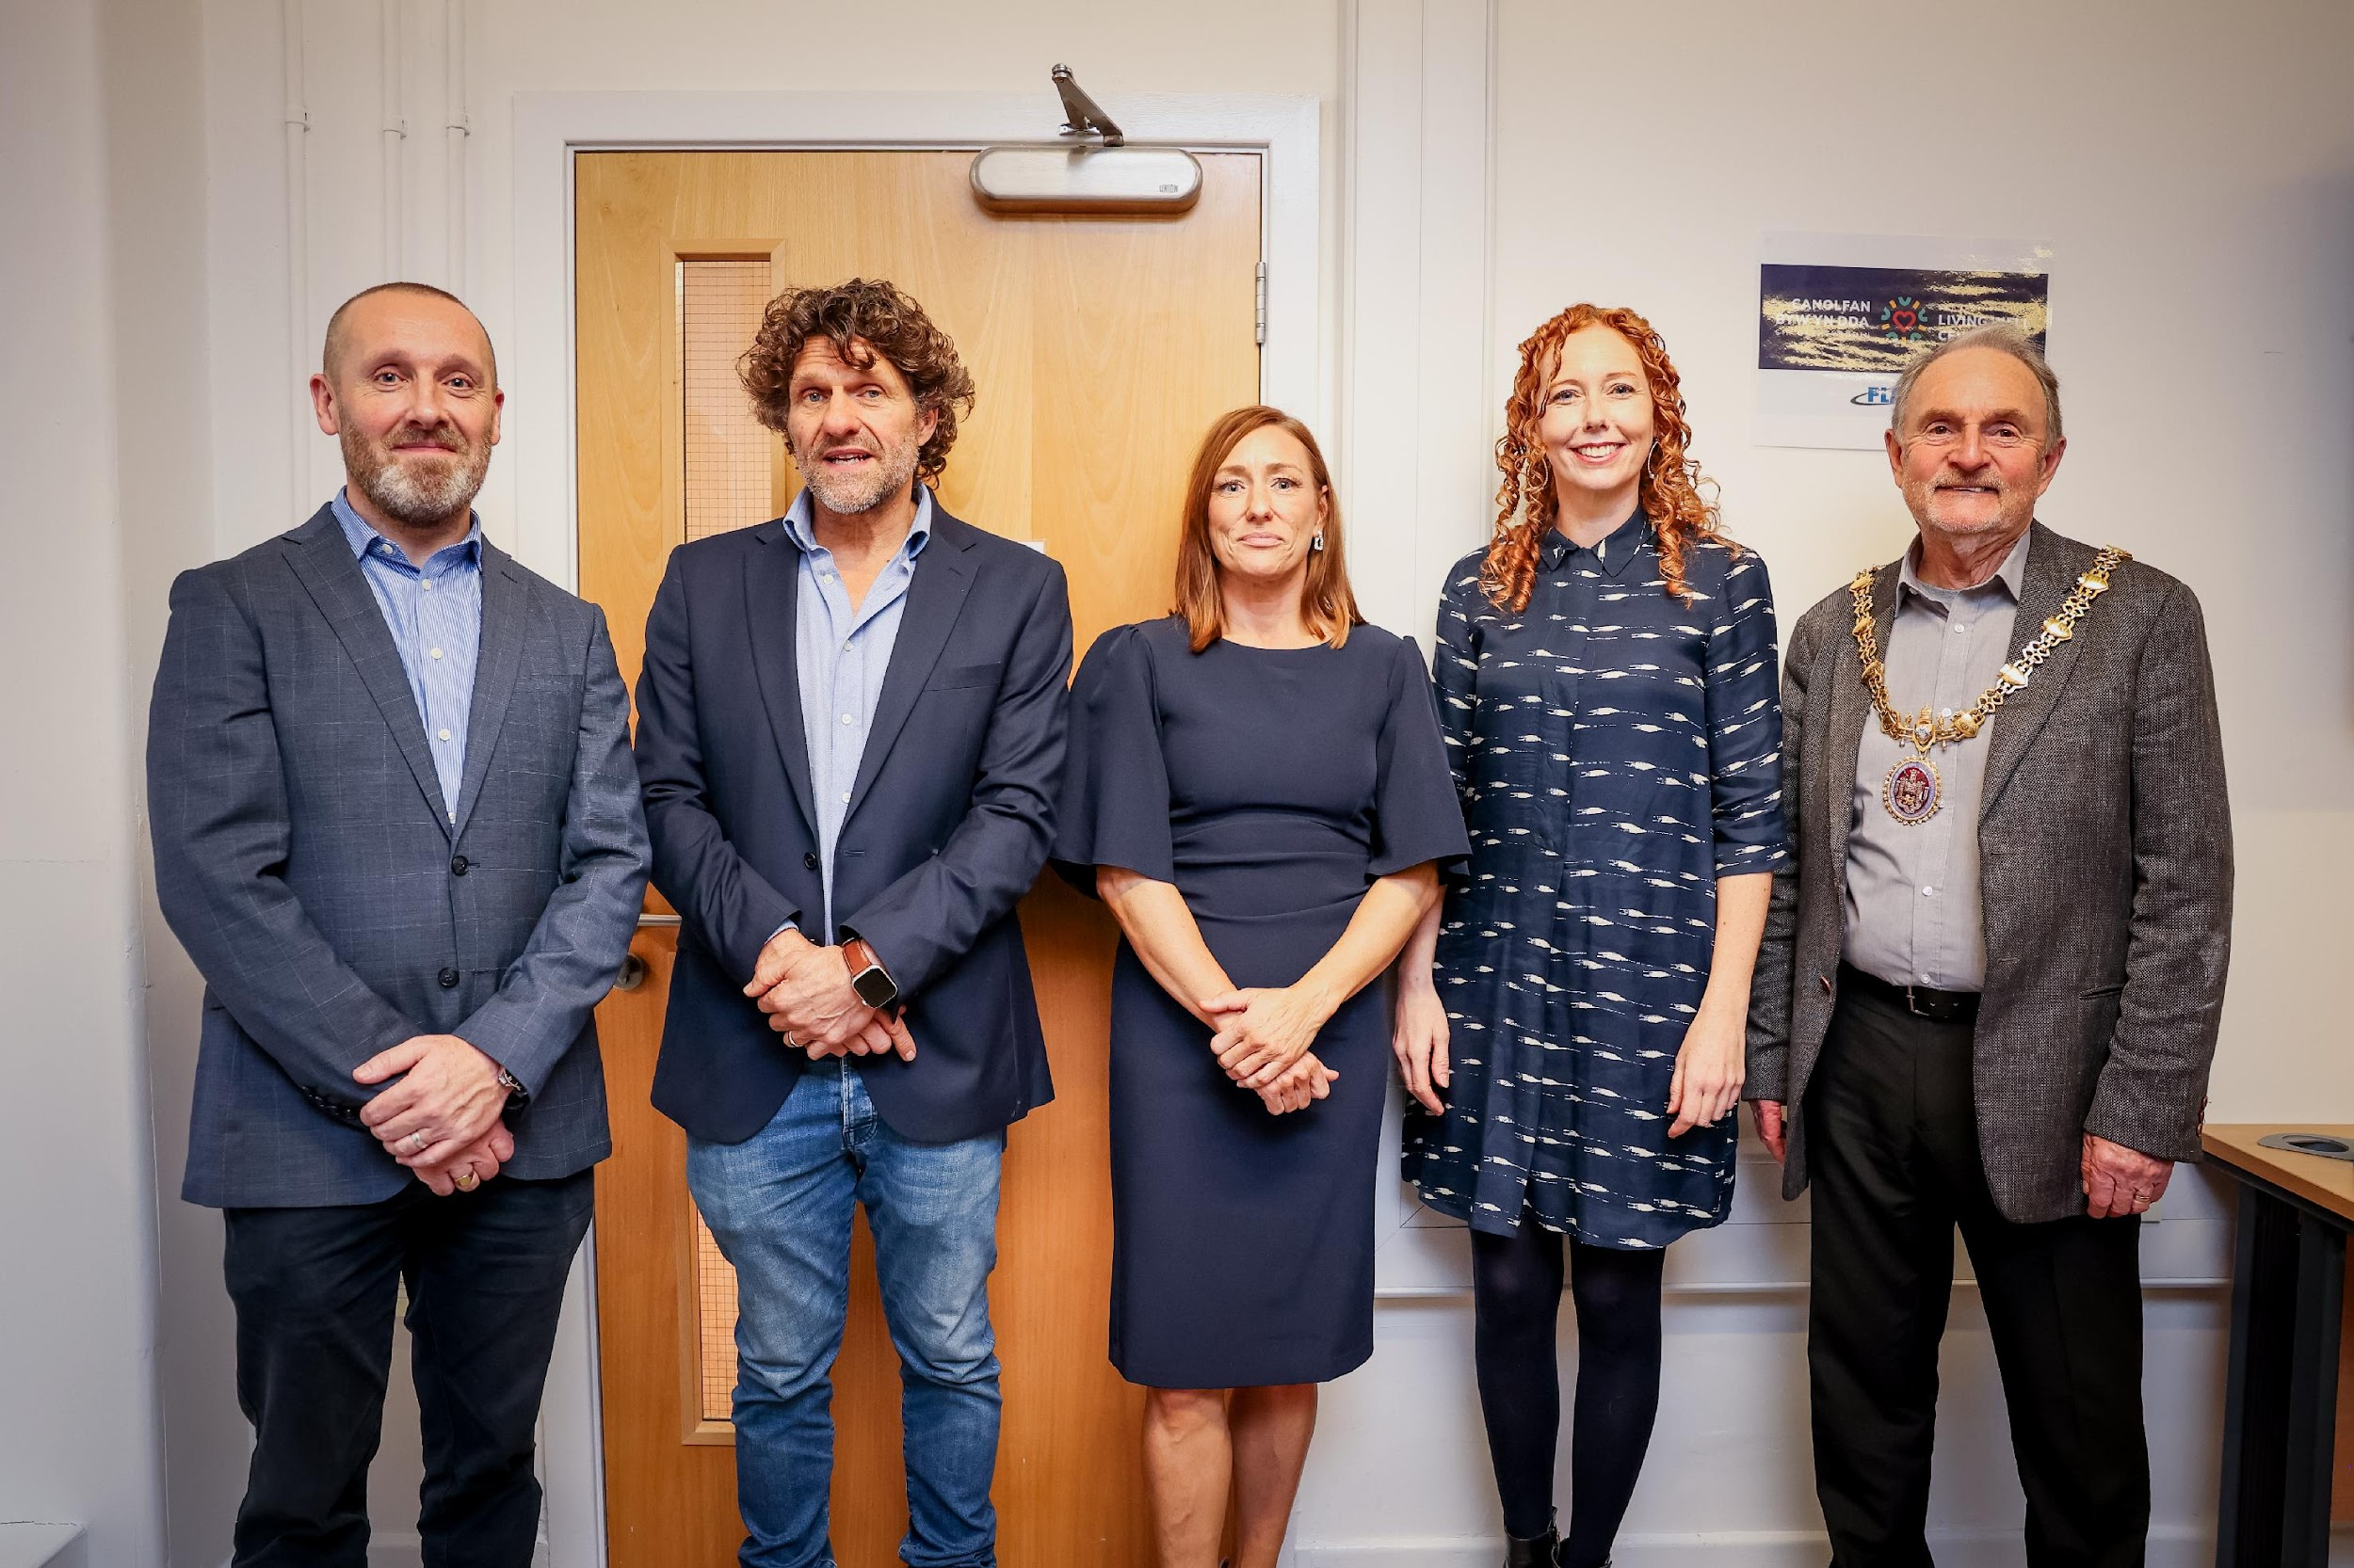
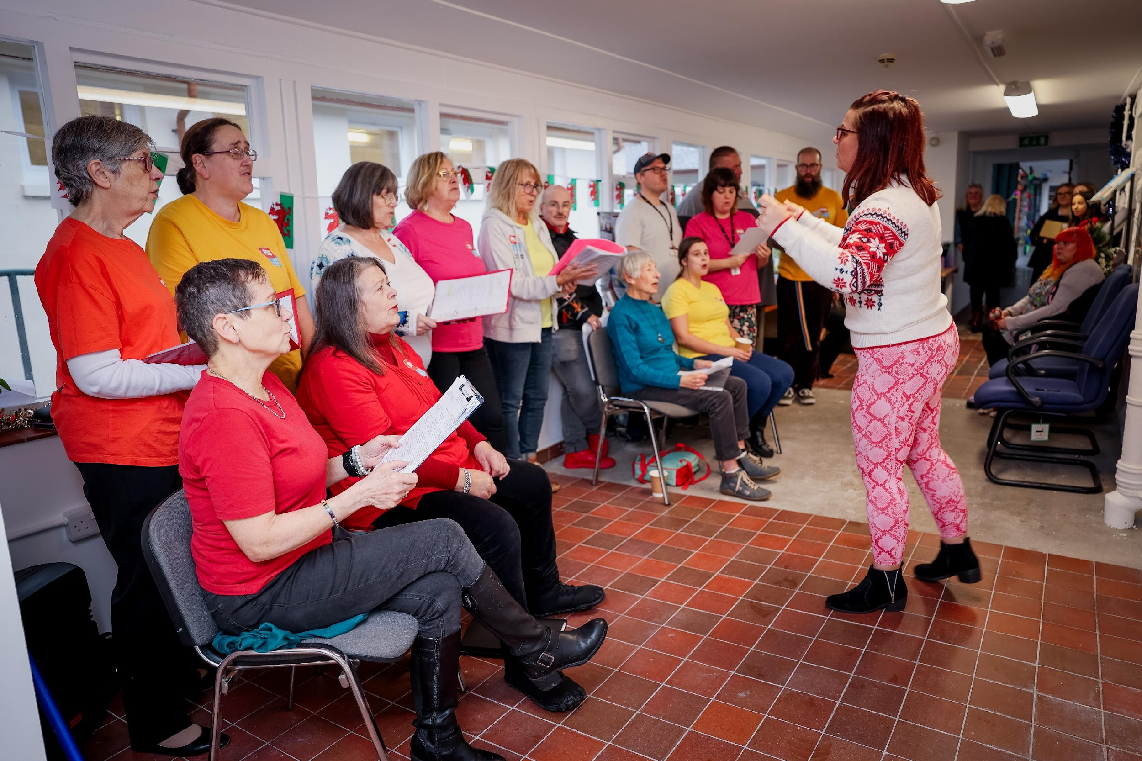
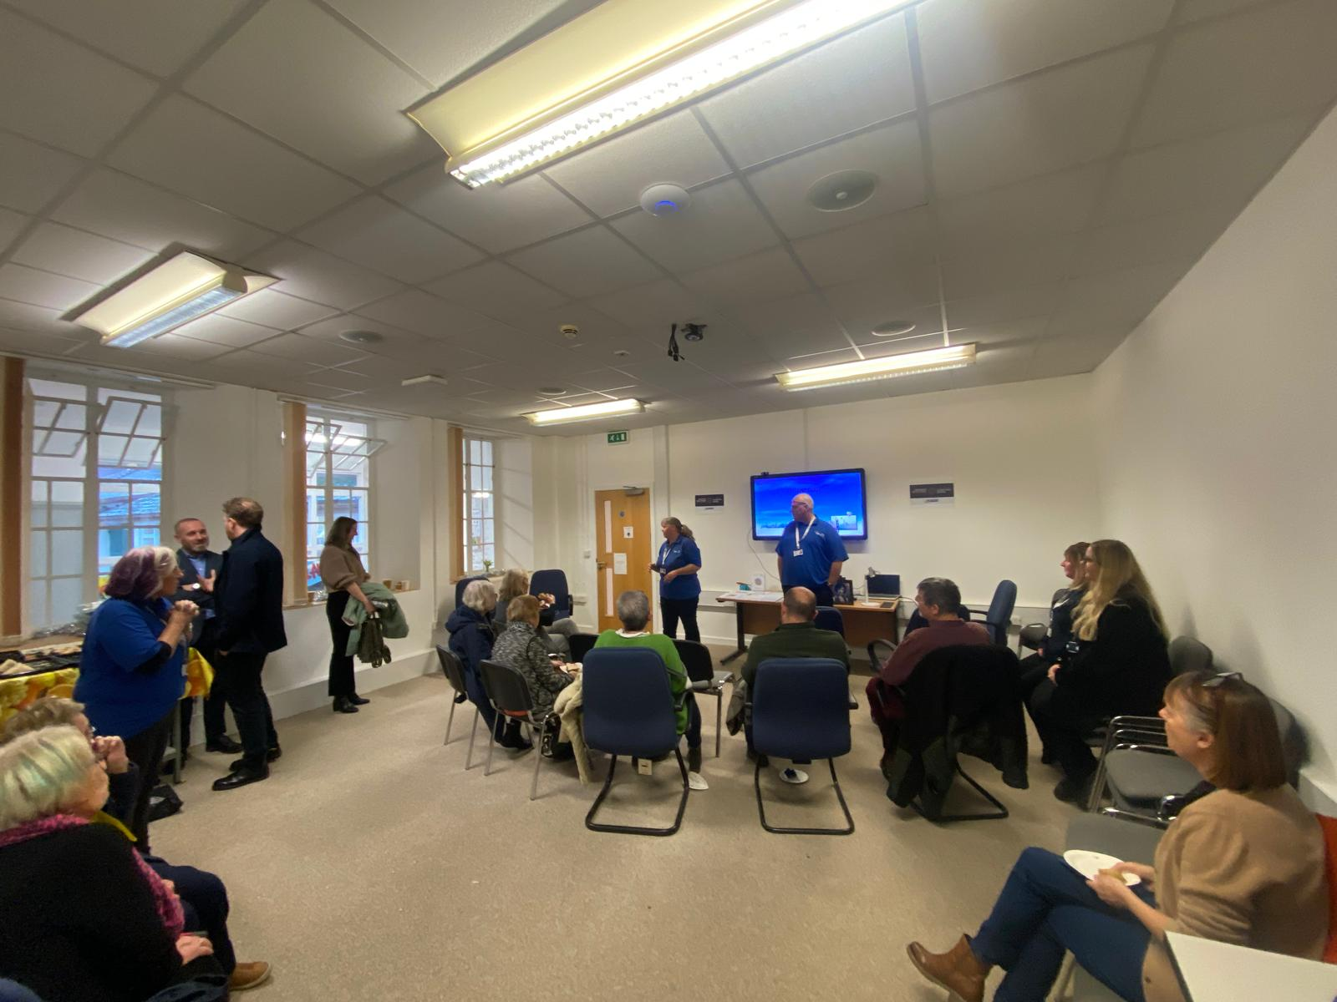
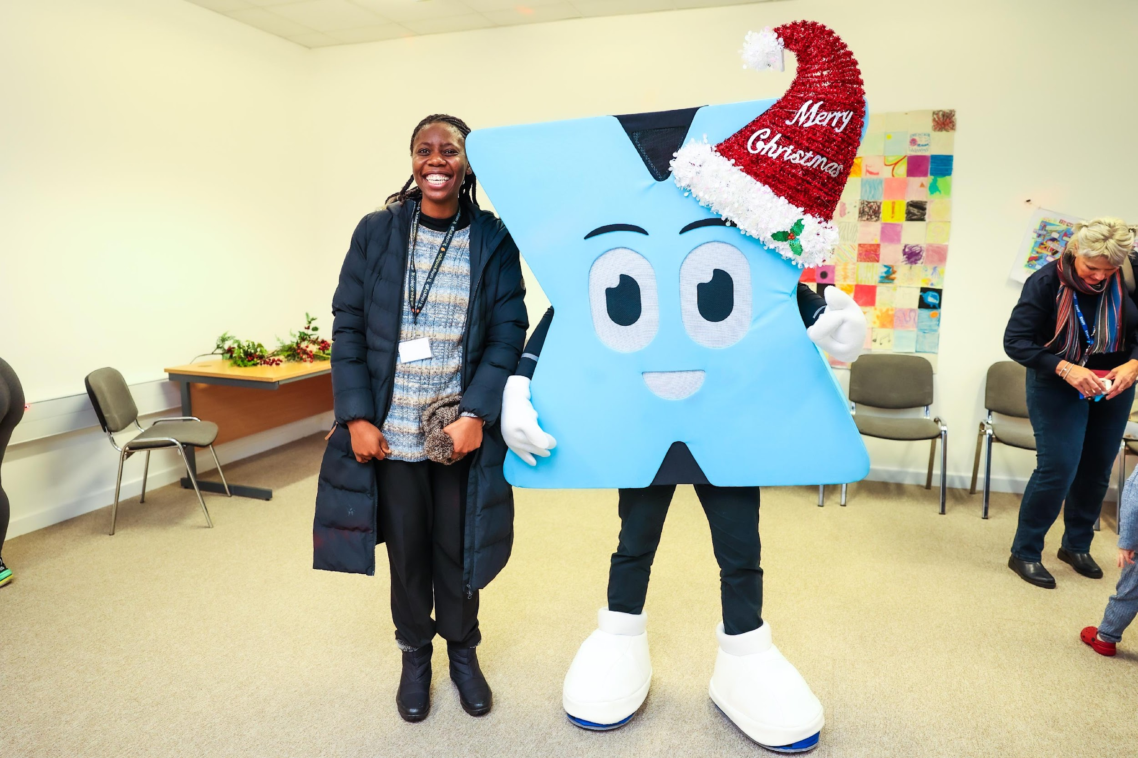
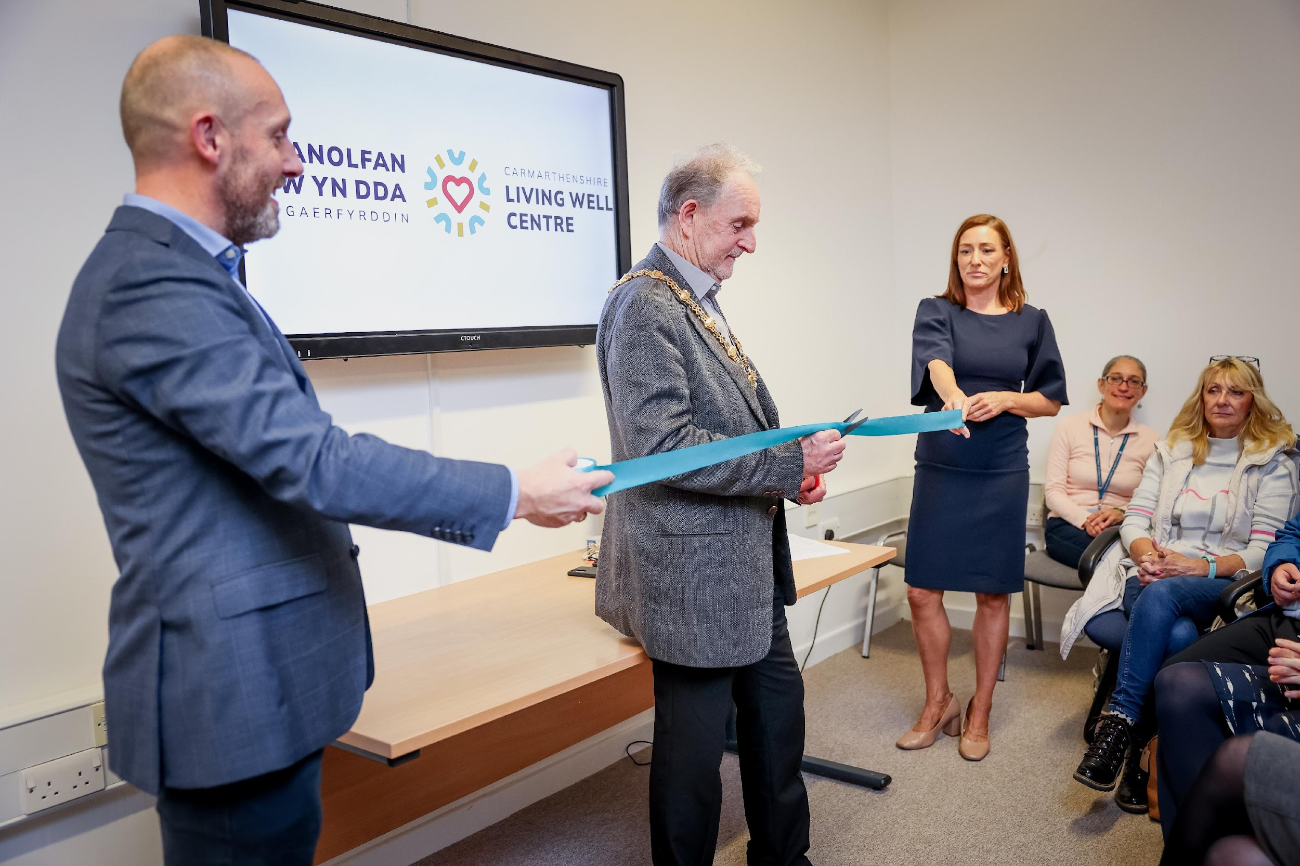
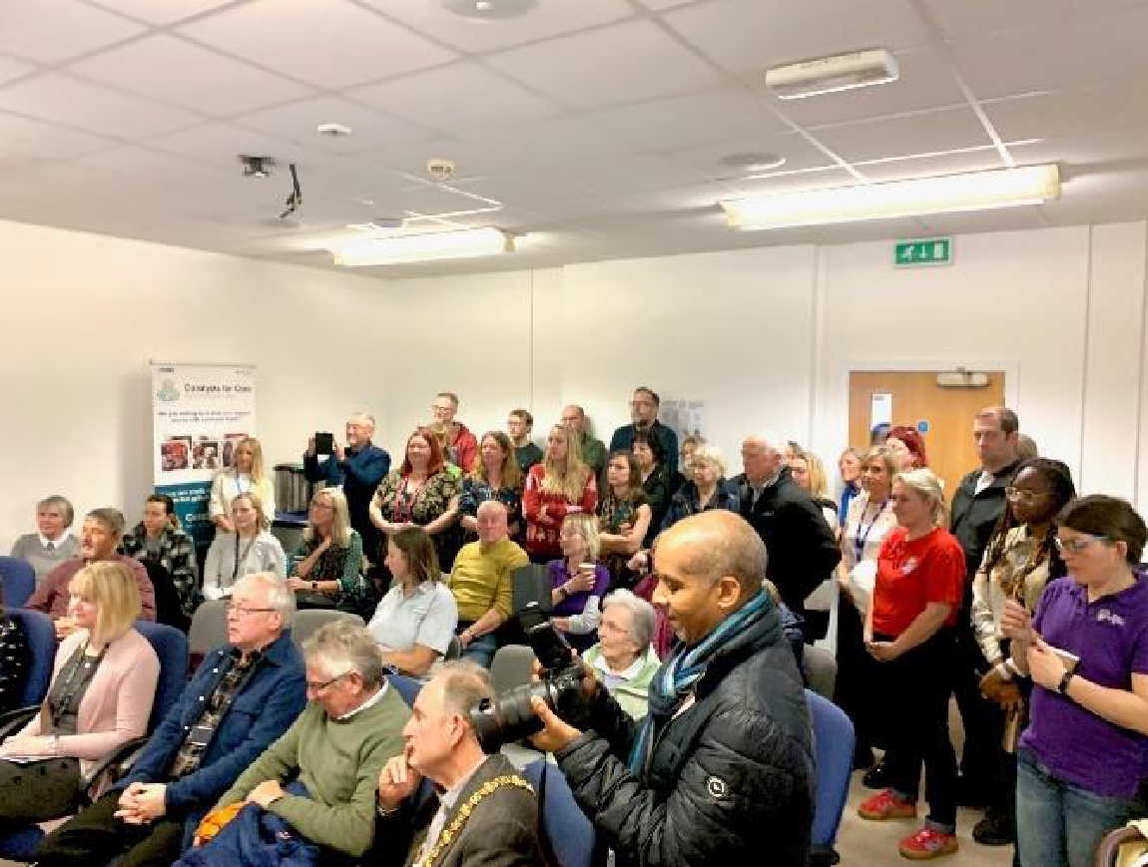

Slide 13
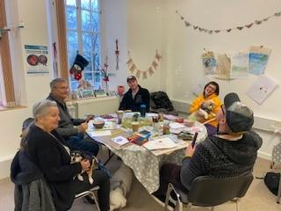

















PICTURE SLIDE
20XX

Slide 14







Slide 15
NEXT STEPS……
•Develop groups / tenants/events (Hwb/Marie Curie/Walking Group)
•Day Opportunities
•Develop garden project
Facilitated sessions to learn skills – build a shed, benches, make planters
Learn how to grow food and be sustainable – keep produce
Learn how to cook healthy meals (café – cooking sessions)
Nutrition advice and courses
How to cook on a budget / manage money

Slide 16













Slide 17
THANK YOU!
Lucy Cummings

