Slide 1




Dementia Friendly Communities in West Wales
Sophie Buckley
Pembrokeshire Strengthening Communities Programme Manager
PAVS (Pembrokeshire Association of Voluntary Services)
CVC/Third sector representative on West Wales Regional Dementia Steering Group
Vice Chair of West Wales Carers Development Group
PAVS 4 pillars
GOOD GOVERNANCE
Our PAVS Values
Excellence
Inclusiveness
Enthusiasm
Innovation
Collaboration
Kindness

Slide 2

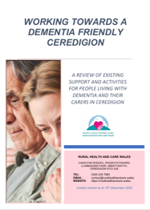


What is a Dementia-Friendly Community?
“A dementia friendly community can be defined as a place or culture in which people living with dementia and their carers are empowered, supported and included in society, understand their rights and recognise their full potential” (Alzheimer’s Disease International, 2016).
“An inclusive and accessible community environment, with enhanced opportunities for participation, health and safety, ensuring a good quality of life and dignity for people with dementia and their families” (World Health Organisation, 2017).
A place where people with dementia:
Feel understood
Can stay active and connected
Remain part of everyday life
Dementia is not just a health issue - it’s a community issue
Can impact:
  Isolation
  Carer stress
  Loss of independence

Slide 3
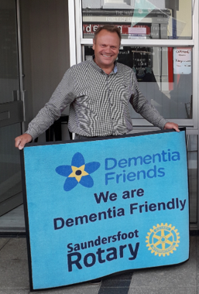
What Makes a Community “Dementia-Friendly”?
Awareness & Understanding Dementia Friends sessions Staff training in shops, police, libraries | Inclusive Places & Services Clear signage Friendly customer service Flexible support
Connection & Belonging Peer groups Intergenerational activities Arts and culture | Support for Carers Respite Advice Emotional support
Co-production People living with dementia shaping services “Nothing about us without us”

Slide 4
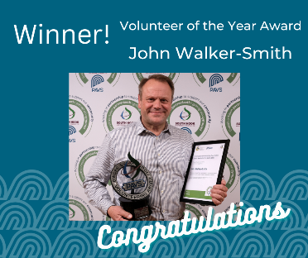

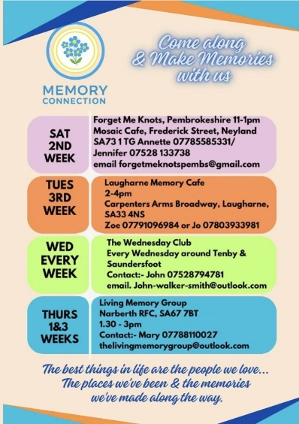
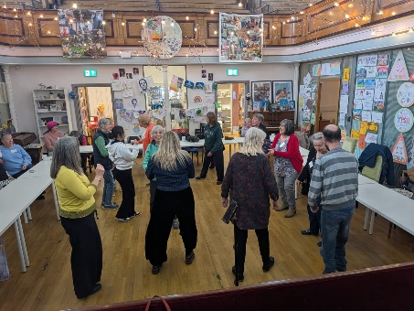
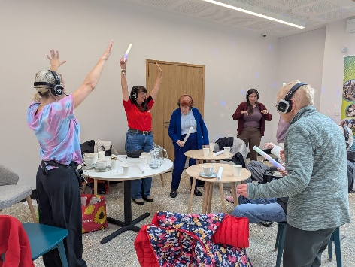
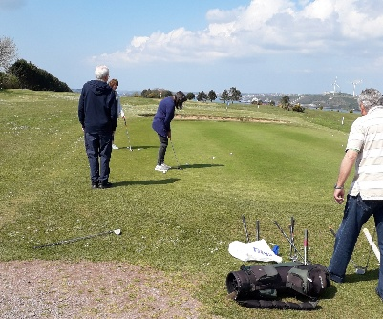
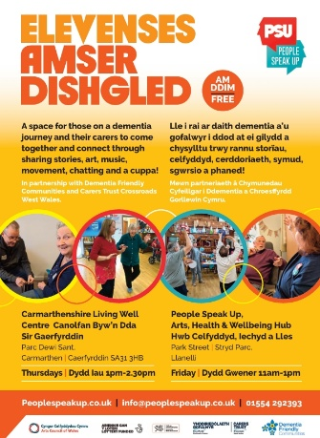

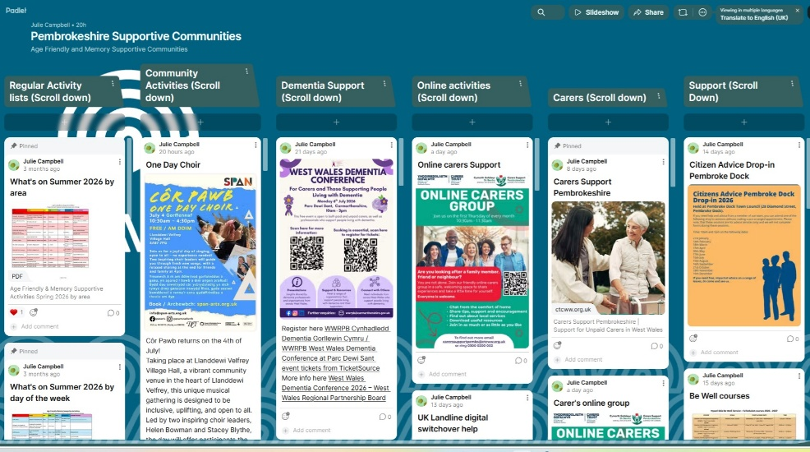
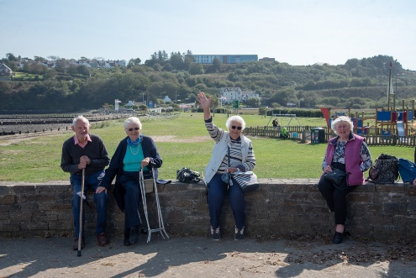
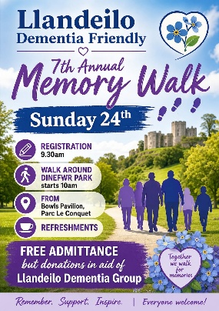
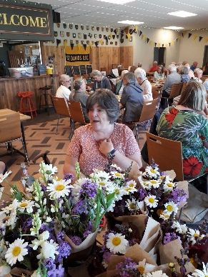
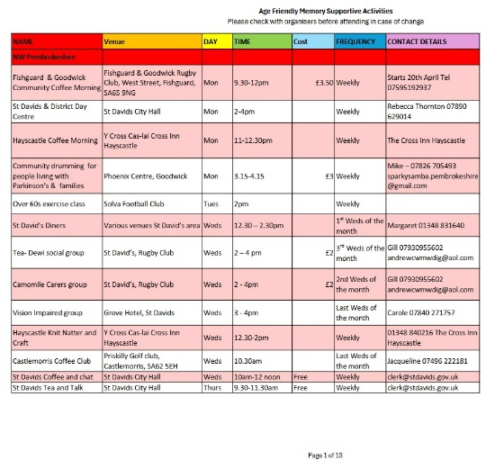
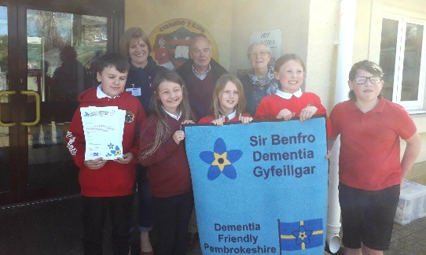
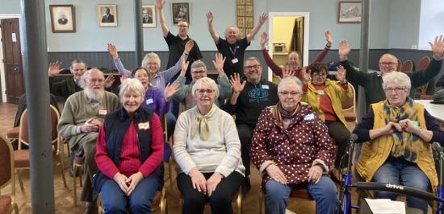
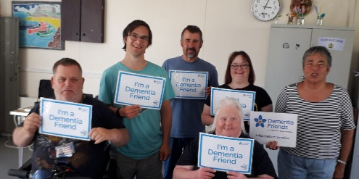
What’s happening in communities in West Wales?
  “We already have strong foundations”

Slide 5
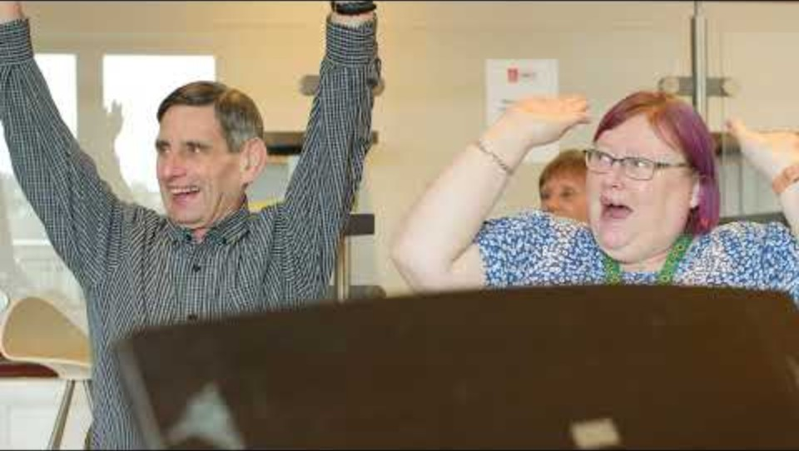
What difference can Dementia Friendly communities make?
With thanks to the WNO Cradle choir in Milford Haven (and Llandeilo) and David Fortey, WNO

Slide 6
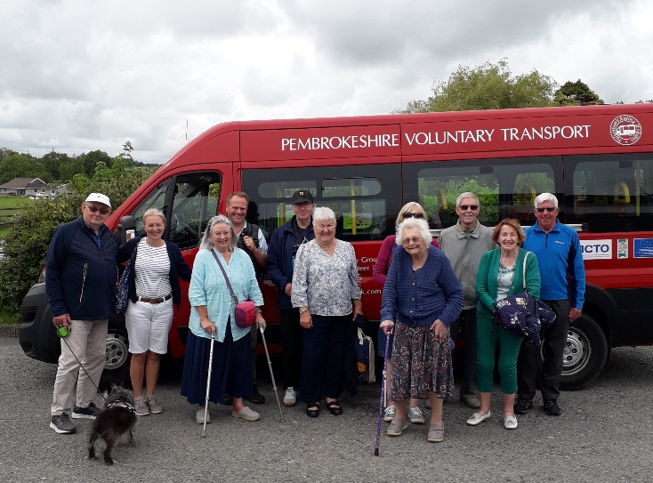
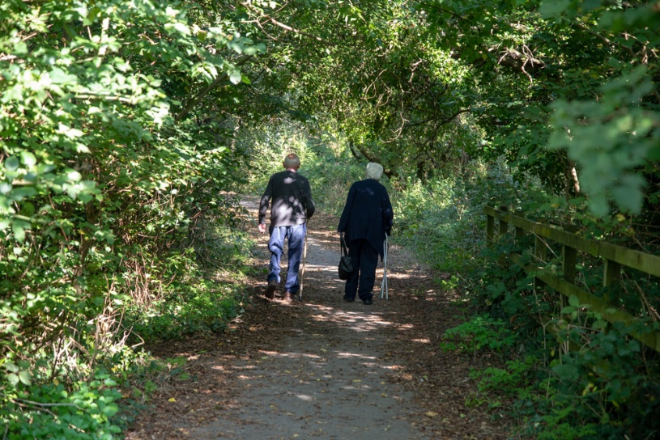
Challenges in West Wales
Rural isolation
Transport barriers
Awareness gaps
Funding
Fragmentation between services

Slide 7
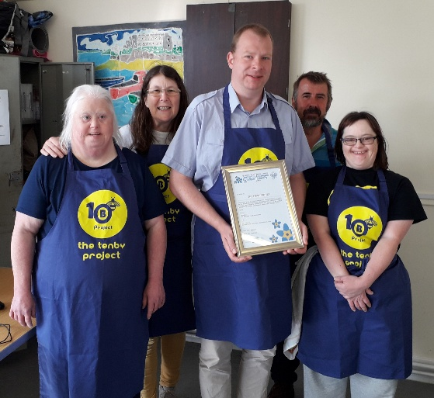
What can YOU do to help?
Organisations:
Make one service dementia-friendly this year
Partner locally
Individuals:
Become Dementia Aware through training
Change how you interact (patience, time)
System:
Join up services
Listen to lived experience (including unpaid Carers and family members)

Slide 8
A dementia-friendly community isn’t something we build for people - it’s something we build together. And across West Wales, we’re already on that journey.
sophie.buckley@pavs.org.uk
Tel. 07523 512 975
Thank you for listening
Diolch

