Slide 1


Fframwaith Dysgu a Datblygu Dementia
Dementia Learning & Development Framework
Rhianydd Barnes

Slide 2
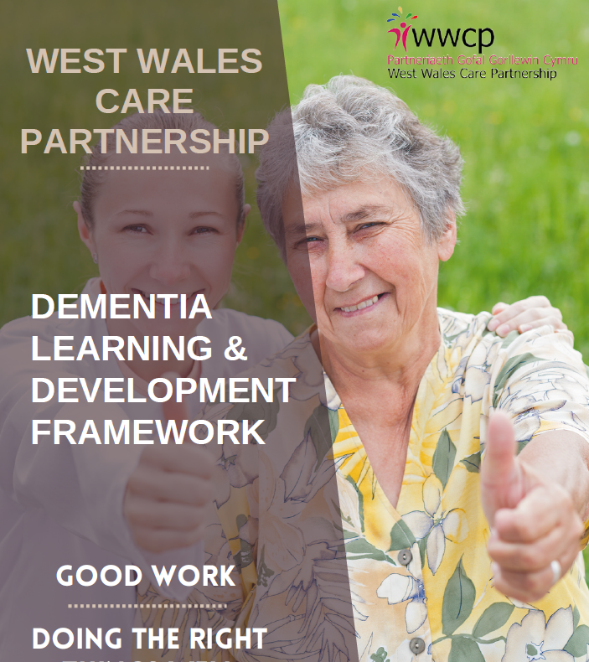

Original Framework
Fframwaith Gwreiddiol
Notes:
Commissioned out to independent company.
They developed the document by consulting with certain people – not individuals who are experts in the field. Consultation was weak (i.e. only certain sections were sent out for review).
Over 80 pages log
Pages were very busy and difficult to focus on with links throughout
Was not clear with sweeping statements throughout, not evidence based.
Only available in an interactive format.

Slide 3

Soft Launch Lansiad Meddal
Notes:
Beca identified a team in health to trial and Hafan Y Waun in Ceredigion kindly agreed to trial the framework.

Slide 4
Iechyd
Mae'r ddogfen yn rhy hir.
Roedd y ddogfen yn rhy brysur ac yn drysu.
Roedd y broses yn cymryd gormod o amser.
Gofal Cymdeithasol
Mae'r ddogfen yn rhy hir i'r staff uwch ei gwblhau.
Ar ôl cyfnod o 3 mis, methasant â gweithredu'r fframwaith.
Health
Document too long.
Document was too busy and confusing.
Process was too time consuming.
Social Care
Document was too long for senior staff to get through.
After a 3-month period they failed to implement the framework.
Notes:
Soft Launch Feedback.
Feedback from service users (i.e. care home manager) was that:
the document was too long
pages were very busy and difficult to focus on
Language was not accessible
Not clear what they should do with it / how it could be used
Too time consuming and thus unlikely to use
WS5a – based on the feedback, agreed that it needed to be reviewed and done differently - a task & finish group was established, with a more collaborative approach to design and development. Specialists in the field were also involved to ensure that the information in the document was informed by research and evidence, but also the most up to date (at time of writing).

Slide 5

Task & Finish
Group
Grŵp Tasg a
Gorffen

Slide 6
Task & Finish Group
Representative from:
Health, Carmarthenshire, Pembrokeshire and Ceredigion.
Aim to simplify and reduce the size of the document.
We then presented changes to a group of professionals working in Health & Social Care.
Grŵp Tasg a Gorffen
• Cynrychiolaeth o:
Iechyd, Sir Gaerfyrddin, Sir Benfro a Cheredigion.
• Nod: symleiddio a lleihau maint y ddogfen.
• Yna gwnaethom gyflwyno’r newidiadau i grŵp o weithwyr proffesiynol sy’n gweithio ym maes Iechyd a Gofal Cymdeithasol.

Slide 7

Feedback Workshop
Gweithdy Adborth
Notes:
Carers
Senior Carers
Home Managers
Assistant Manager
Commissioning Colleagues (Health & Social Care)

Slide 8
Changes Made
(Nov 2025 Workshop)
Newidiadau Wedi Eu Gwneud (Gweithdy Tach 2025)
Simplify language of document (Easy read)
Reduce the size of the document
Split the document into 2x booklets
Use accessible friendly colours (tiers)
Spread the tiers over 3 pages, making it more accessible and easier to navigate
More variety in photos, to represent all ages and cultures
Name of the Dementia L&D Framework, change to Guide
Symlhau iaith y ddogfen (Darllen hawdd)
Lleihau maint y ddogfenm
Rhannwch y ddogfen yn 2 lyfryn
Defnyddia liwiau cyfeillgar hygyrch (haenau)
Lledaena'r haenau dros 3 tudalen, gan ei wneud yn fwy hygyrch ac yn haws ei lywio
Mwy o amrywiaeth mewn lluniau, i gynrychioli pob oedran a diwylliant
Enw Fframwaith Dysgu a Datblygu Dementia, newid i Ganllaw

Slide 9
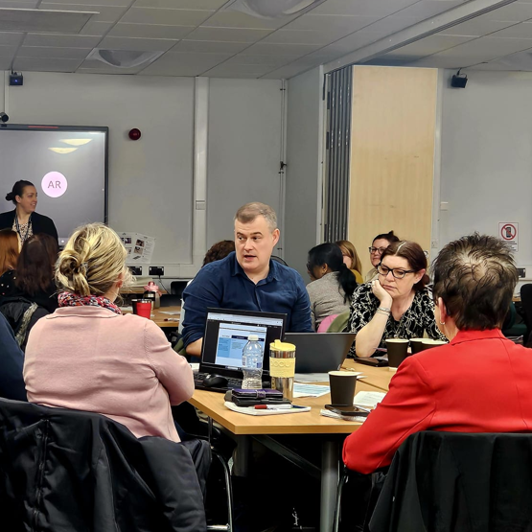
Registered Managers Forum Feedback
Adborth Fforwm
Rheolwyr Cofrestredig

Slide 10
Changes Made (Feb 2026 Managers)
Changes Made (Feb 2026 Managers)
Size of the document - Bitesize
Improve accessibility – More bullet points/tables
Reduce cognitive overload – Bubbles / Colour
More Interaction – Links
More Case Scenarios to support learning – relate to day-to-day
Review Jargon/Acronyms - Health
Maint y ddogfen - Bitesize
Gwella hygyrchedd – Mwy o bwyntiau bwled/tablau
Lleihau gor-lwyth gwybyddol – Bwlbls / Lliw
Mwy o Ryngweithio – Dolenni
Mwy o Sênarios i gefnogi dysgu – cysylltwch â'r dydd i ddydd
Adolygu Jargon/Acronybau - Iechyd

Slide 11
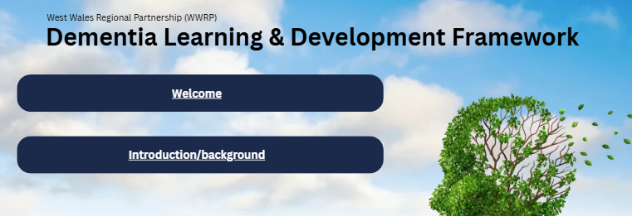
Booklet 1 Llyfryn 1
Notes:
The Introduction Booklet is now only 11 pages long. Condensed down by 6 pages.
Includes a more accessible format and less words.
Outlines – Purpose
Clarifies Tiers

Slide 12
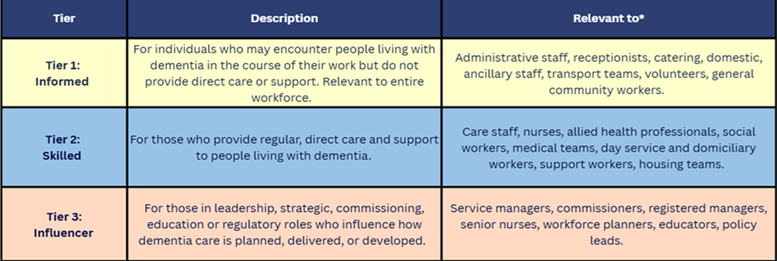
Framework Tier
Descriptors
Disgrifiadwr Haen y Fframwaith
Notes:
Gives a regional and national rational for the framework

Slide 13
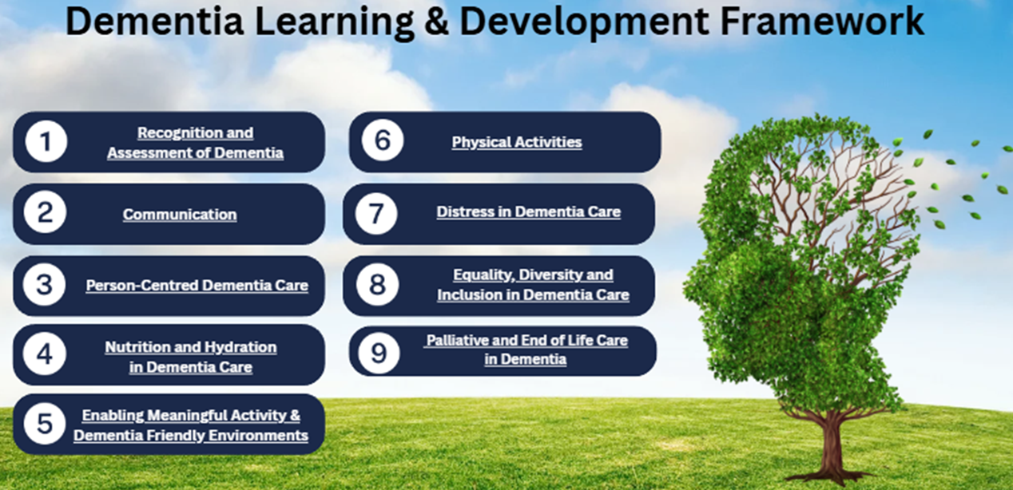
Booklet 2
Lyfryn 2
Notes:
Booklet 2 has 59 pages, increase to accommodate Theme 6 and 8.

Slide 14
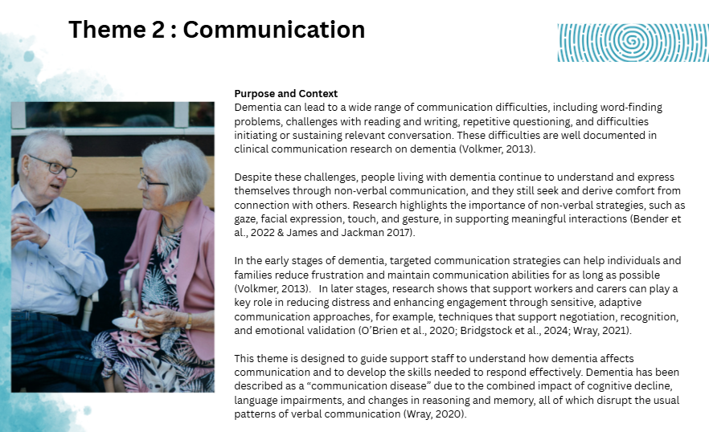
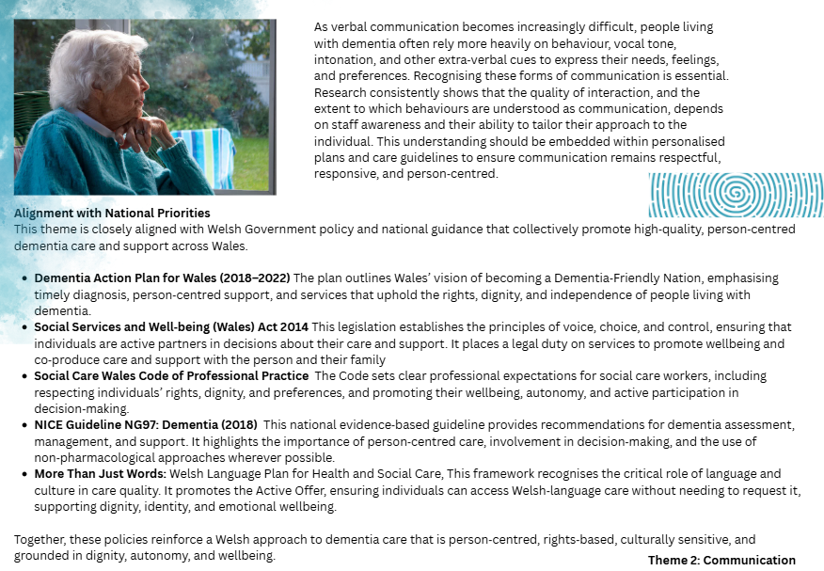
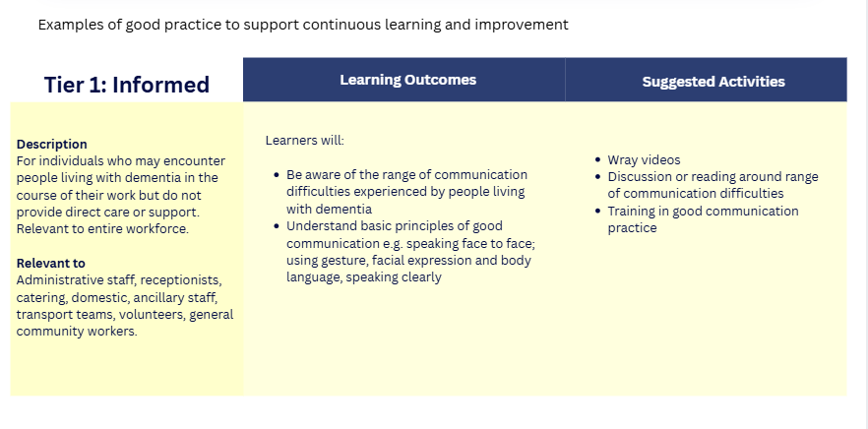
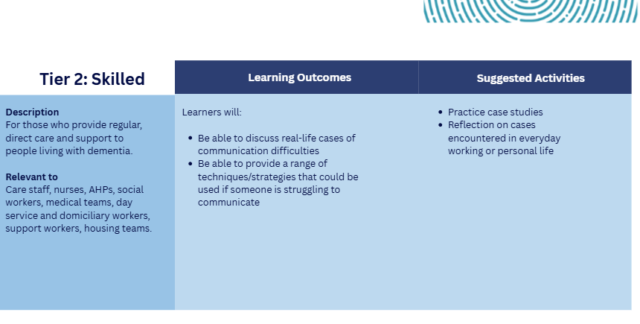
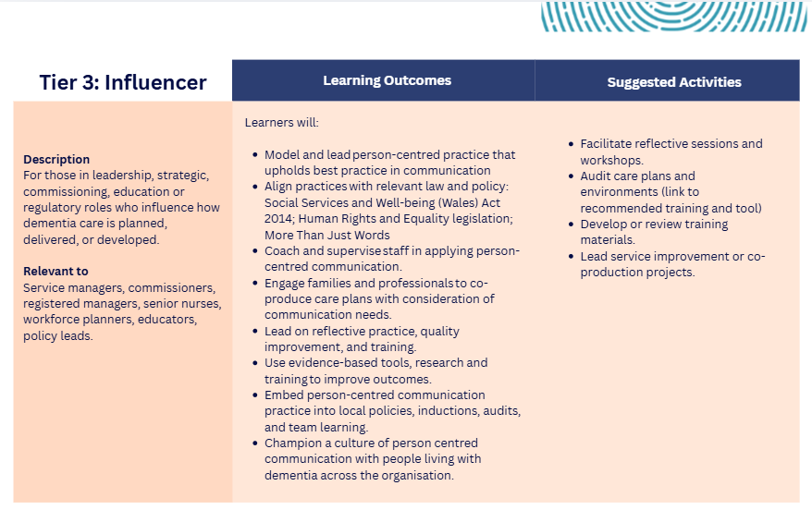
Framework / Guide (Theme 2)
Fframwaith / Canllaw (Pwnc 2)

Slide 15
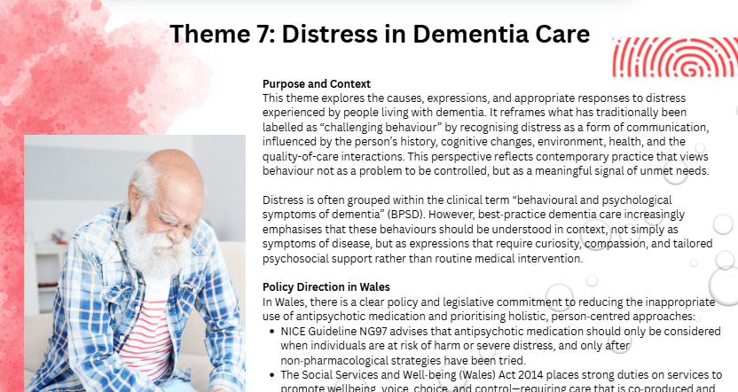
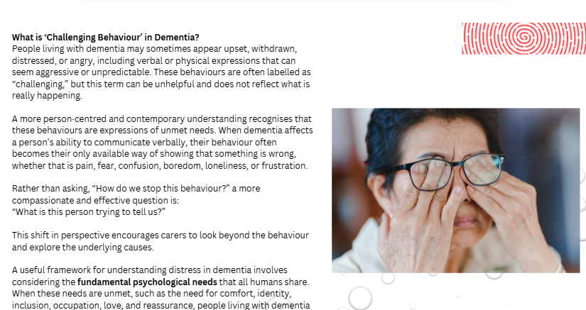
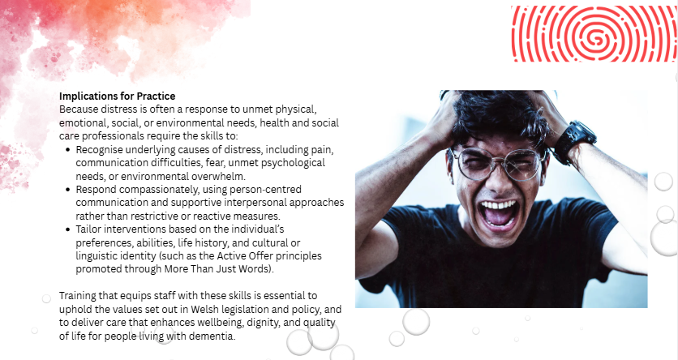
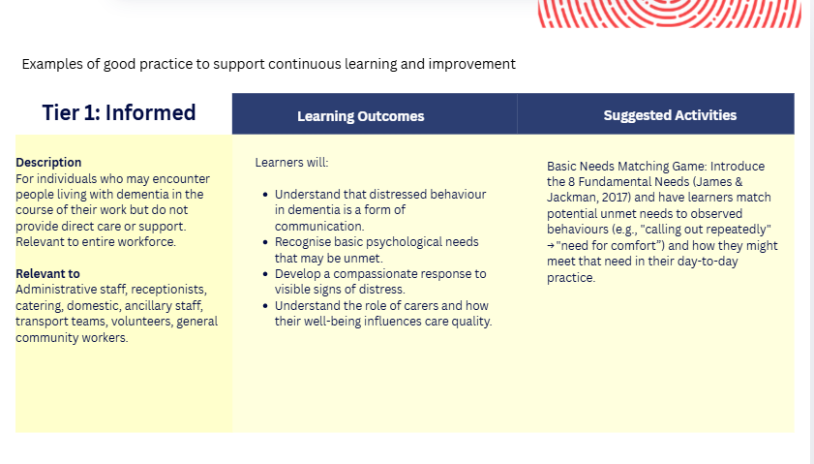
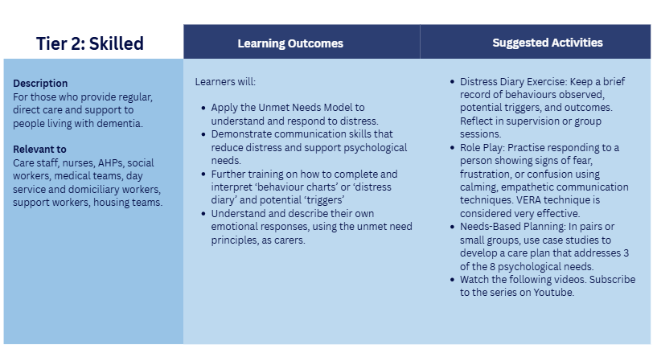
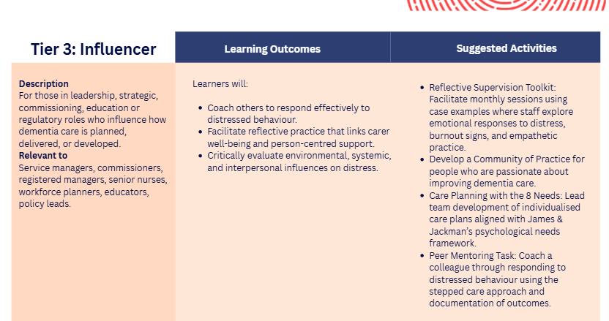
Framework / Guide (Theme 7)
Fframwaith / Canllaw (Pwnc 7)
Notes:
As we as the Task & Finish group have been working on this document.
It became clear that we needed a training pathway to accompany the framework.

Slide 16

Training Pathway
Llwybr Hyfforddi
Notes:
We did try our very best to develop a regional offer available to all in Health & Social Care, but that has not been possible, due to different systems unable to share resources.
So currently there are two separate offers we have been working on.

Slide 17
Health’s Training Pathway Llwybr Hyfforddi Iechyd
Too Many Courses on ESR
Duplication – Causing confusion
Staff were discouraged to source Dementia Training.
Gormod o gyrsiau ar ESR
Dyblygu – yn achosi dryswch
Roedd staff yn cael eu hatal rhag chwilio am hyfforddiant Dementia
Tier | Training
Tier 1 | 9 Modules (Bradford Modules)
Tier 2 | 10 Modules (Bradford Modules)
Tier 3 | 13 Modules (Bradford Modules) + Research and Evidence-Based Practice in Dementia; + Leadership + Transforming Dementia Care
Notes:
The Dementia Wellbeing Team have worked closely with the L&D team to develop a Dementia Learning Certification for Health Board staff.
Feedback from health staff was that there was too many modules to choose from, including duplication.
The DWT scrutinised all of the training and narrowed the Certificate down to training that have been written by multi-professional teams and in collaboration with experts by experience. The modules are consistent with current good practice.

Slide 18
Training Offer Cynnig Hyfforddiant
Foundation in Dementia
Wellbeing Training
Hyfforddiant Sylfaen mewn Llesiant Dementia
Theme 1 | Themâu
Introduction | Cyflwyniad
Person-Centred Care | Gofal Sy’n Canolbwyntio ar yr Unigolyn
Communication | Cyfathrebu
Life Story | Stori Bywyd
Activity and Occupation | Gweithgarwch a Galwedigaeth
Dementia Friendly Environments | Amgylcheddau sy’n Gyfeillgar i Ddementia
Nutrition and Hydration | Maeth a Hydradiad
Physical Health and Dementia | Iechyd Corfforol a Dementia
Human Behaviour | Ymddygiad Dynol
Notes:
Themes for Foundation in Dementia Wellbeing Training: Developed by the Dementia Well-being Team NHS. In line with Good Work Framework
These training modules will be available for Social Care, 3rd Sector and Independent provides on Thinqi via LAs.
Booklet 2 will be aimed at Tier 1
Foundation in Dementia Wellbeing Tier 2
Bespoke training from Beca’s team once foundation training has been completed and evidence that learning is implemented into practice.

Slide 19

Feedback from People Living with Dementia
Adborth gan Bobl sy’n Byw gyda Dementia
Feedback from our Citizen Engagement Group
Adborth gan ein Grŵp Ymgysylltu â Dinasyddion
Training is being translated into Welsh.
Mae’r hyfforddiant yn cael ei gyfieithu i’r Gymraeg.
Lauch the Framework/Guide across the region (Autumn 2026)
Lansio’r Fframwaith/Canllaw ar draws y rhanbarth (Hydref 2026)
Next Steps
Camau Nesaf

Slide 20
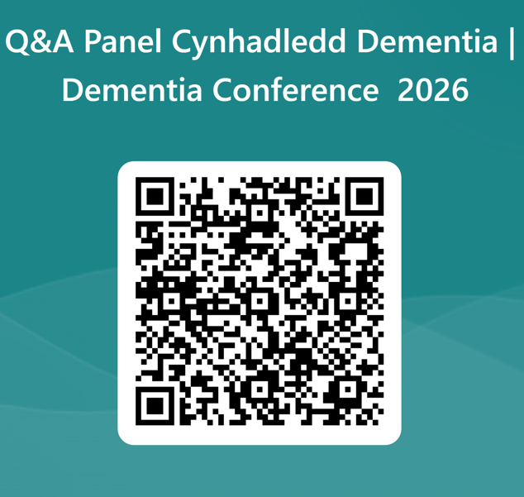
Thank you for listening!
Please submit any questions you have via the QR code.
Dolch am wrando!
Anfonwch unrhyw gwestiynau sydd gennych drwy’r cod QR.

