Slide 1
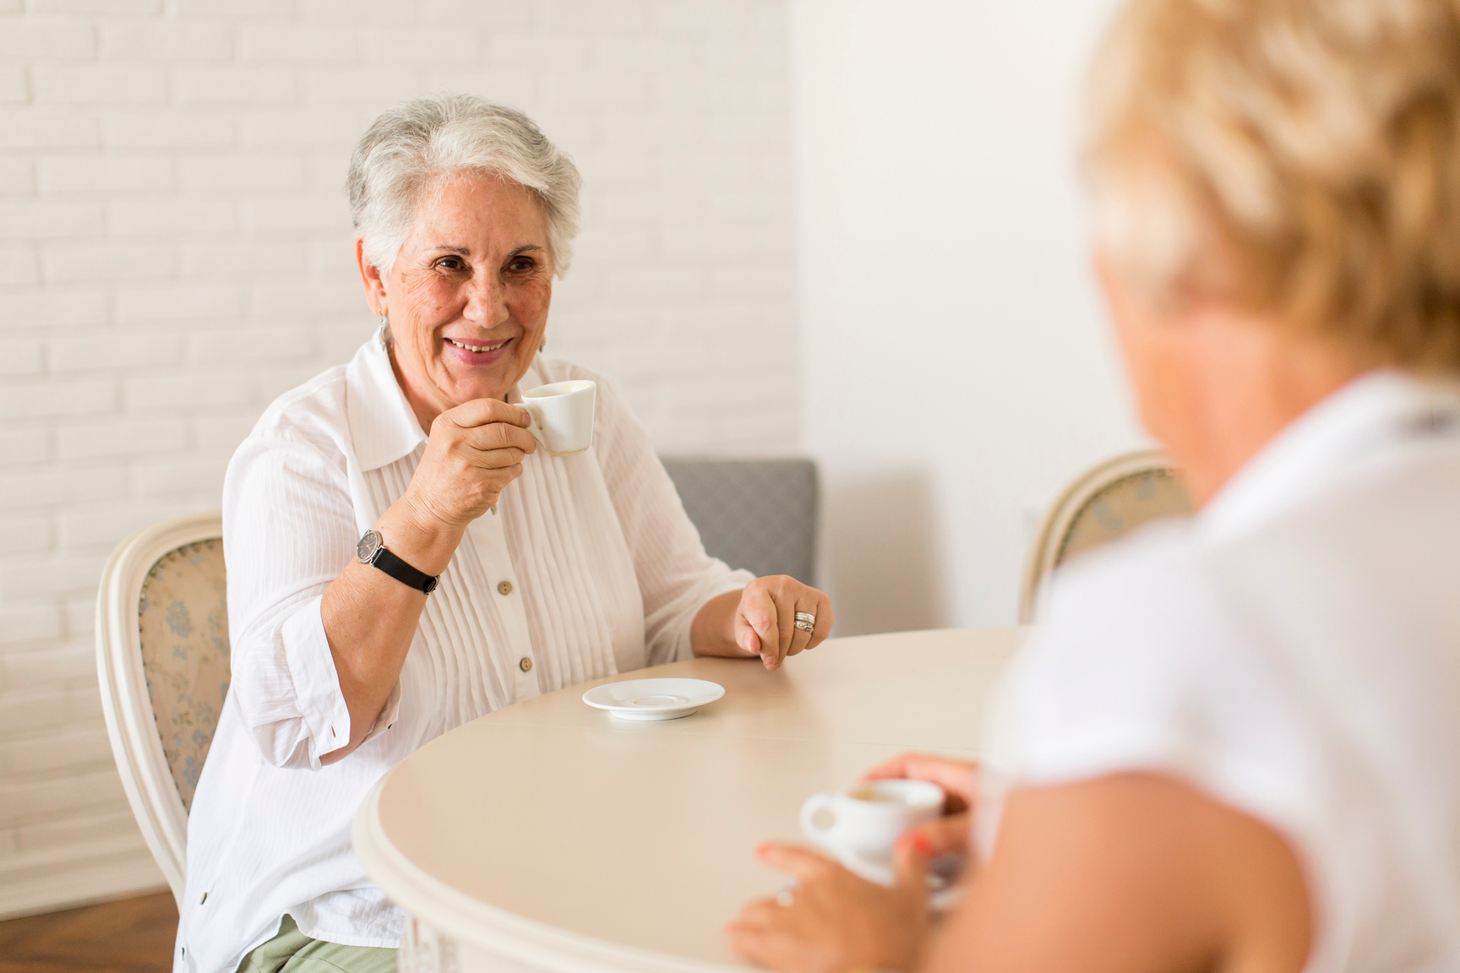
Thirst for Life
Every sip counts: Supporting hydration for People living with Dementia
Alexandra Rees
Clinical Lead Dietitian
Dementia Wellbeing Community Team
Notes:
Welcome to my presentation today- Thirst for Life. The importance of hydration.
My name is Lexi Rees, I am the Clinical Lead Dietitian for the Dementia Wellbeing Community Team. My presentation is going to talk about how small consistent changes can make a big difference to wellbeing through ensuring adequate hydration

Slide 2

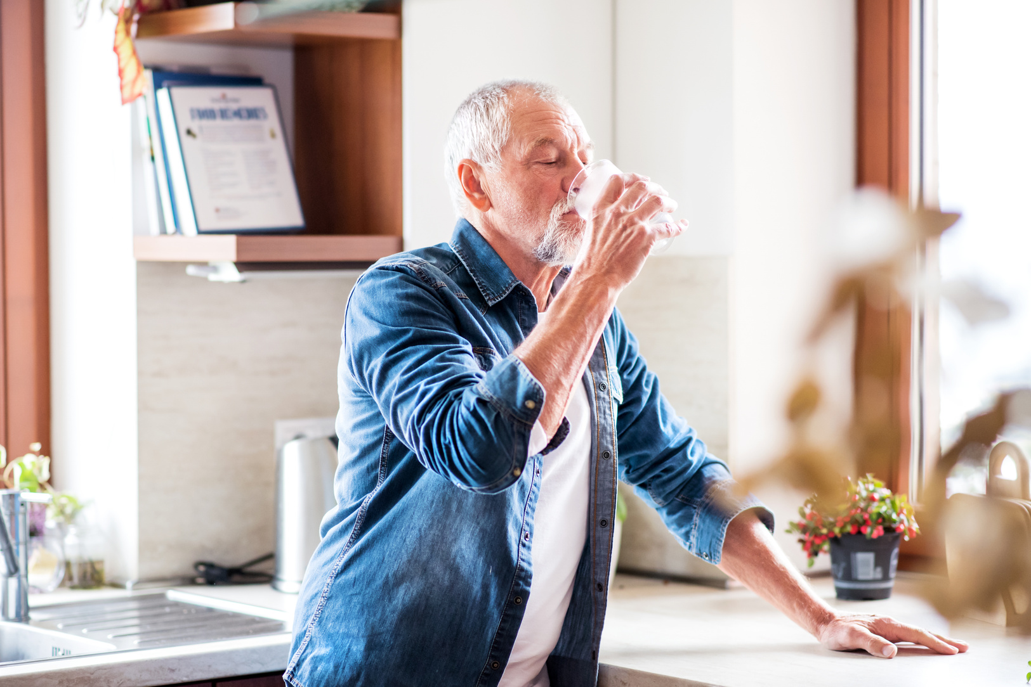
Why hydration
Brain function & mood
matters
Digestion & comfort
Our bodies are ~50-60% water
Temperature Control
Reduces risk of falls & confusion
Even mild dehydration can affect health
Prevents infections e.g. UTI’s
Notes:
How well hydrated someone is can directly affect how well someone can think & function.
Dehydration can increase the risk of someone becoming more confused.
Being well hydrated also helps with our digestion system as having enough to drink is as important as fibre intake to prevent constipation.
Making sure we drink enough is also important to help regulate our temperature and for our circulation. This helps us to maintain our blood pressure so prevents dizziness and an increased risk of falls.
If we are dehydrated we can experience dizziness and lightheadedness which could also increase risk of falls
If we are not regularly going to the toilet, we can increase the risk of infection.
Staying hydrated isn't just about thirst-it affects every part of the body including the brain

Slide 3

Mild dehydration can lead to:
  Increased confusion
  Agitation
  Falls
  Hospital admissions
But hydration is something we can influence every day
Notes:
It is not "being difficult or "non-compliance". It is the dementia that is affecting the person's ability to drink enough

Slide 4

Why it can be difficult
  Reduced awareness of thirst
  Forgetting to drink
  Difficulty recognising cups/drinks
  Physical challenges (grip/ swallowing)
  Changes in taste preference
Notes:
PLWD often don't feel thirst in the same way- or may not act on it
They might:
Forget what a drink is for
Not recognise the cup
Or stop mid task
This isn't refusal- it's the condition affecting how the brain processes information
Understanding this helps us respond with patience and flexibility

Slide 5


A positive approach
Drink more
Hydration works best when it becomes:
  Visible
  Accessible
  Pleasant
Make drinking easier & more enjoyable
Notes:
Instead of focusing on how much someone drinks, lets shift to: How easy are we making it for them to drink?
This is where carers can make the biggest impact

Slide 6

Creating opportunities to drink
  Offer drinks regularly (not just at mealtimes)
  Link drinks to routines
  Use prompts “shared choices”
Notes:
Rather than waiting for someone to ask, we can create regular opportunities
Offer drinks every 1-2 hours
Link drinks to daily routine e.g. after toileting, with medications, after activities
Give simple choices "would you rather tea or juice rather than what would you like
Consistency and gentle prompting make all the difference

Slide 7
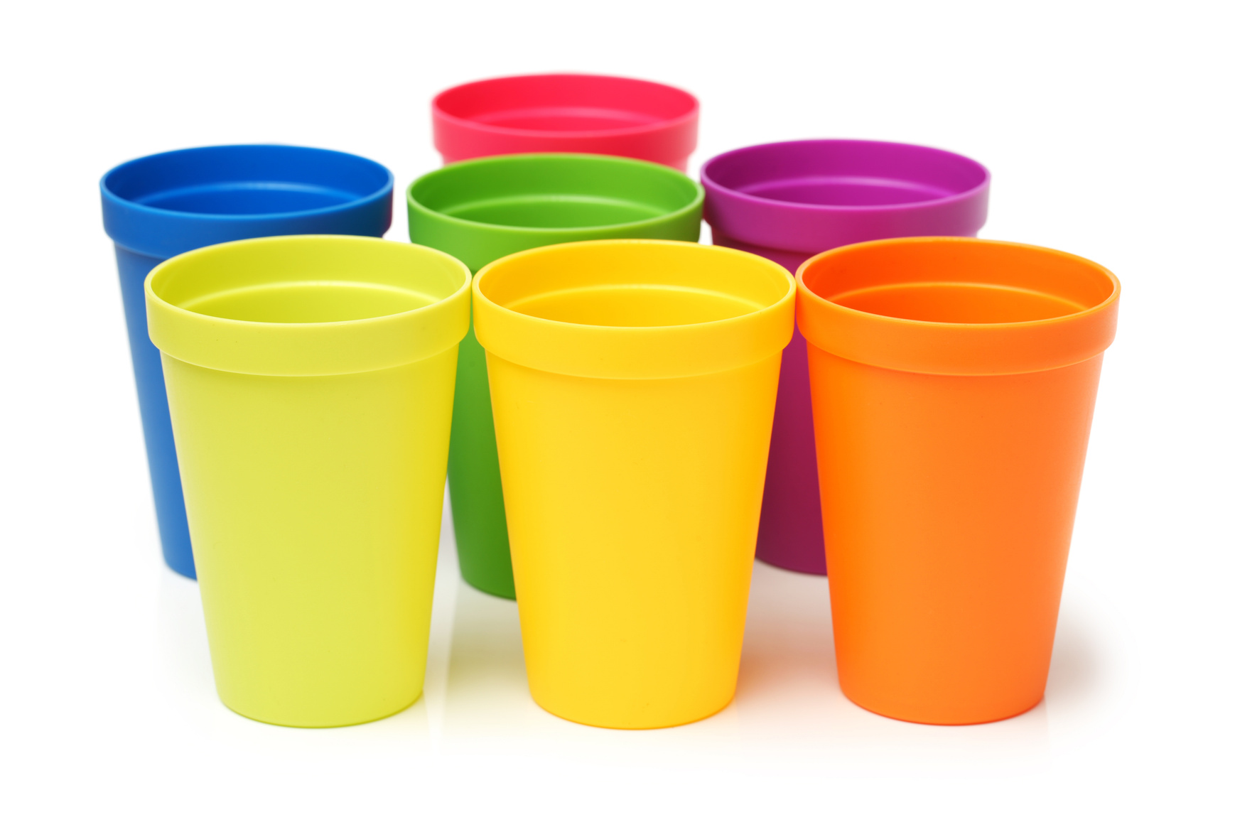
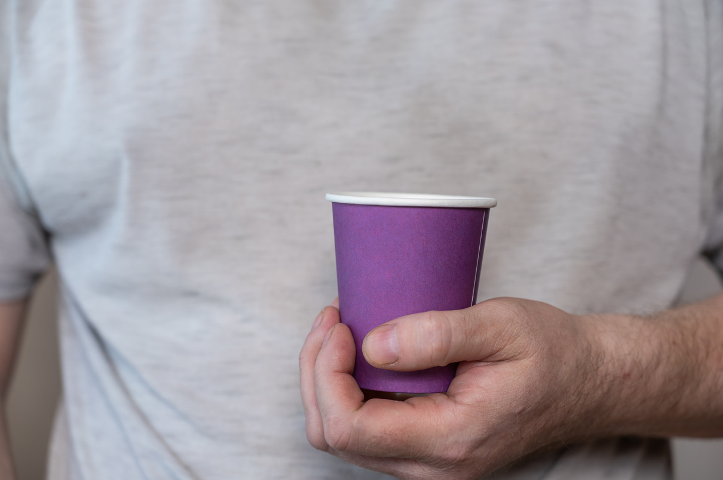
Make drinks easy to see
and reach
  Keep drinks within sight
  Use bright cups or contrast colours
  Avoid clutter
Notes:
Visibility is key
If someone can't see their drink, they're unlikely to use it
Try brightly coloured cups
Good contrast (e.g. red cups on a white table)
Keep drinks within arms reach
Simple environmental changes can reduce confusion and increase independence

Slide 8
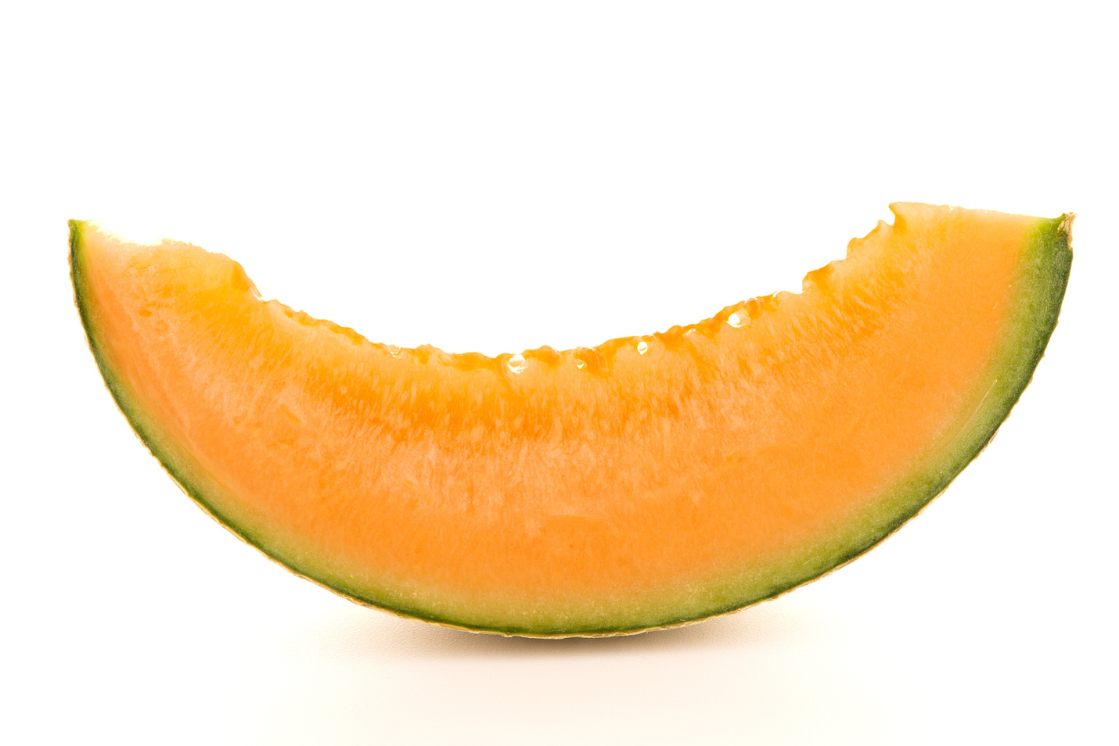
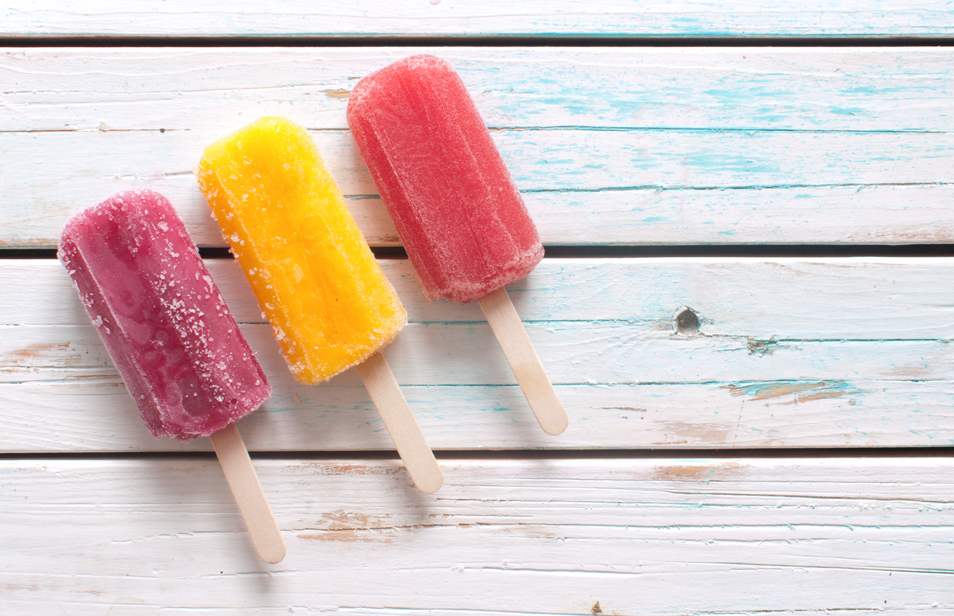
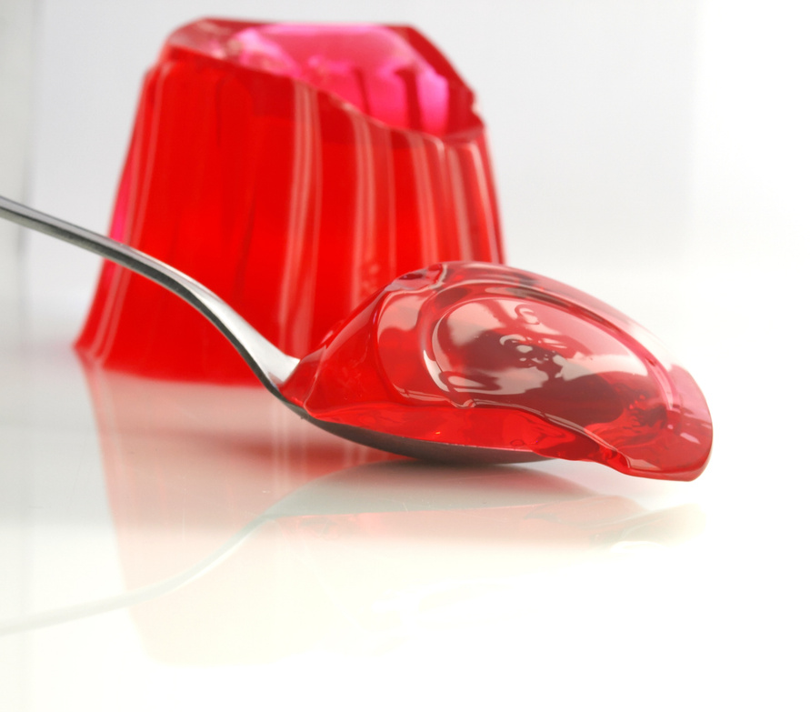
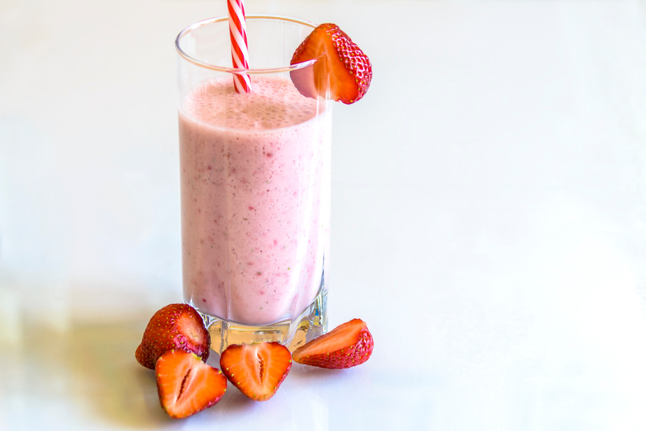
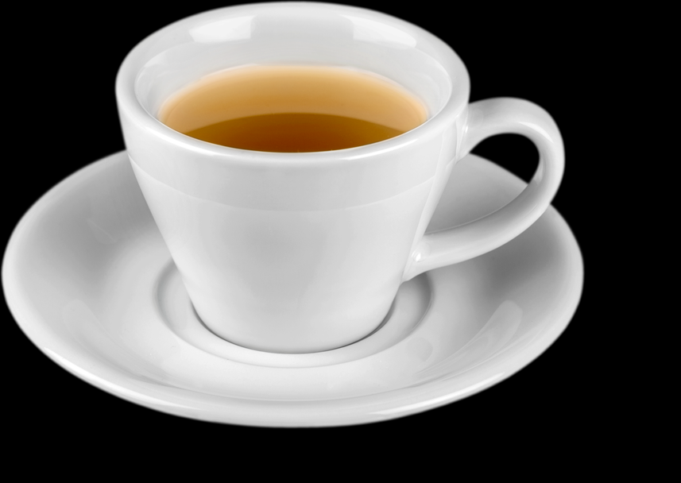
Think beyond water
  All fluids count:
  Tea, coffee
  Milk
  Smoothies/milkshakes
  Soups
  Jelly, ice lollies
  High water fruits (melon, orange)
Notes:
Hydration doesn't mean just water
In fact, offering a variety of options often works better. Some people may:
Prefer sweet drinks
Respond well to familiar favourites
and foods can help too- things like: jelly, ice cream, fruit
The goal is hydration not perfection

Slide 9
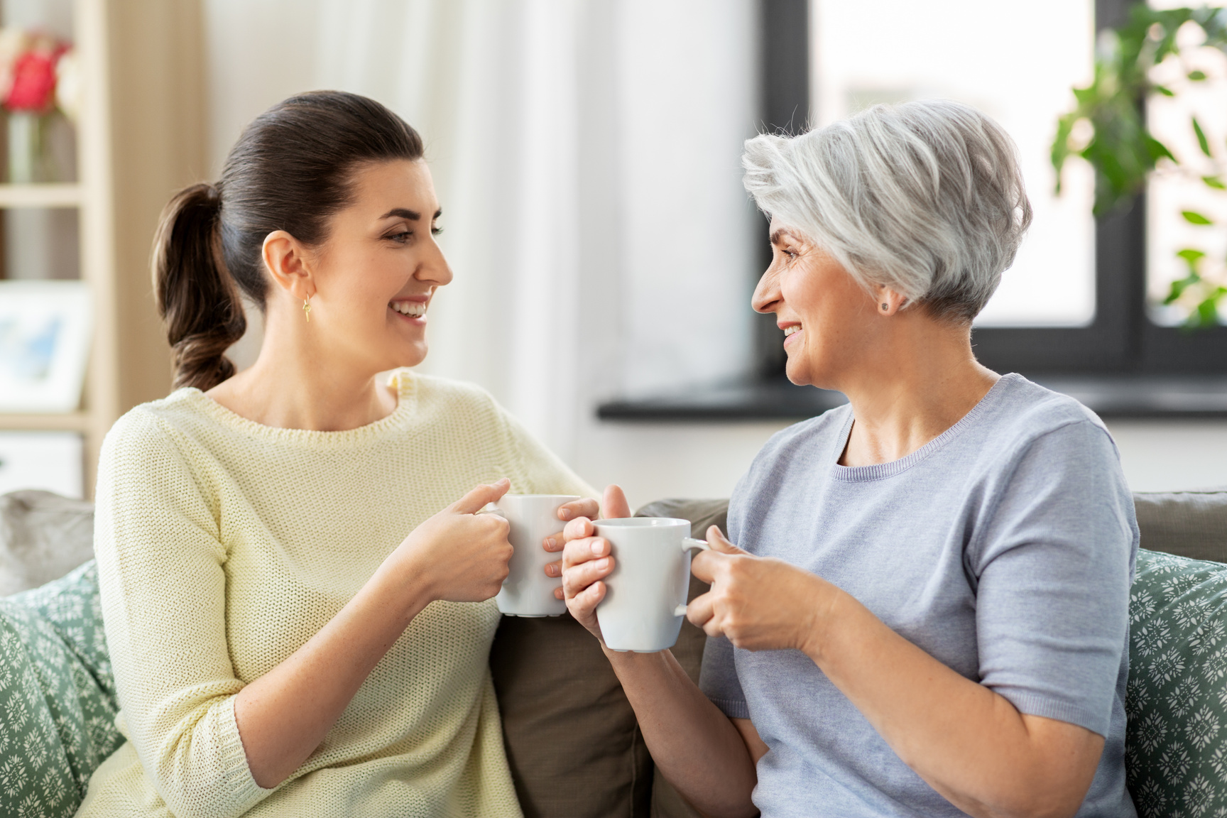
Making it enjoyable
  Offer favourite drinks
  Create social moments
  Sit and drink together
  Use meaningful routines
Notes:
Drinking should feel like a pleasant, social activity not a task Try:
Sitting together for a cuppa
Playing music or having a chat
Using favourite mugs or cups
Sometimes people drink more when we drink with them
That shared moment can be incredibly powerful

Slide 10
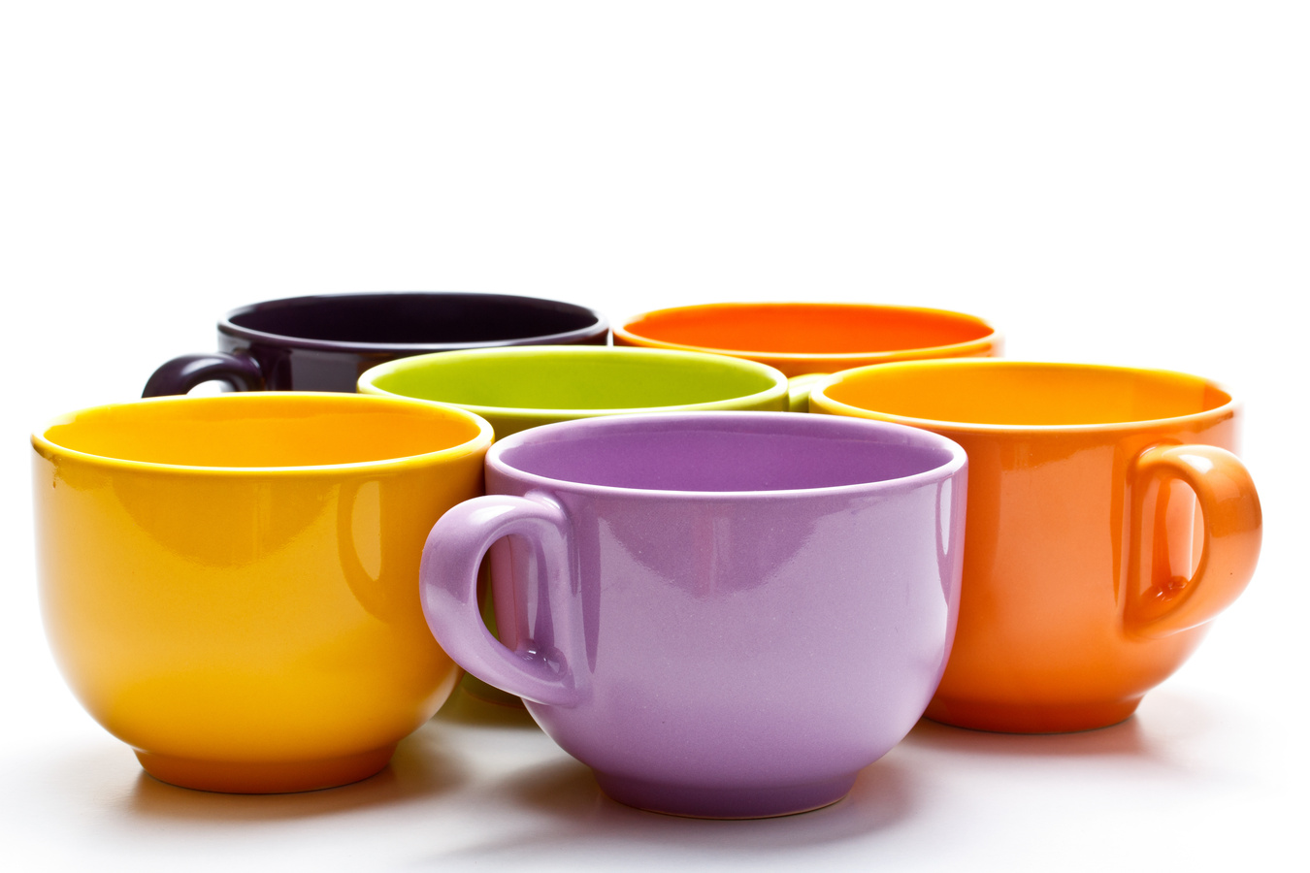
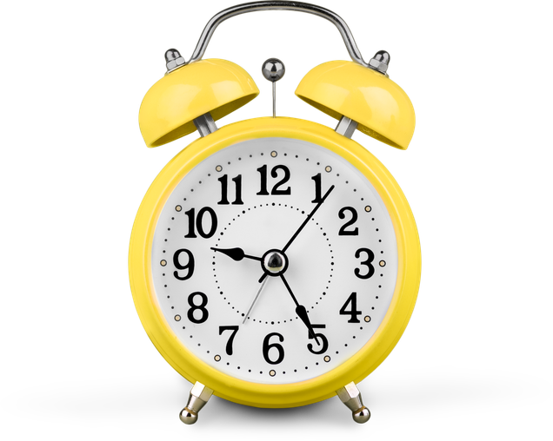
Supporting
Independence
  Use appropriate cups (lightweight, handles)
  Offer support without rushing
  Allow time
Notes:
Many people can still drink independently with the right support
Consider:
Lighter cups
Cups with handles or lids
Not overfilling
And most importantly: give time. What might feel slow to us is often exactly the pace that is needed to help maintain independence with drinking

Slide 11

Signs of dehydration
Dark urine
Dry mouth
Increased confusion
Drowsiness
Constipation
Notes:
Spotting early signs can prevent bigger problems. If someone suddenly seems "different", think about whether they could be dehydrated
Early action- for example offering drinks more regularly and can often help

Slide 12
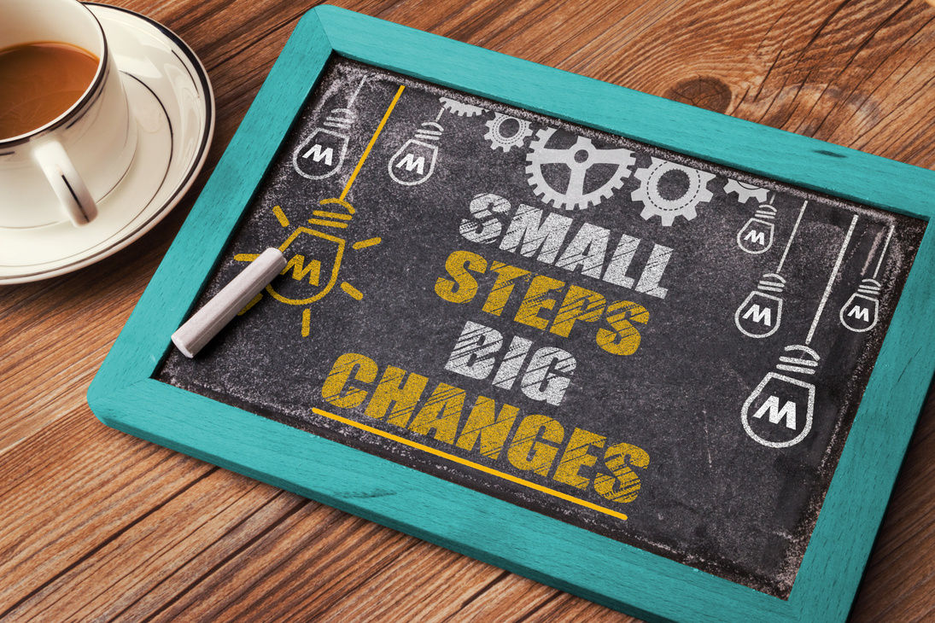
Small changes, big impact
Every sip counts
Personalised care matters most
No “perfect” approach
Notes:
There's no one size fits all
But small changes like using a brighter cup, offering a favourite drink or a friendly prompt can make a real difference
Supporting hydration isn't about getting it perfect, it's about making it possible and meaningful and trying different things

Slide 13
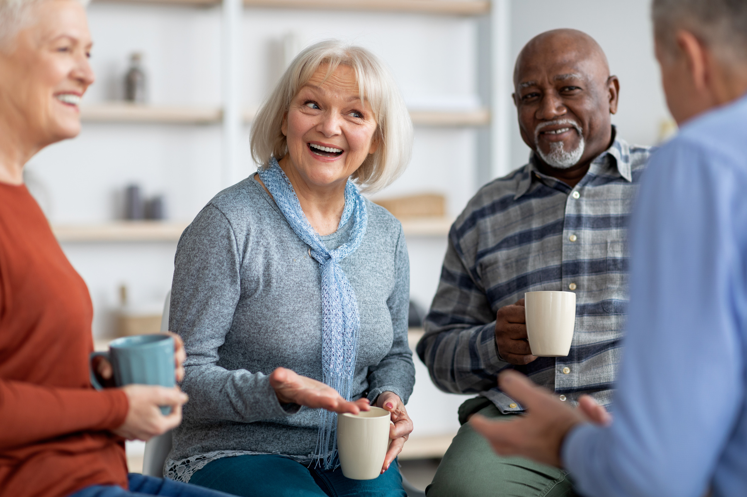
Key messages:
  Make drinks visible & accessible
  Offer regularly & gently prompt
  Think creatively- food counts too
  Make it enjoyable & sociable
Notes:
Keep drinks visible and within easy reach
Offer regularly-don't wait for thirst
Use variety and creativity
And most importantly-make it enjoyable

Slide 14
Thank you for listening- any questions?
Notes:
There's no one size fits all
But small changes like using a brighter cup, offering a favourite drink or a friendly prompt can make a real difference
Supporting hydration isn't about getting it perfect, it's about making it possible and meaningful and trying different things

