Slide 1

Herbert Protocol
Jess Thomas

Slide 2





Operation:
Herbert Protocol
When a person living with dementia is reported missing, having an up-to-date, easily accessible Herbert Protocol could be vital in finding them quickly.
Powered by MedicAlert

Slide 3



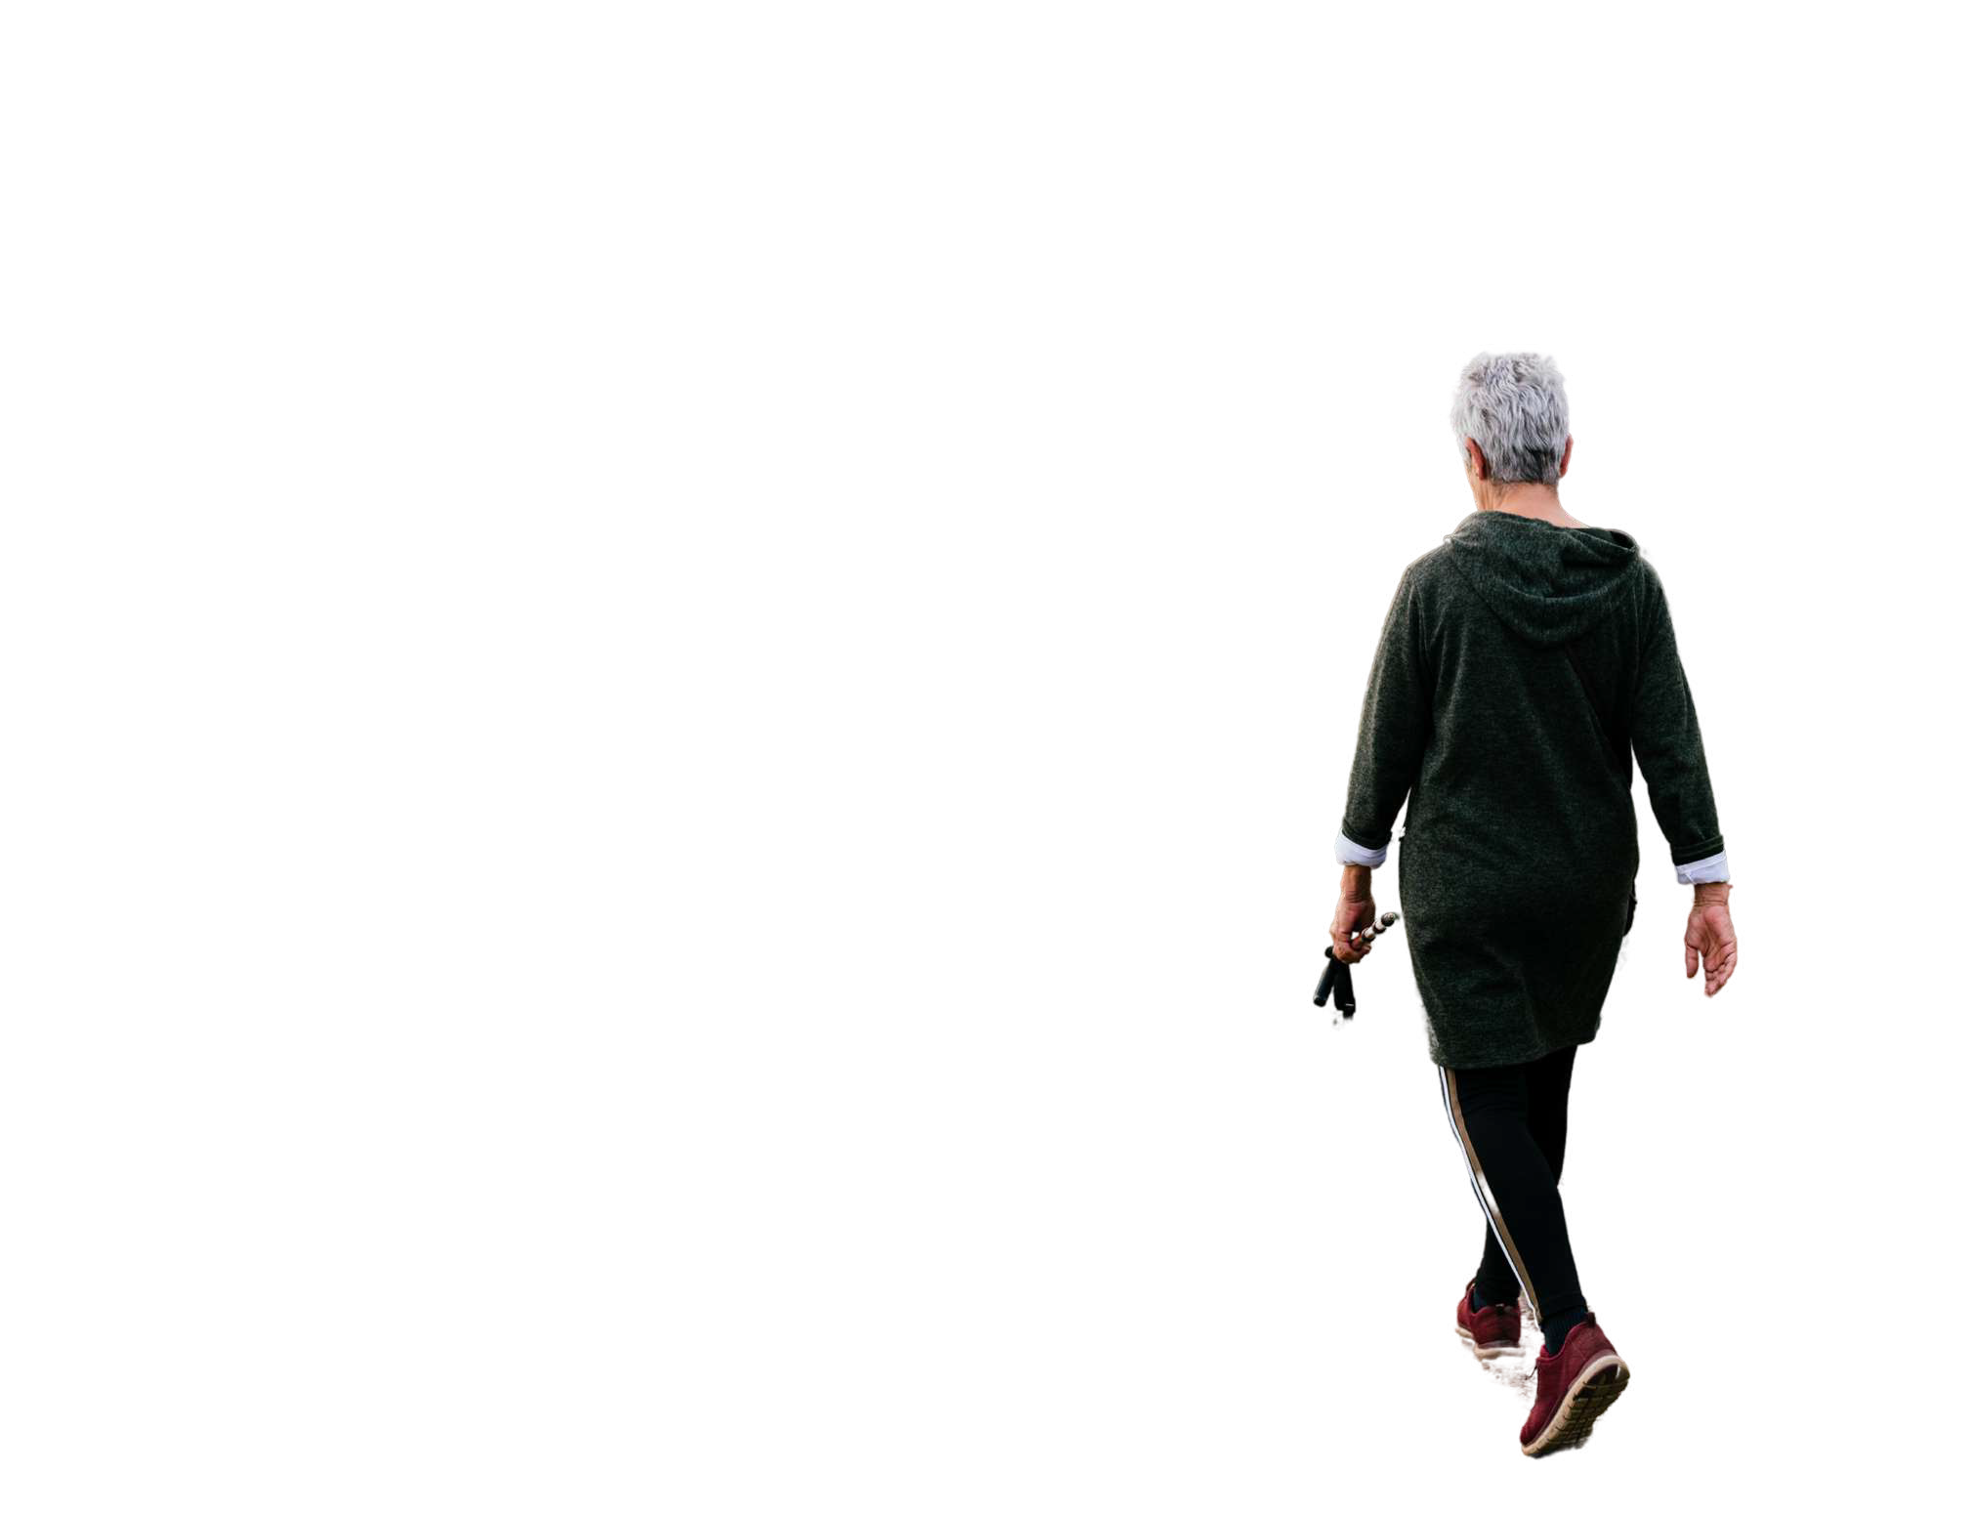


Powered by MedicAlert

Slide 4
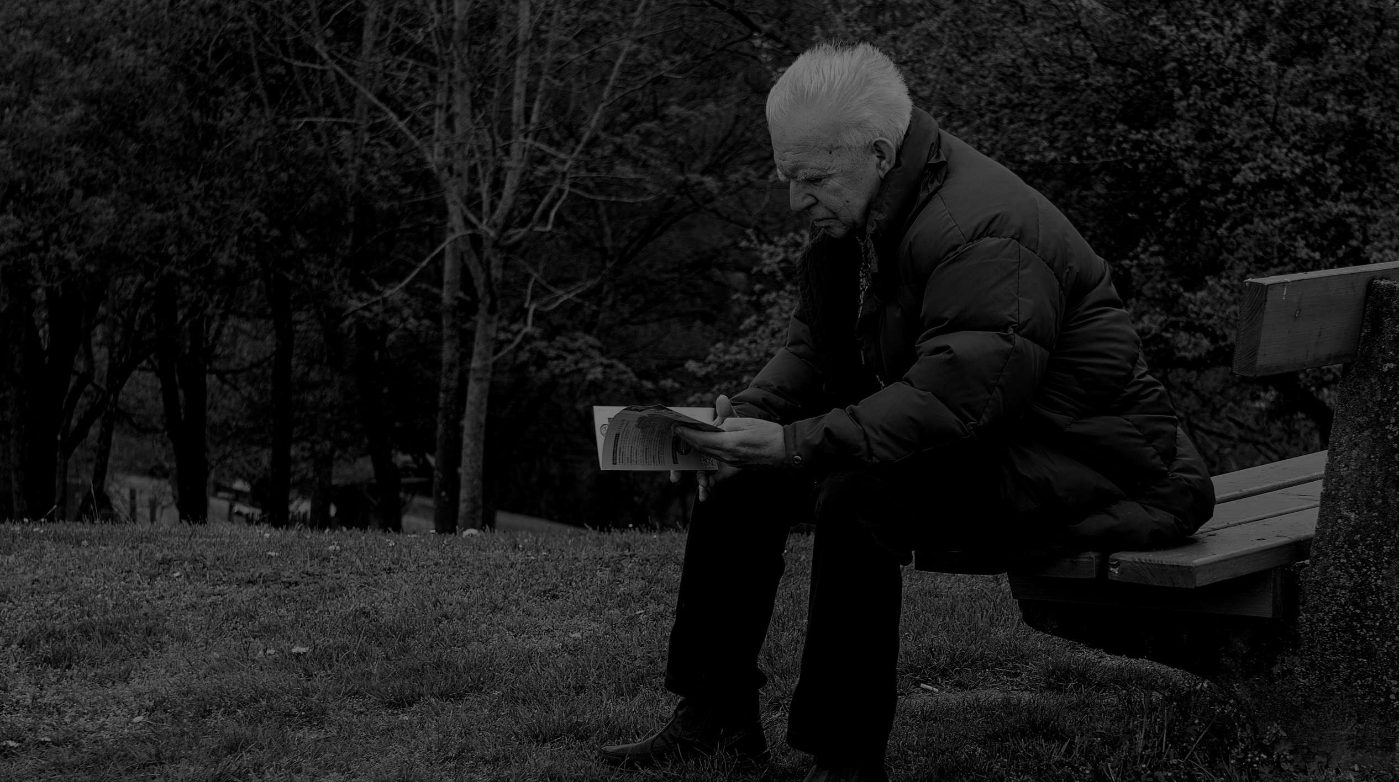


944,000+
Just under 1 million people living with dementia in the United Kingdom
70%
people living with dementia will go missing at least once
40,000+
people in the UK are reported missing for the first time every year
Powered by MedicAlert

Slide 5



How It Works
The Challenge
People living with dementia can sometimes start to walk with purpose. This may lead to them getting lost or going missing. The priority is to find them and get them home as soon as possible.
The situation may be a lot worse if they live with other medical conditions and need regular medication or treatments to safeguard their health.
The Solution
Storing a digital copy of Herbert Protocol and making it easily accessible and available, following a call to our 24/7 Emergency Helpline.
If someone is found and wearing an ID, we can confirm who they are, where they live, their emergency contact’s details and any immediate medical requirements they may have, based on underlying conditions.

Slide 6

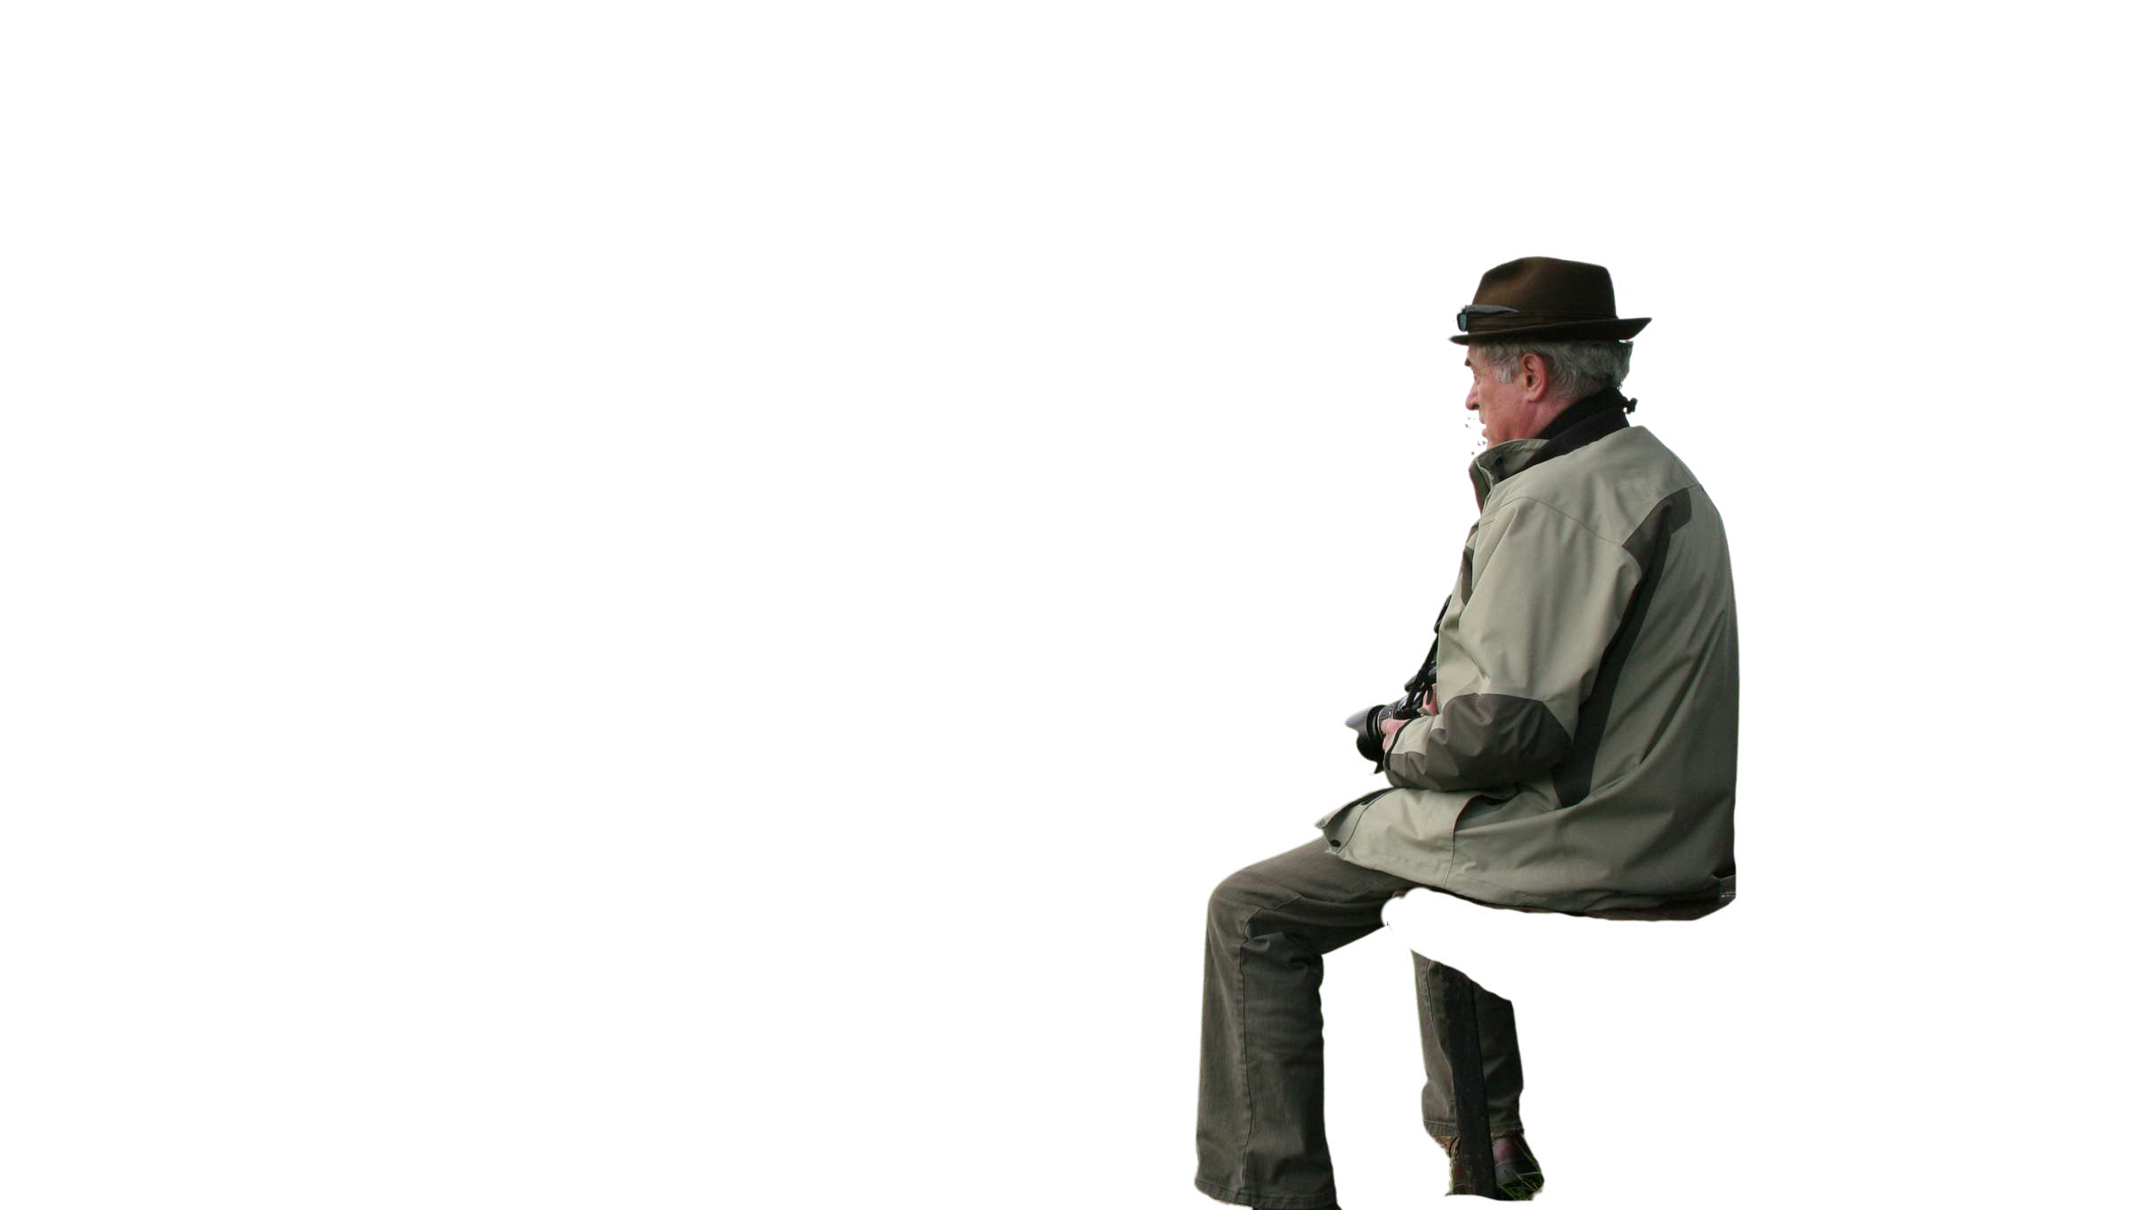

Operation:
Herbert Protocol
When a missing person is reported that fits the possible person living with dementia category:
Police call MedicAlert’s 24/7 emergency helpline on 0207 407 2818 with the name and post code provided by the individual’s carer or loved one.
If we hold a Herbert Protocol, this can be sent immediately to a verified email address.
Powered by MedicAlert

Slide 7


Powered by MedicAlert
www.medicalert.org.uk
www.herbertprotocol.com

Slide 8
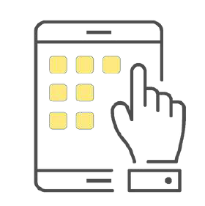



Digital Medical Record
The Digital Medical Record can be updated by the member as regularly as is needed. This will be shared with emergency services when needed.
Live better with
MedicAlert
The safety and wellbeing of vulnerable people is a priority at MedicAlert.
Charity
We are the only charity provider of medical ID services in the UK. This means we do what is right, putting safety first.
NHS Recommend
MedicAlert is recommended by multiple areas of the NHS. First responders are also trained to recognise the MedicAlert symbol.
Advocacy
Parents, guardians or caregiver can assist in creating and updating the child’s medical record and serve as an advocate on the account.

Slide 9







Our Journey
Missing Person Co-ordinator
National Problem-Solving Awards
Dyfed-Powys Police Data
Relaunch of Herbert Protocol
Internal & External Communications
Promotional Events
DP Connects

Slide 10
Data-2025
Data set- January 2025
Total of 813 missing adults
40 of whom were linked to Dementia/Alzheimer’s
We expect these figures to increase

Slide 11
Data-2026 (01.01.26-28.06.26)
Total of 493 missing adults
6 of whom were linked to Dementia/Alzheimer’s
We expect these figures to increase

Slide 12
Data-Herbert Protocol
Dyfed-Powys Police (107)
South Wales Police (61)
North Wales Police (59)
Gwent Police (37

Slide 13
Collaborative Working
All Wales police dementia group
Welsh forces to join MedicAlert
Data collection for Wales
Share best practice
North Wales police educational video

Slide 14
Gaps
Carers & key stakeholders not aware of the protocol/changes
Registration to HP is set aside until a missing episode occurs
No data capture for safety/welfare reports
Follow up calls
Role and capacity of Missing Person Co-Ordinator
Internal processes and systems

Slide 15
Future Opportunities
Promotional Opportunities & Social Media Campaigns
Improved Data Sets
Training for our Staff/Officers
Funding Opportunities
Collaborative Working
Opportunities to raise awareness at the point of diagnosis

Slide 16


Q & A Panel

