Slide 1
Tîm Cyfalaf / Capital Team
Diweddariad PMO Cyfalaf Rhanbarthol
Llety i Blant
Regional Capital PMO Update
Childrens Accommodation
Andrew Hopkins
Rheolwr Rhaglen Gyfalaf
Capital Programme Manager
Dydd Mercher 11 Rhagfyr 2024 Wednesday 11th December 2024

Slide 2


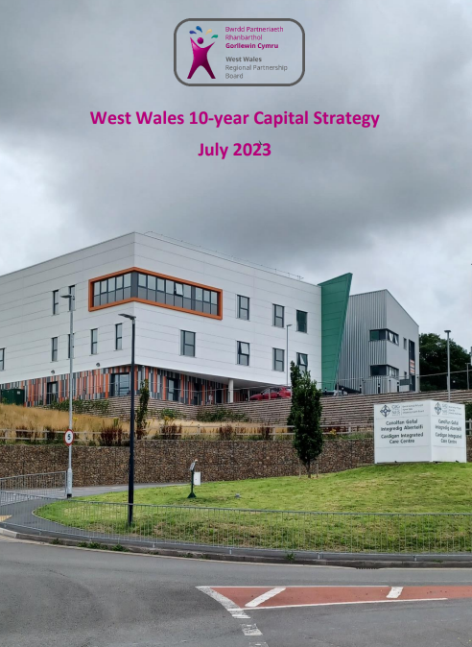
Cyd-destun Strategol/ Strategic Context
Programme for Government
Policy Commitments
Market Stability Report
(supply)
Population Needs Assessment
(demand)
Regional Integration Fund
Housing with Care Fund
(2022-2026*)
Integration & Rebalancing Capital Fund (2022 -2027)
Area Plan 2023-2028
response
Programme Delivery Plan
Obj 1: Housing with Care
Obj 2: Intermediate Care and Accommodation
Obj 3: Minor projects
* Funding allocation for 25/26 yet to be formally confirmed
Community Hubs
Rebalancing Care & support
Eliminate Profit from Children’s Care (Priority 3)

Slide 3
Argymhellion MSR/ MSR Recommendations
Re-provision services into other models of care when faced with potential loss of placements
Reprovision care homes into specialist housing
Market intervention
Ensuring continuity of care
In-house capacity and capability
Eliminate profit from childrens residential care
Re-provision
Reconfigure
Rebalance
Different models for care and support
“Hub & Spoke” residential and community services
Independence with options of community support
Flexibility in staffing models, recruitment & retention
IRCF “Health and Social Care Hubs”

Slide 4
Strwythur Tîm / Team Structure
Director of Communities (CCC)
Co-Chair of Strategic Capital (Programme) Board
Exec. Director of Strategy & Planning (HDUHB)
Co-Chair of Strategic Capital (Programme) Board
Regional Partnerships Programme Manager
Head of Capital Planning (HDUHB)
Chair of HCF/IRCF Operational Capital Group
Capital Programme Manager (1.0 WTE)
The team will also report professionally to the programme SRO’s / Chairs of the Strategic Capital Board as well as the Head of Capital Planning at HDUHB who Chairs the Operational Capital Group.
Both forums are core components of the capital programme governance structure
Capital Project Leads
(2.8 WTE)

Slide 5
Agenda Dileu/Eliminate Agenda
Llywodraeth Cymru yn Dileu Ymateb
Welsh Government Eliminate Response (Capital)
September 2024 - RPB collated a response to Welsh Government/Albert Hearney (Chief Social Care Officer Wales) to demonstrate how the West Wales region proposes to maximise the opportunities/take advantage of capital funding available to support eliminate profit from care of children e.g., HCF Objective 2, IRCF Priority 3.
Broadly response compiled covered the following:
Refreshing of 10 Year Strategic Capital Plan
Pipeline of projects
Appetite of Social Enterprises in delivering registered social care (Cwmpas/PCC)
Programme issues/areas of clarity
Revenue Funding Risks
Importance of Revenue and intrinsic link with capital projects
Further Assurance

Slide 6
Gronfa Tai â Gofal/ Housing with Care Fund
Cronfa Tai â Gofal (CTG)
Housing with Care Fund (HCF)
Aim - ‘to increase the stock of housing to meet the needs of people with care and support needs’
  - Objective 2 – Intermediate Care & Accommodation
Application Process
  Schemes are subject to a 2 or 3 stage application process
  In Principle – Project description, principles, and estimated costs
  Acquisition Application – Property valuation, evidence of title
  Construction application – Construction contract awarded, planning consent in places
  Technical Scrutiny on projects over £750k
  Business Case requirement for high value schemes over £2million
Regional Governance and Sign Offs
  Capital Investment Plan
  Operational Capital Group
  Strategic Capital Board
  WG Application

Slide 7
Prosiectau Cyfredol / Current Projects
Llety preswyl i blant wedi'i ddarparu drwy HCF
Residential Children's Accommodation Delivered via HCF
Scheme | Locality | Lead Body | Funding | Units | Status
Hafan | Carmarthenshire | Carmarthenshire County Council | HCF | 4 | Opened
West Lodge | Pembrokeshire | Pembrokeshire County Council | HCF | 4 | Opened
Sycharth | Ceredigion | Ceredigion County Council | HCF | 3 | Construction Completed - Awaiting Registration
Through Age Bungalow | Ceredigion | Ceredigion County Council | HCF | 2 | Construction Completed - Awaiting Registration
Ty’n Y Fron | Ceredigion | Ceredigion County Council | HCF | 2 | Construction Set to complete Q4 2024/25
Ty Hydref | Pembrokeshire | Action for Children | HCF | 4 | Construction Completed - Awaiting Registration
The total investment has been in the region of £ 4.7 million

Slide 8
Gronfa Gyfalaf Integreiddio ac Ailgydbwyso (CGIA)
Integration & Rebalancing Capital Fund (IRCF)
CGIA/IRCF
Priority 3 – Targeting eliminating profit from the provision of children’s residential care
The fund can provide incentives to support a change of business model in children’s residential care towards a not-for-profit model. e.g. support for local authorities to bring existing for-profit provision of children’s residential care under local government management,
Application Process - Initial Application, BJC <£5 Million, SOC/OBC/FBC >£5million
    Any IRCF scheme must undertaken Capital PMO prioritisation process in first instance
    Property acquisitions undertaken at market value with evidence of an independent valuation.
    Confirmation of any initial building surveys undertaken to establish a benchmark for necessary works and potential indicative refurbishment costs. If none have been completed this should be stated with an assessment of the risk of proceeding with acquisition without this information.
    Highlight any foreseen delivery risks.
    If available, outline of proposed staffing and service provision plan, as a minimum, confirmation that revenue funding is available to support the running costs of the facility should be provided
Regional Governance and Sign Offs (Same Process as HCF)
Scrutiny & Panel Timeframes
    Monthly IRCF WG Panels, Up to 120 days from submission of application to panel date

Slide 9
Gwersi a ddysgwyd/ Lessons Learnt
Gwersi a ddysgwyd
Lessons Learnt
    Early engagement with RPB vital to ensure intentions of grant applicant are known, various approvals and stages are undertaken for compliance and that sufficient time and resource is allocated to programme in projected target panel dates
    Drivers for any project must be clear; any proposals need to be driven by a service strategy
    Where joint applications (IRCF/HCF) are received, the IRCF scrutiny process will be followed
    No set intervention rate for HCF Objective 2 or IRCF Priority 3

Slide 10
Cynlluniau yn y dyfodol/ Future Plans
Edrych Ymlaen
Looking Forward
Eliminate Agenda is a key regional priority for West Wales and will continue to be for the next 12 months, over 60% of our spend for 2023/24 was against childrens accommodation.
Indicative figure of £8million HCF monies available 25/26 to contribute to the development of childrens accommodation across West Wales.
RPB is led to believe there is limited IRCF funding available nationally, therefore ensure prompt engagement with the PMO team.
Welsh Government are seeking confirmation of the next round of seeking investment during thenext financial year.

Slide 11
Any Questions/
Unrhyw gwestiynau
Unrhyw gwestinynau?
Ebost – WWCapitalPMO@sirgar.gov.uk
Any Questions?
Email – WWCapitalPMO@carmarthenshire.gov.uk

